Slide 1
This collection has been developed to improve the graphic style
of Allergy. Please do not use it for publications in other books or journals that are not owned by EAACI.

Slide 2
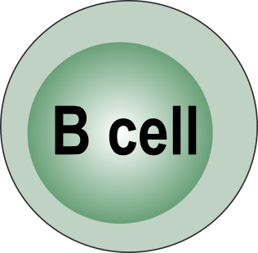

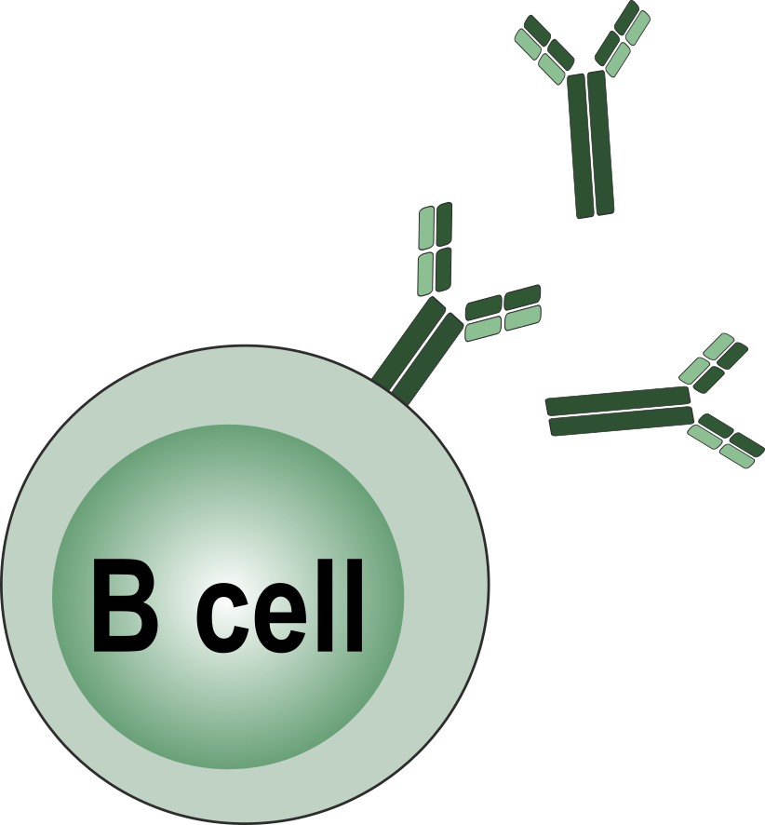
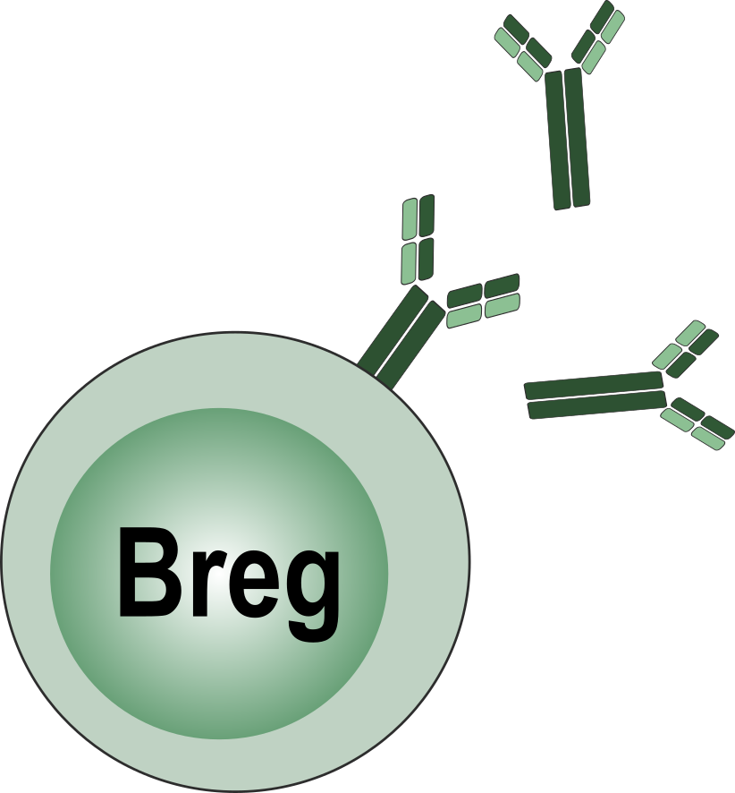

B cell regulatory B cell effector B cell

Slide 3
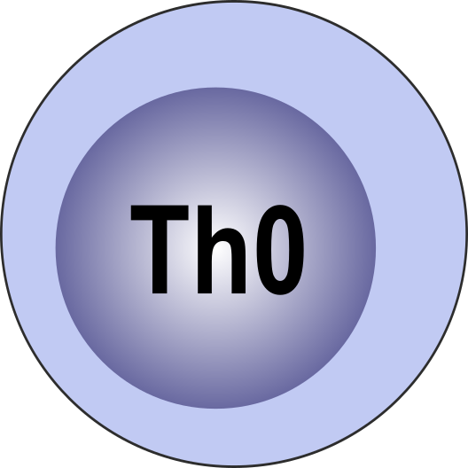

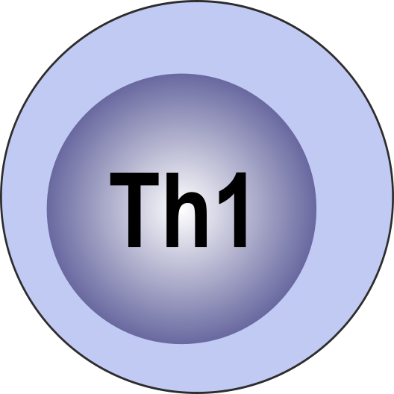
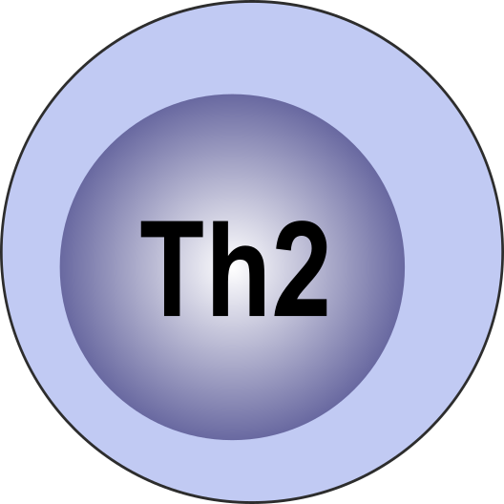
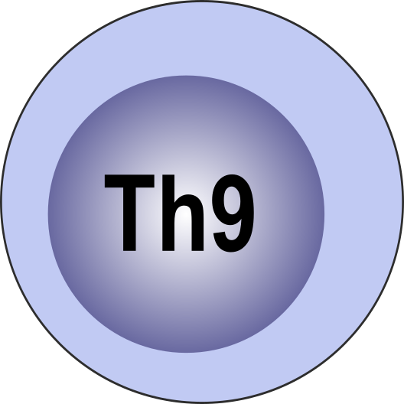

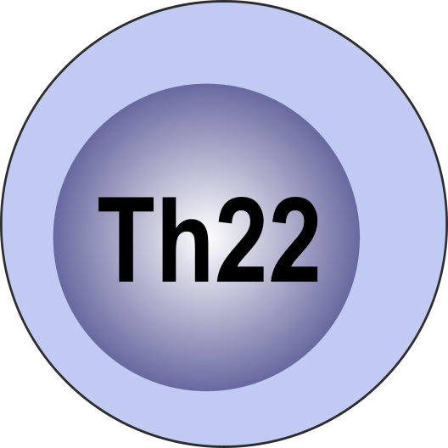
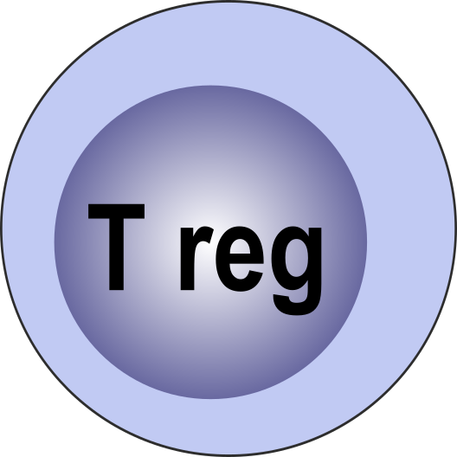
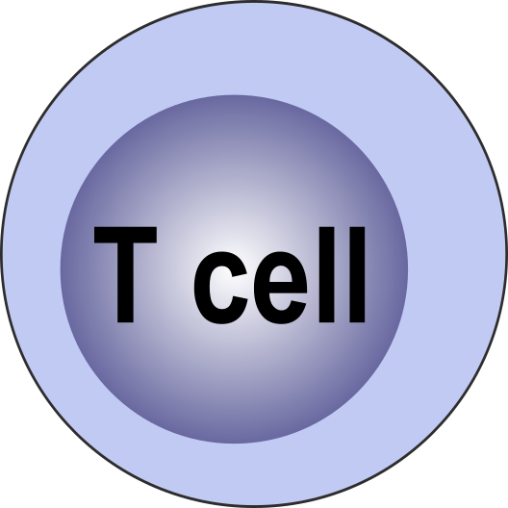
T cells

Slide 4


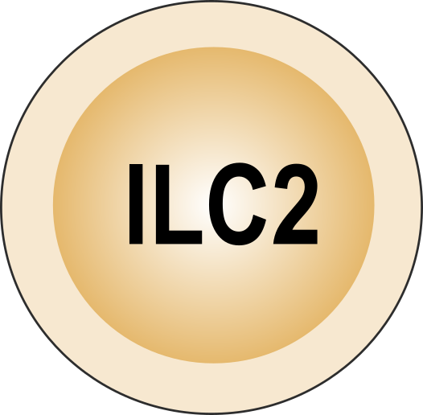
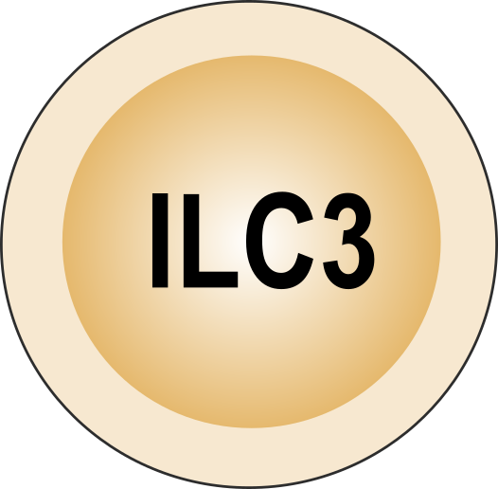

group 1 ILC group 2 ILC group 3 ILC natural killer cell

Slide 5




eosinophil neutrophil basophils

Slide 6



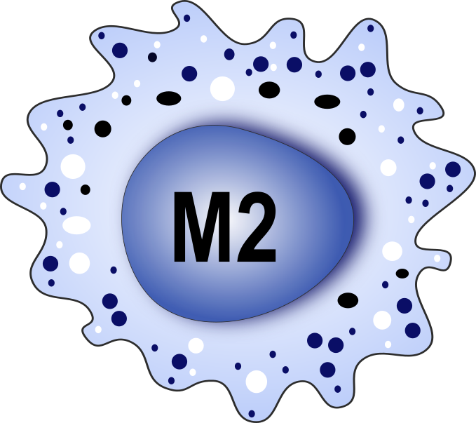
monocyte macrophage classically-activated (M1) alternatively-activated (M2)

Slide 7
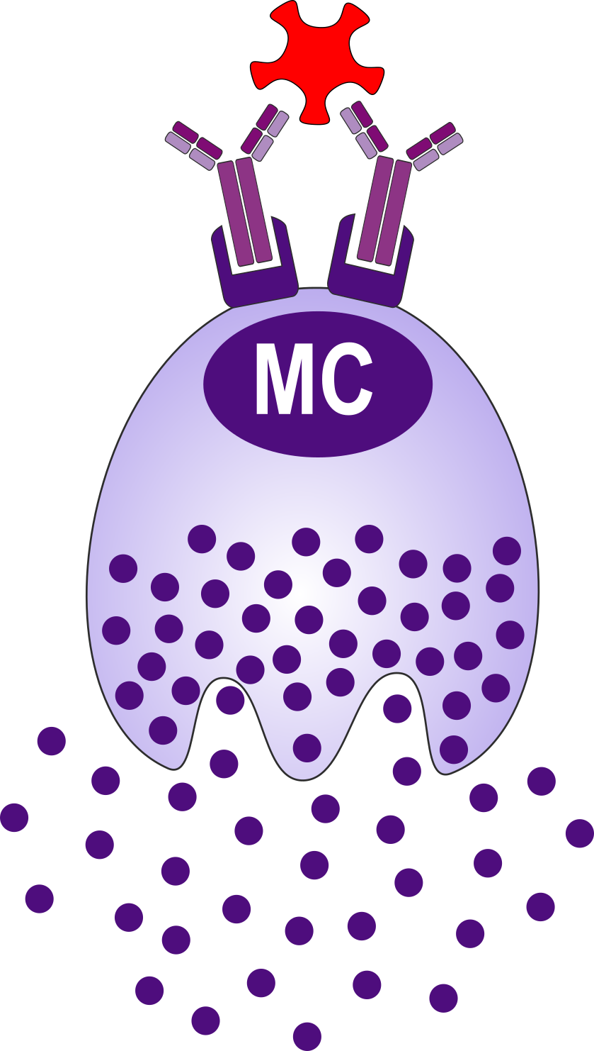


mast cells

Slide 8
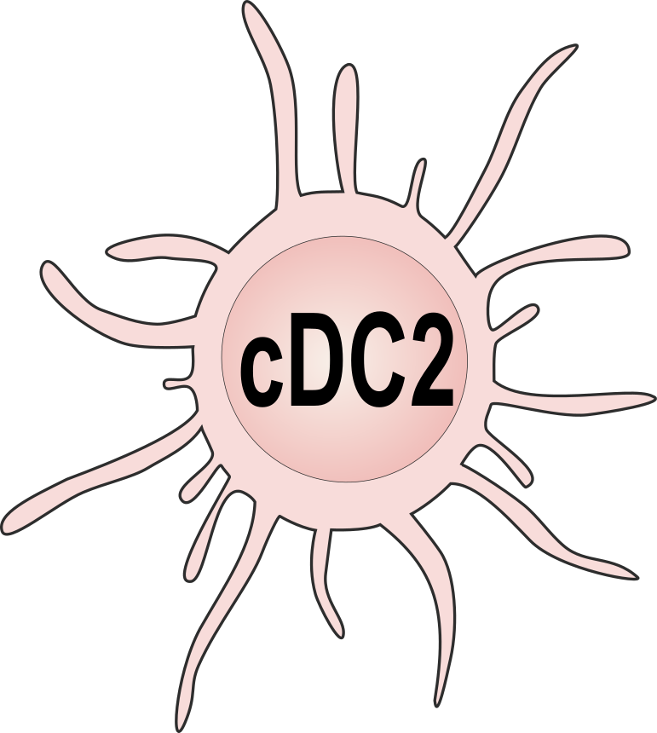


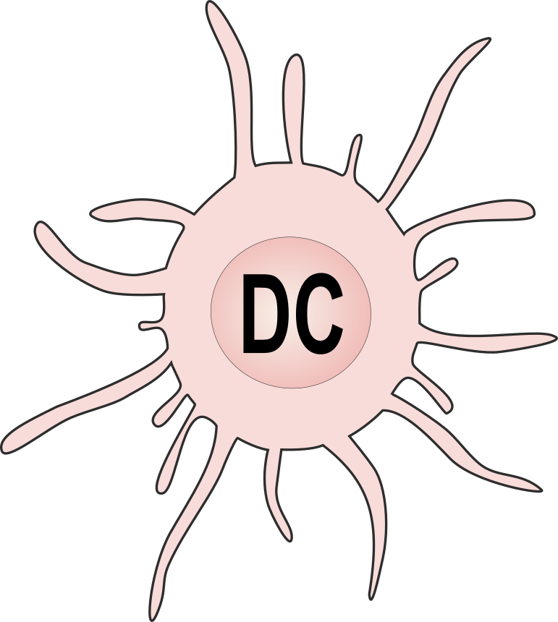

dendritic cell conventional DC1/DC2 plasmacytoid DC Langerhans cell

Slide 9
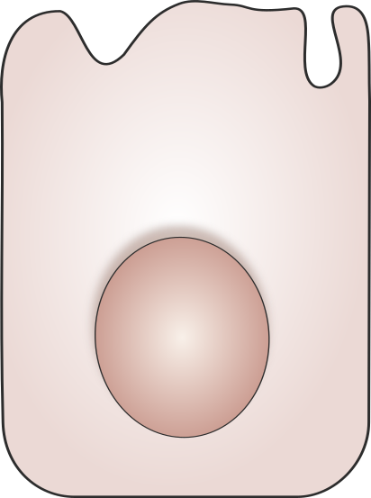
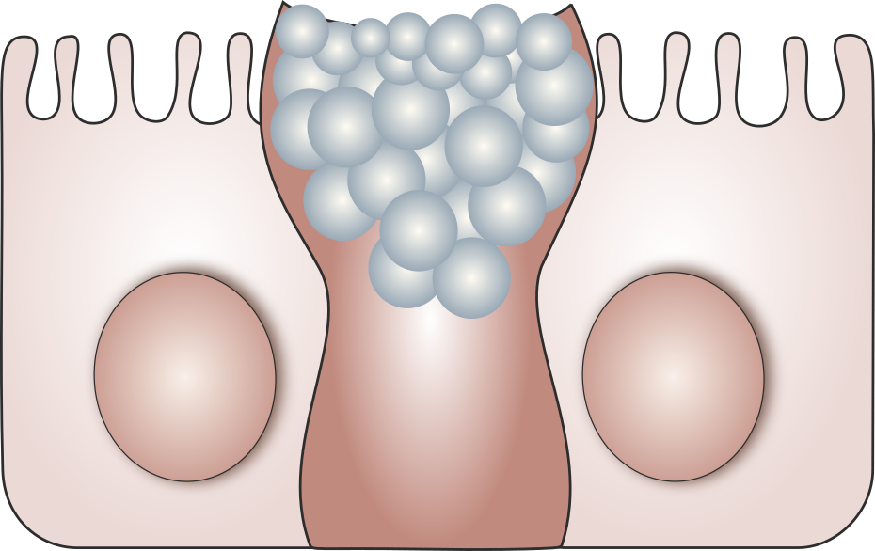
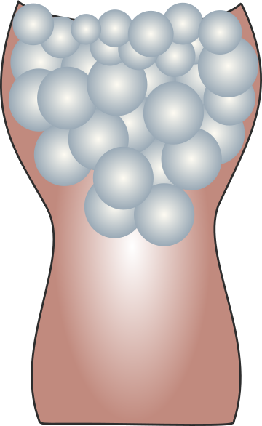

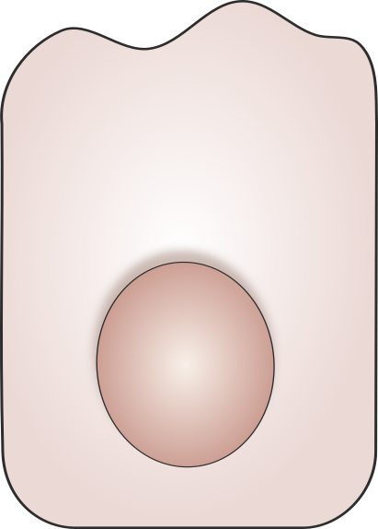
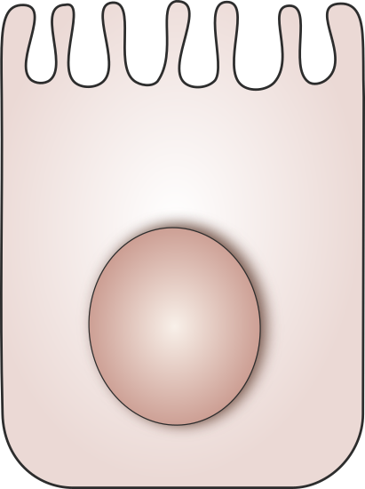
normal epithelial cell goblet cell damaged epithelial cells

Slide 10
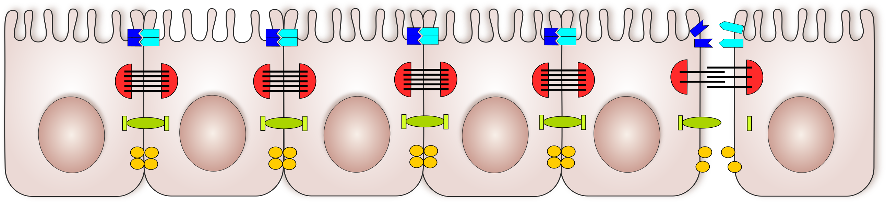
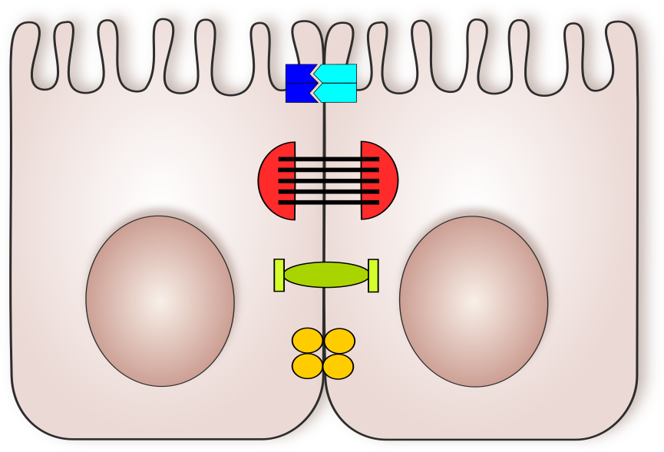
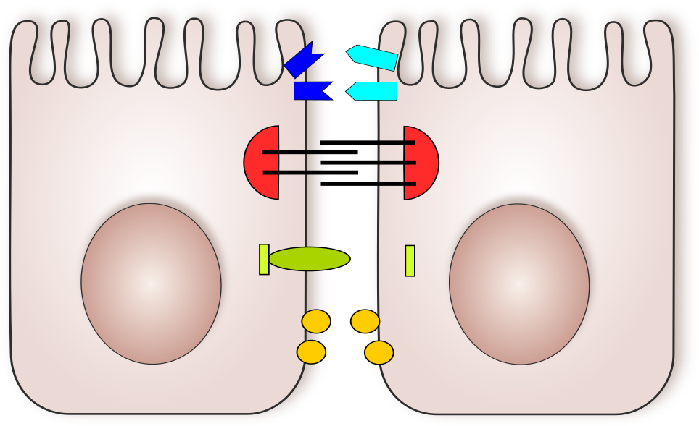
normal tight junctions disrupted tight junctions

Slide 11
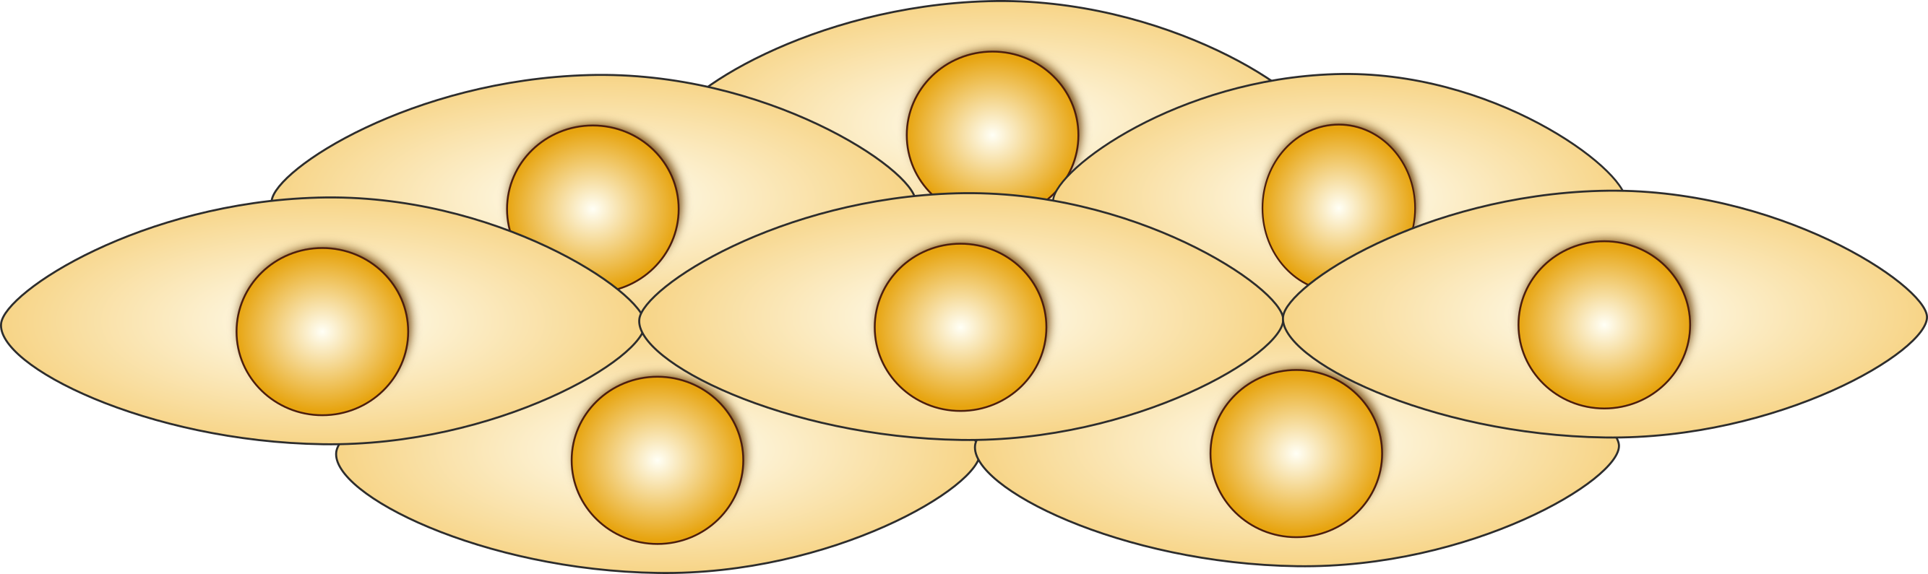


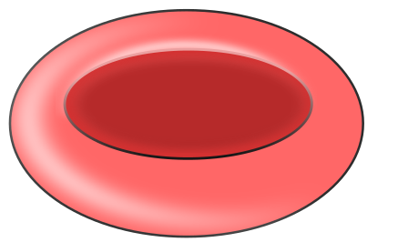

fibroblast /fibrocyte smooth muscle cells erythrocyte platelet

Slide 12
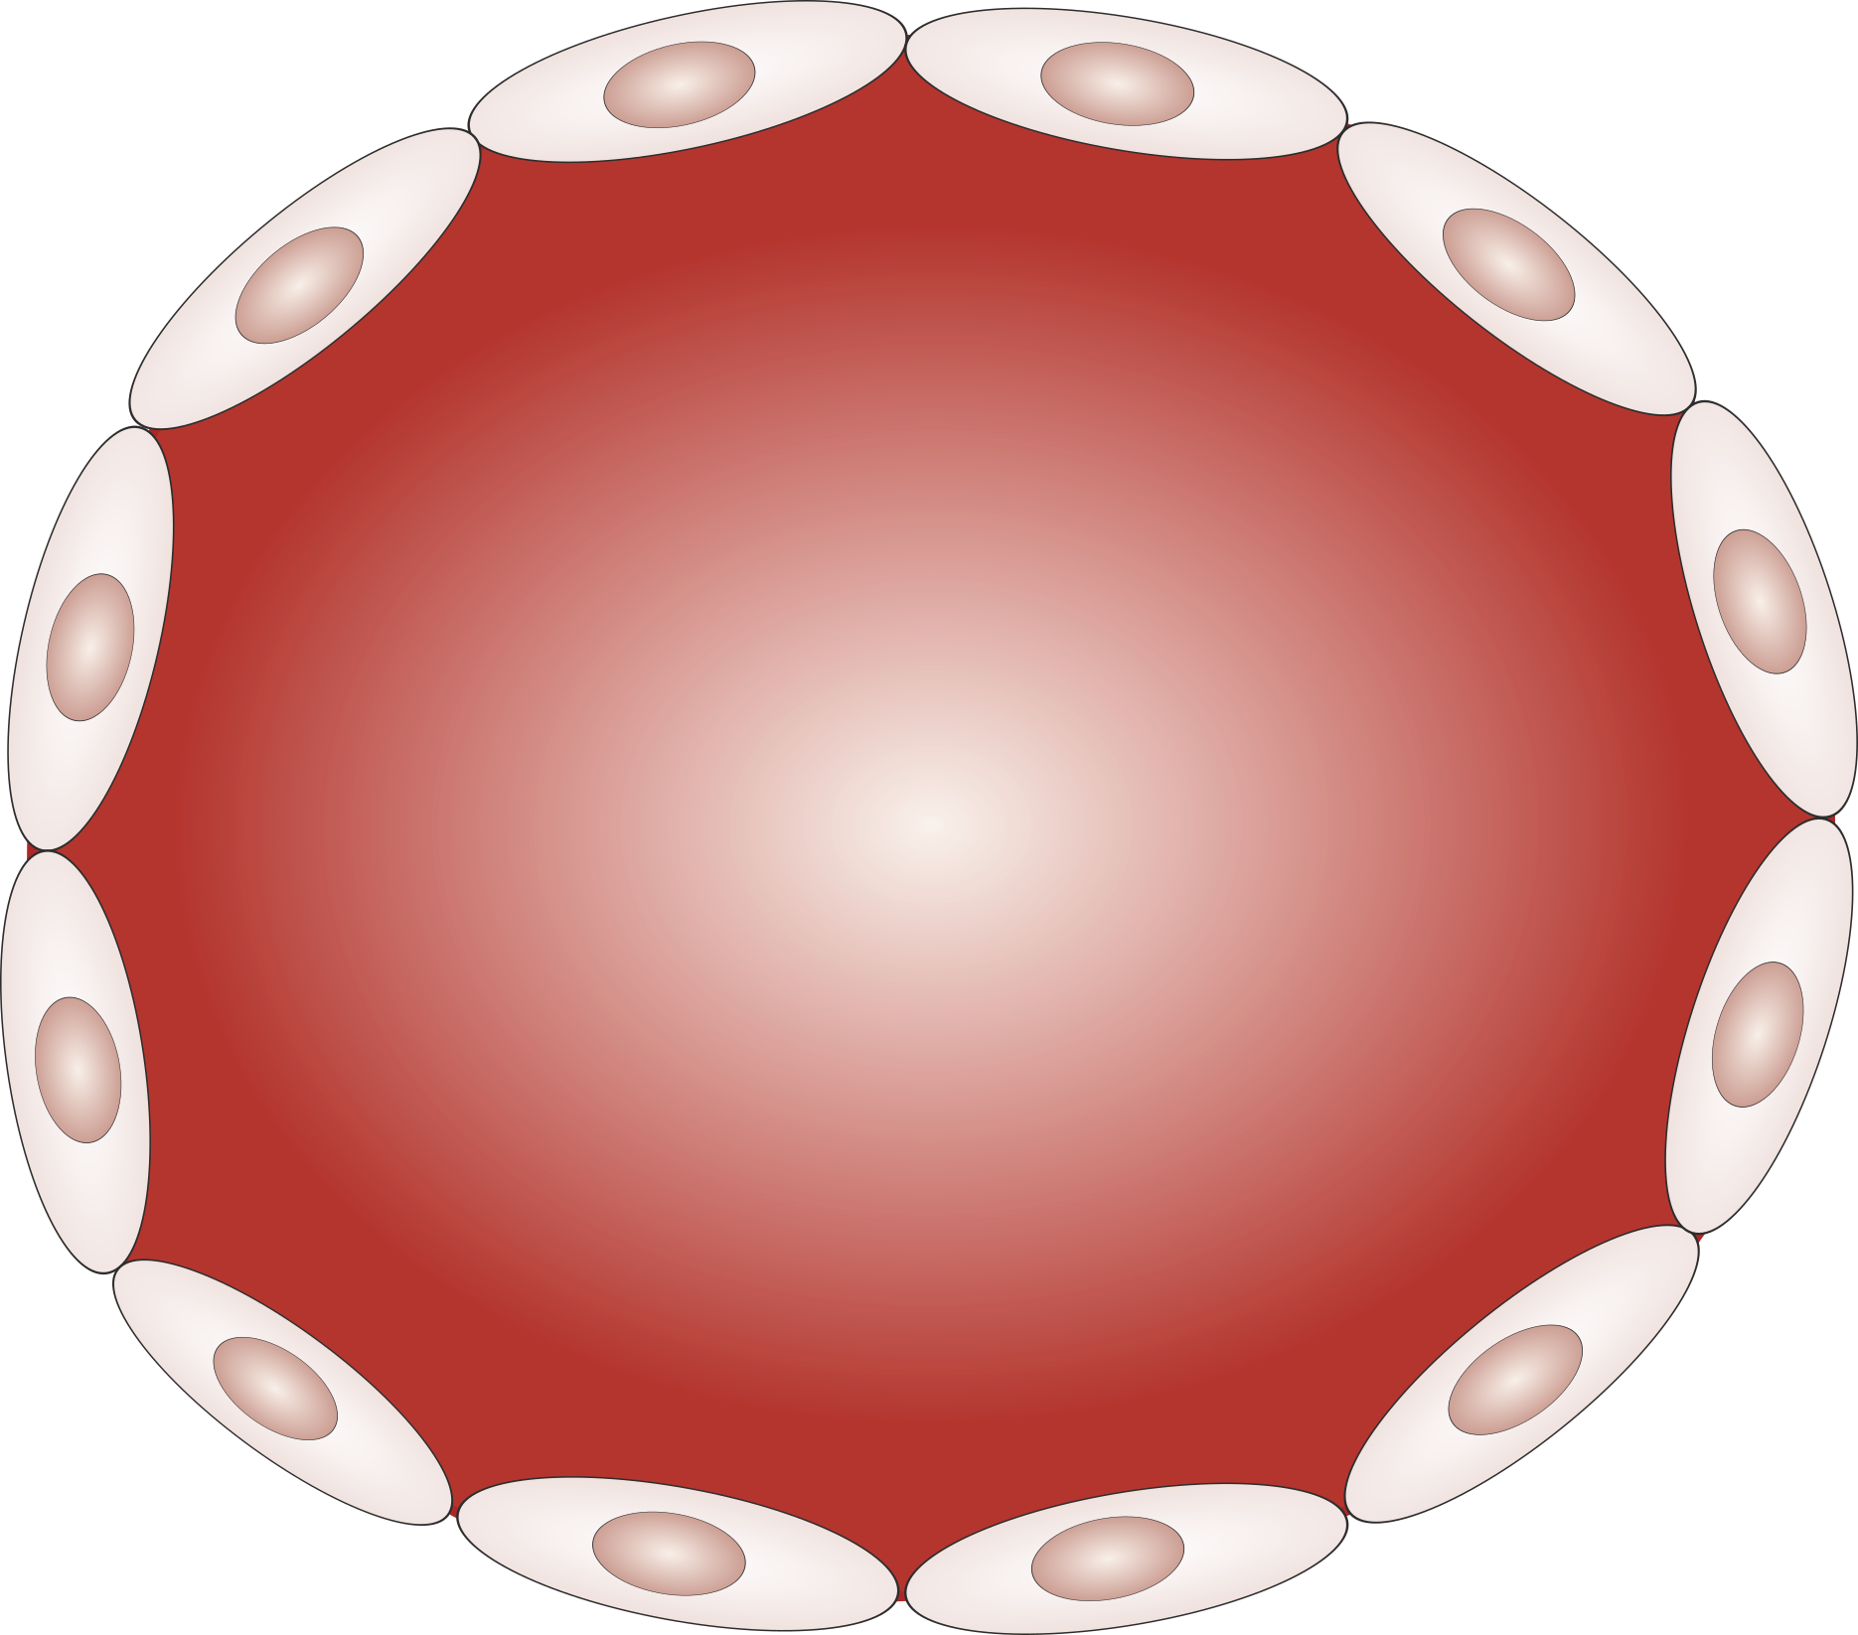
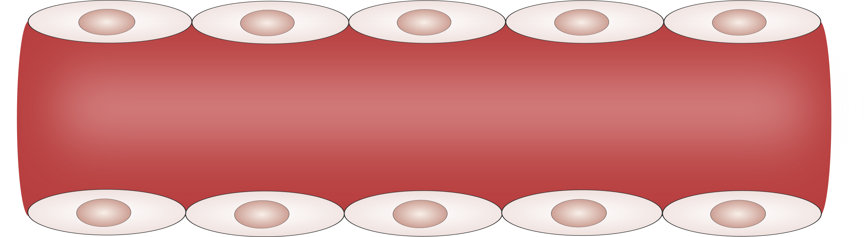

blood vessel endothelial cell

Slide 13
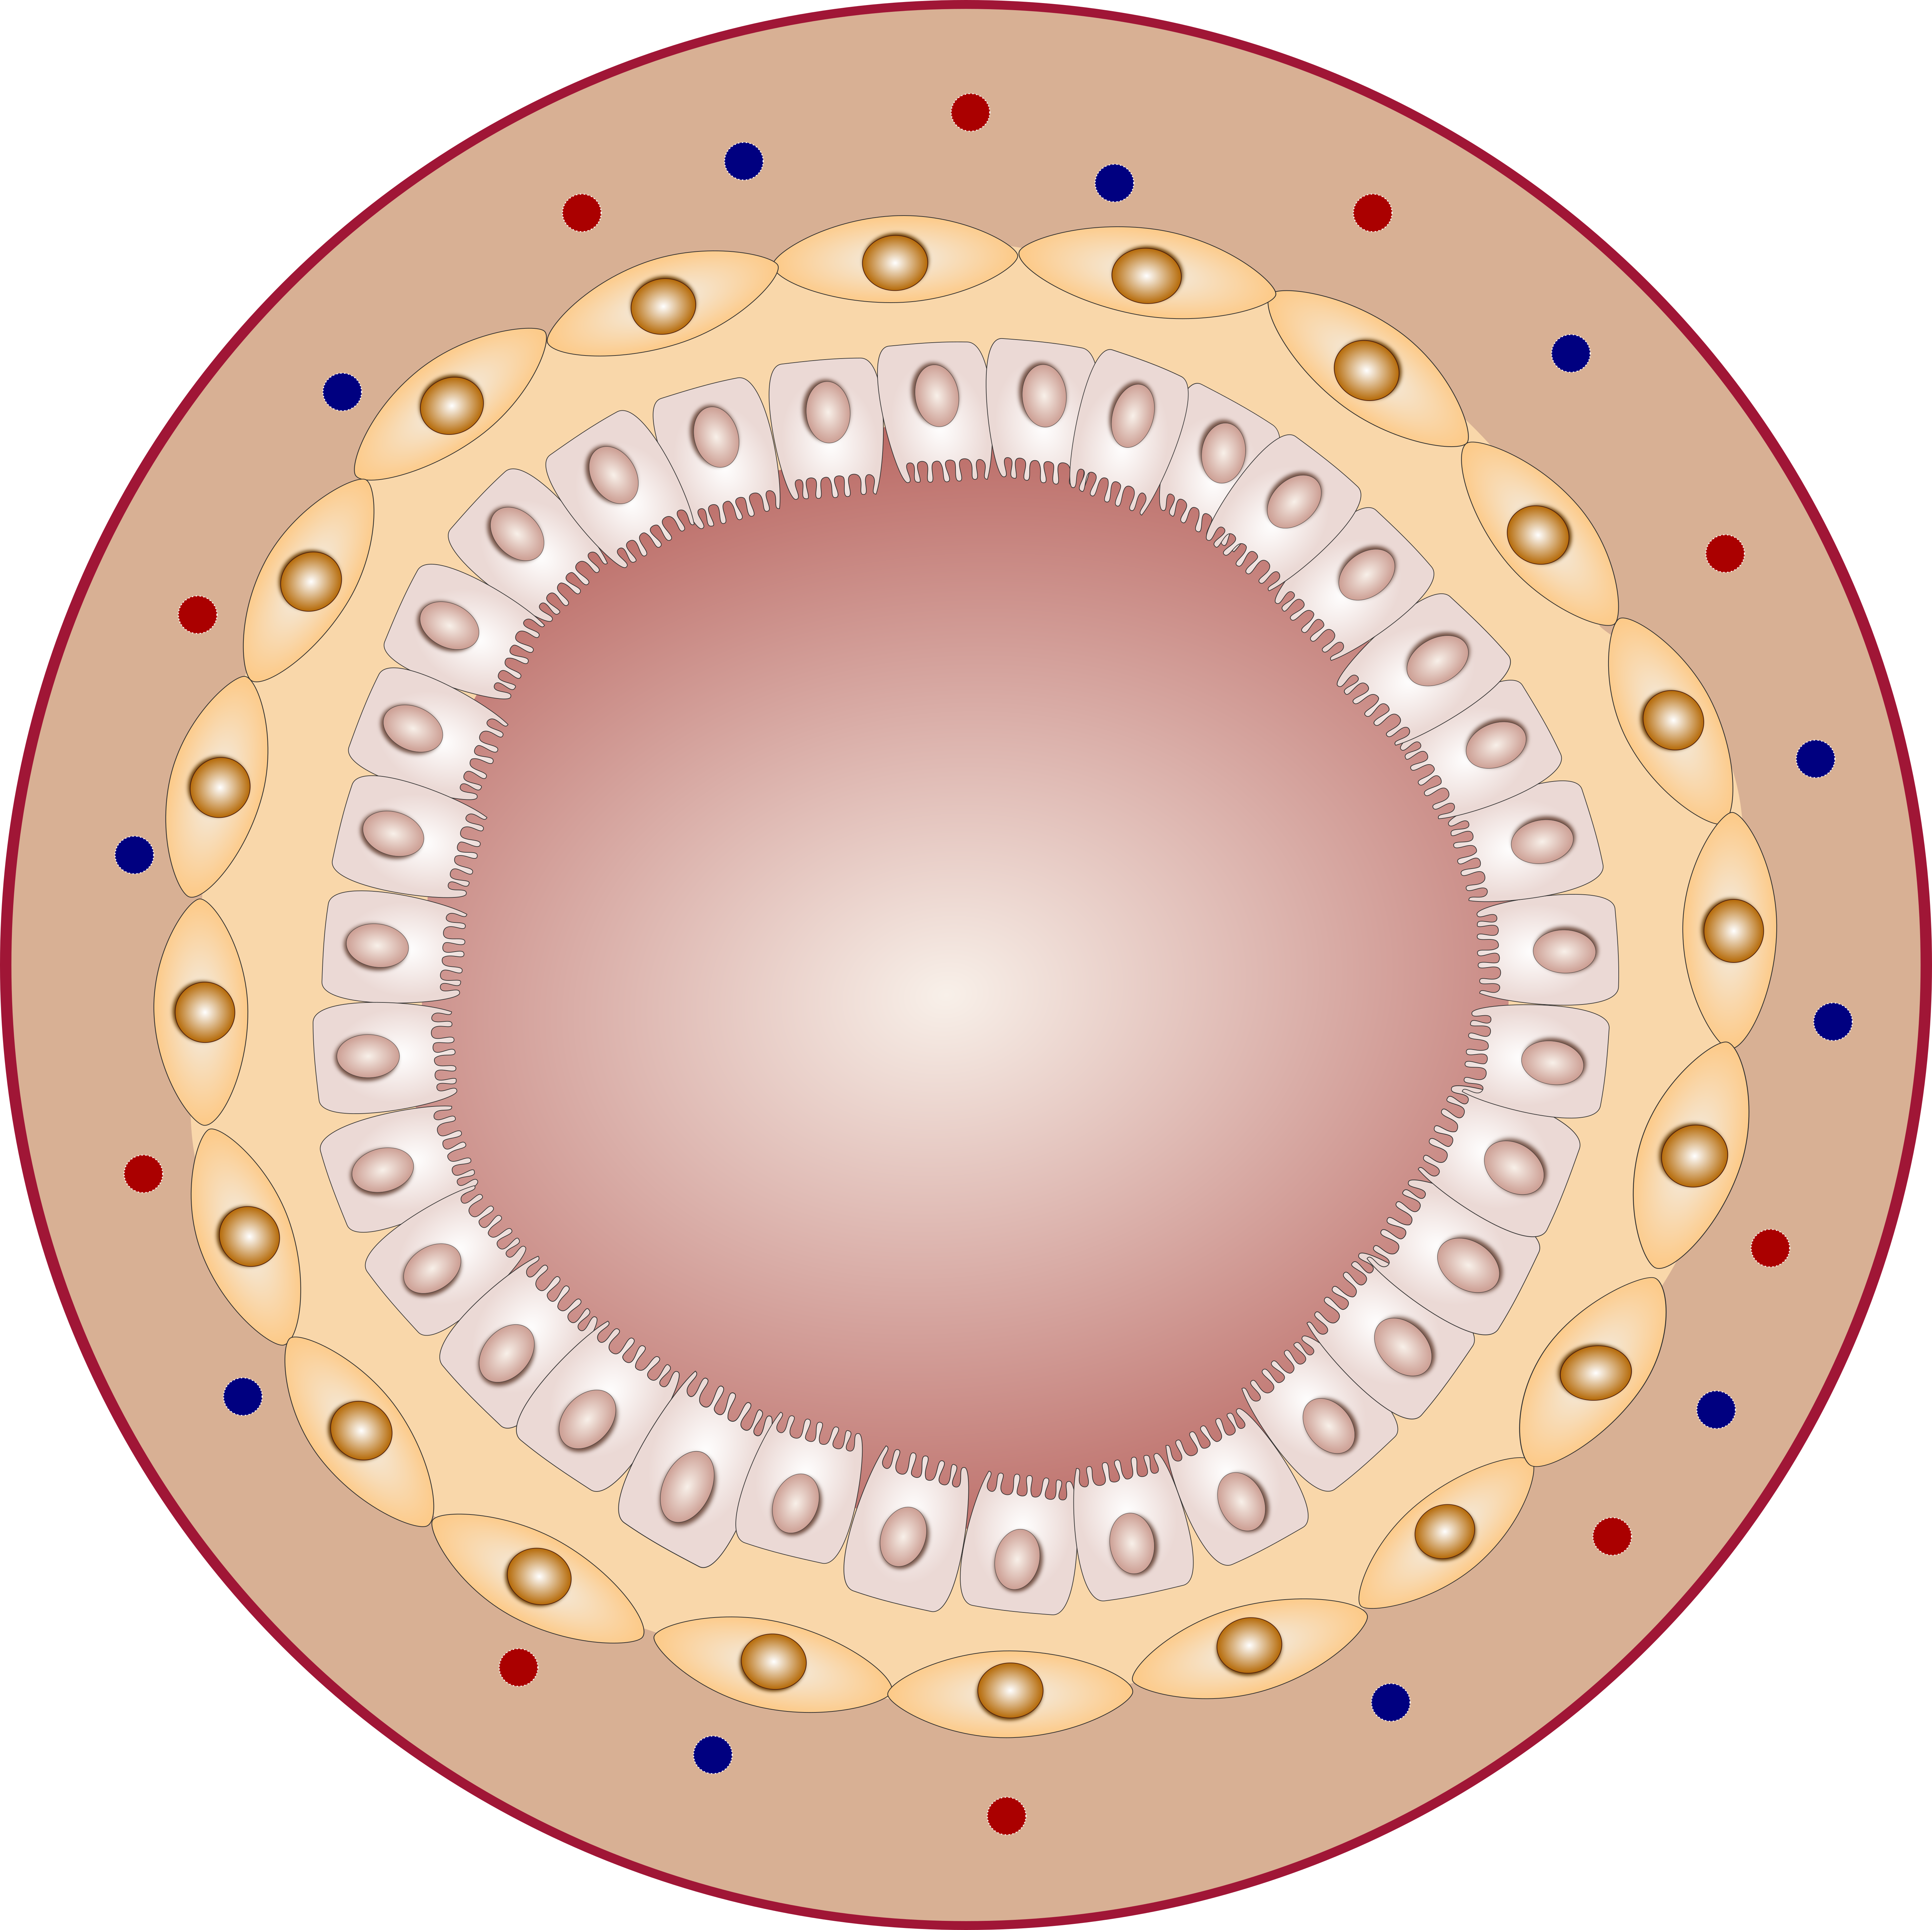
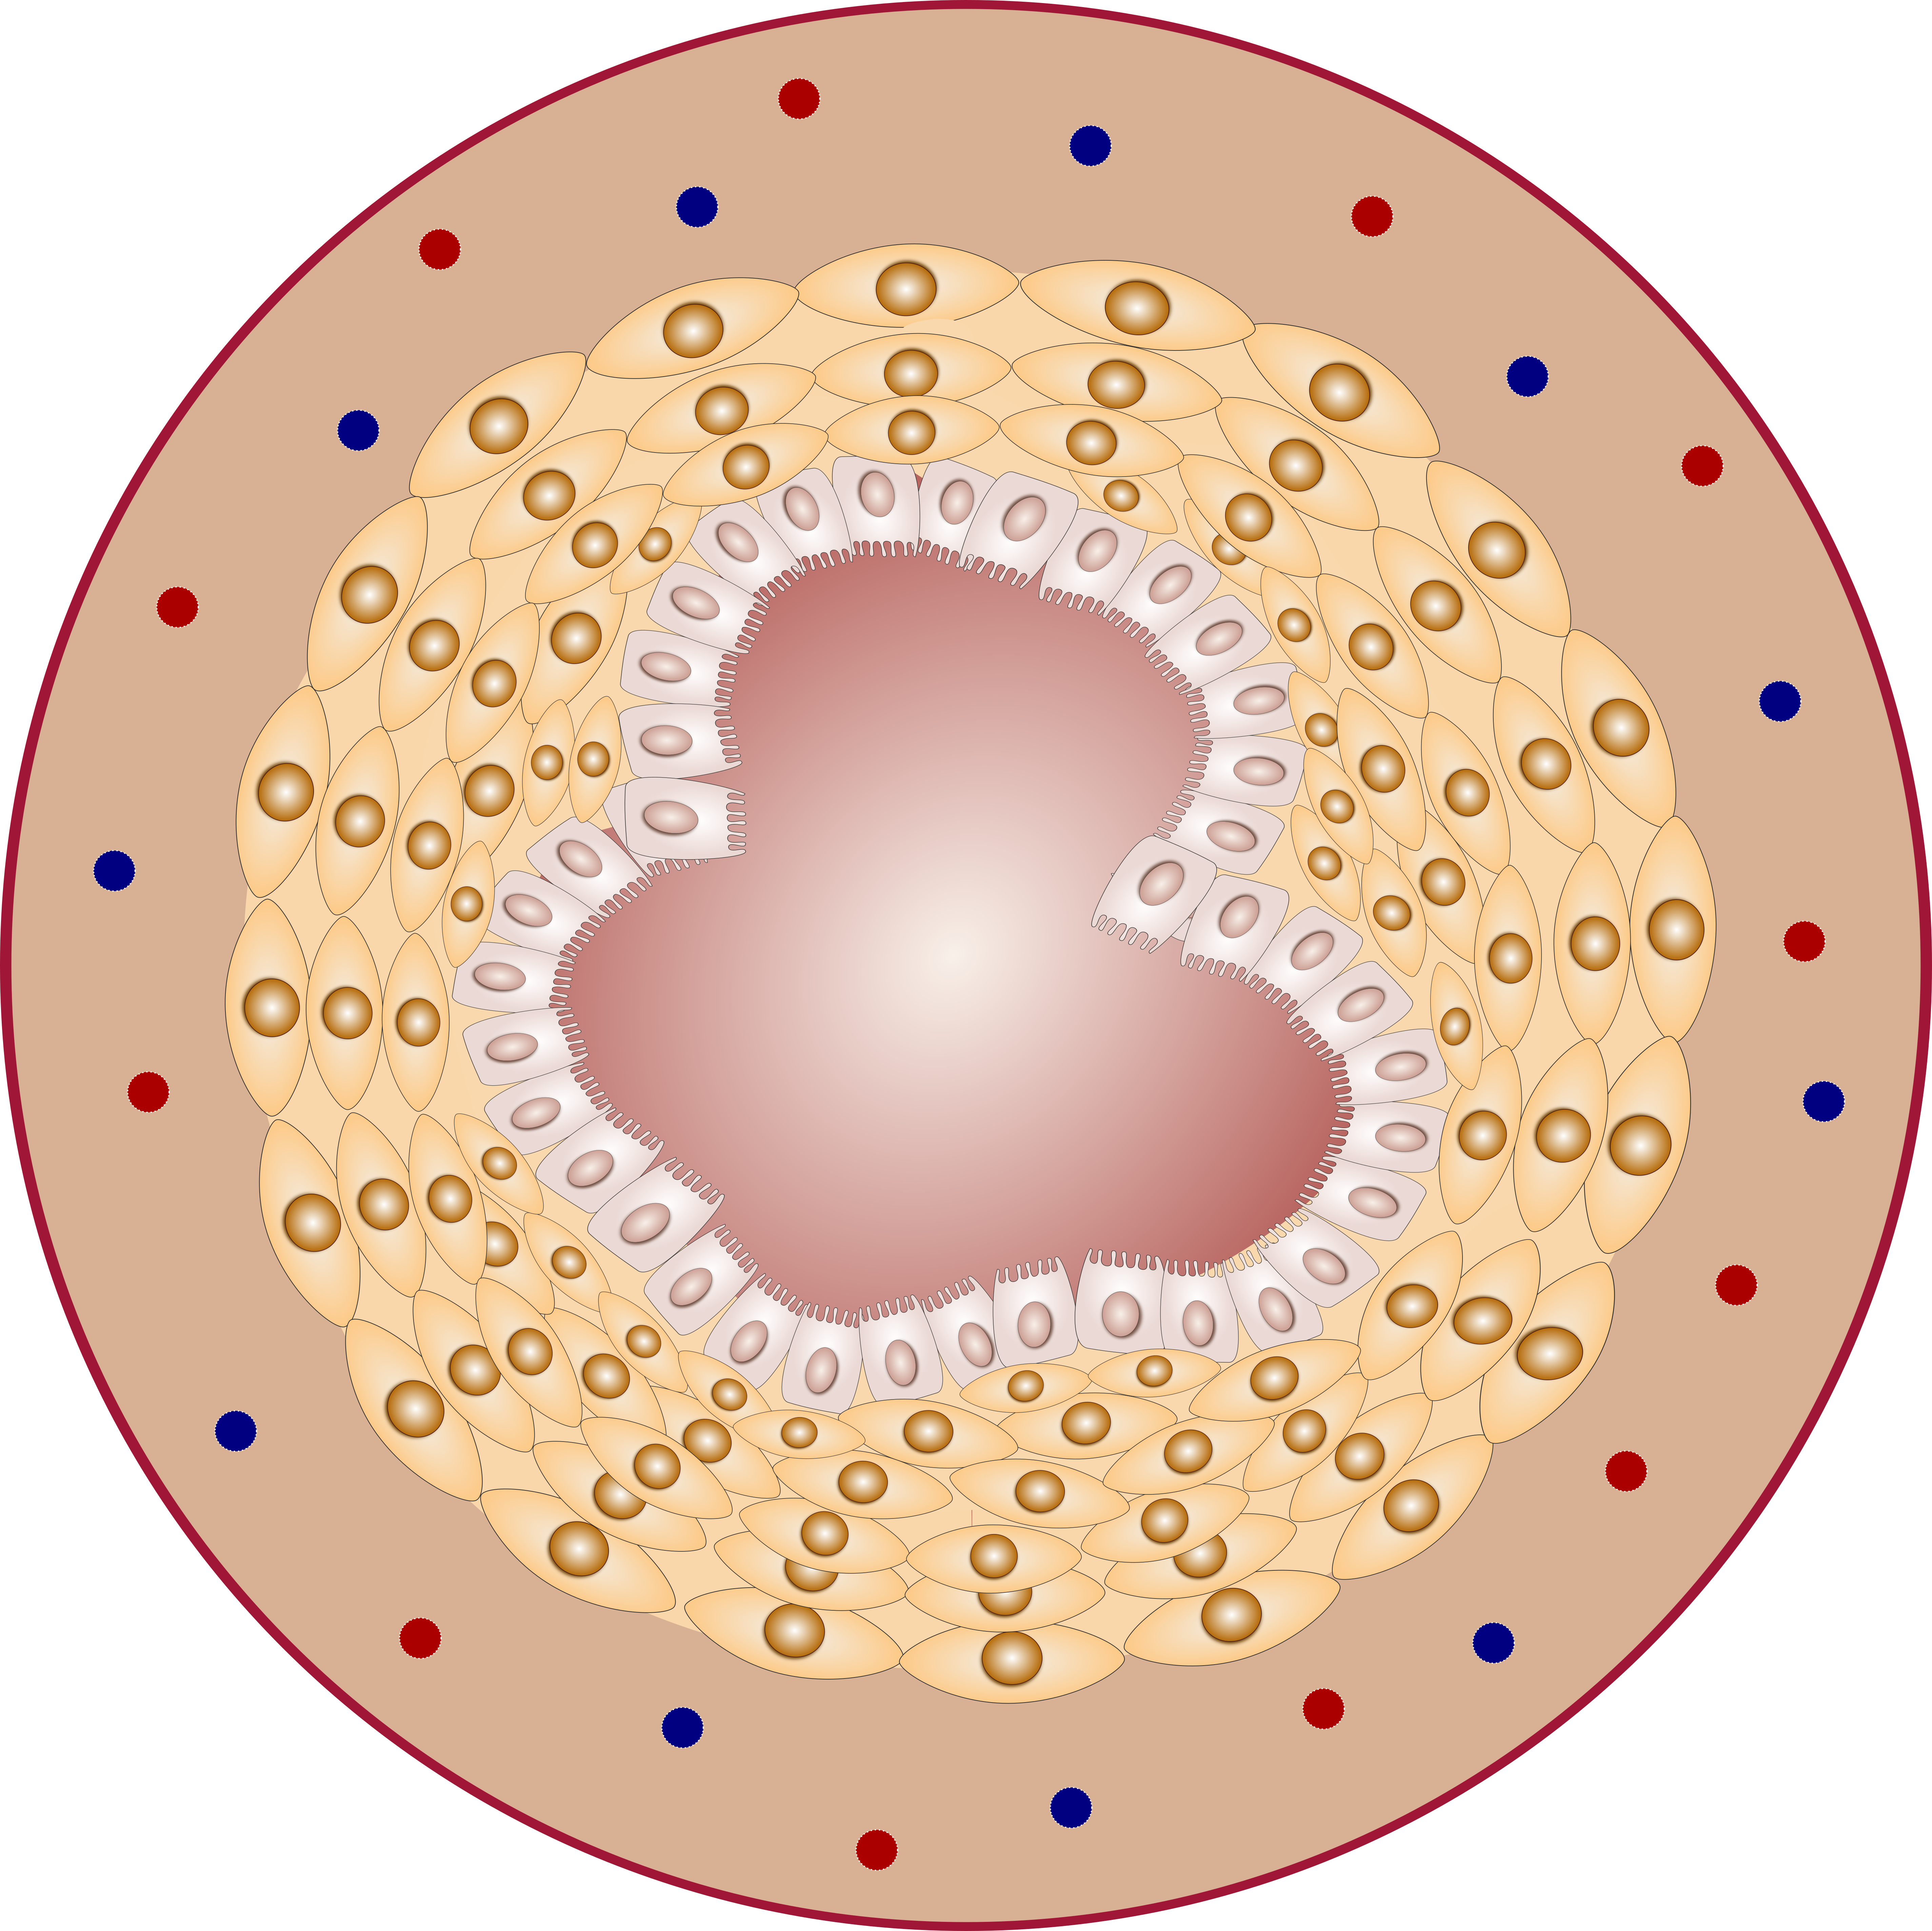
normal bronchus asthmatic bronchus

Slide 14
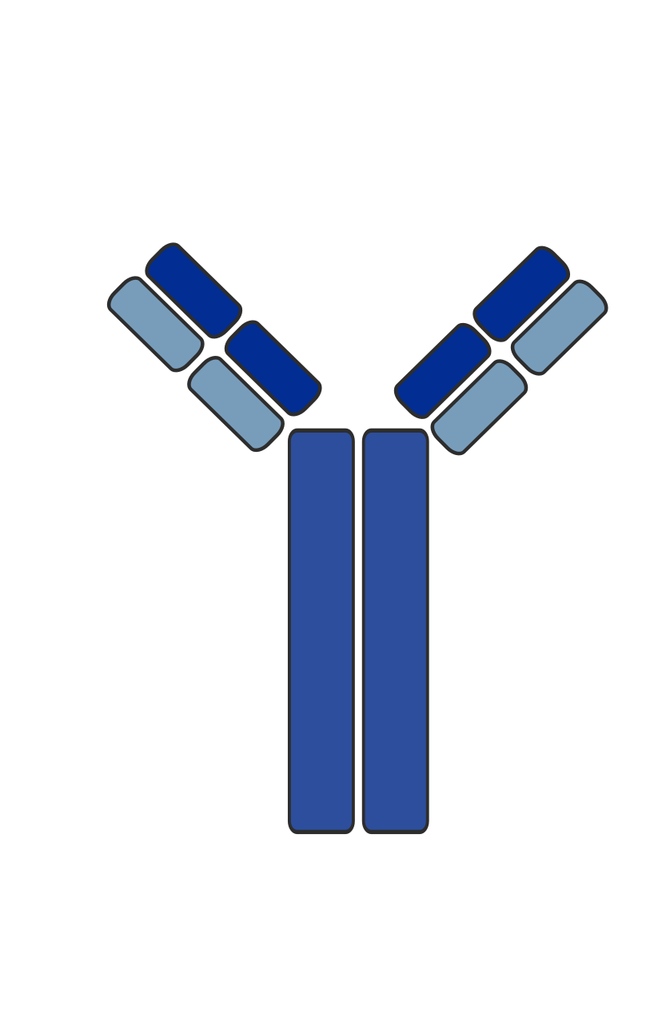



IgE IgA IgG1, IgG2, IgG3 IgG4

Slide 15
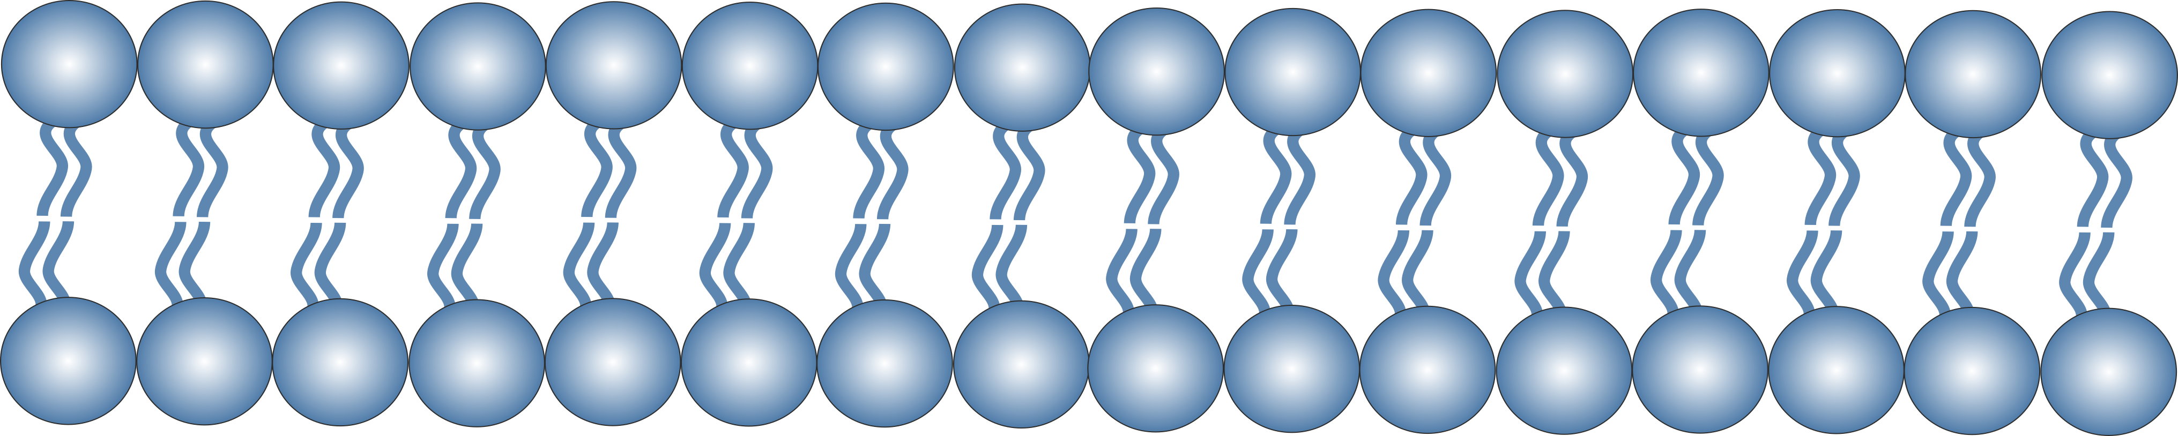
cell membrane

Slide 16

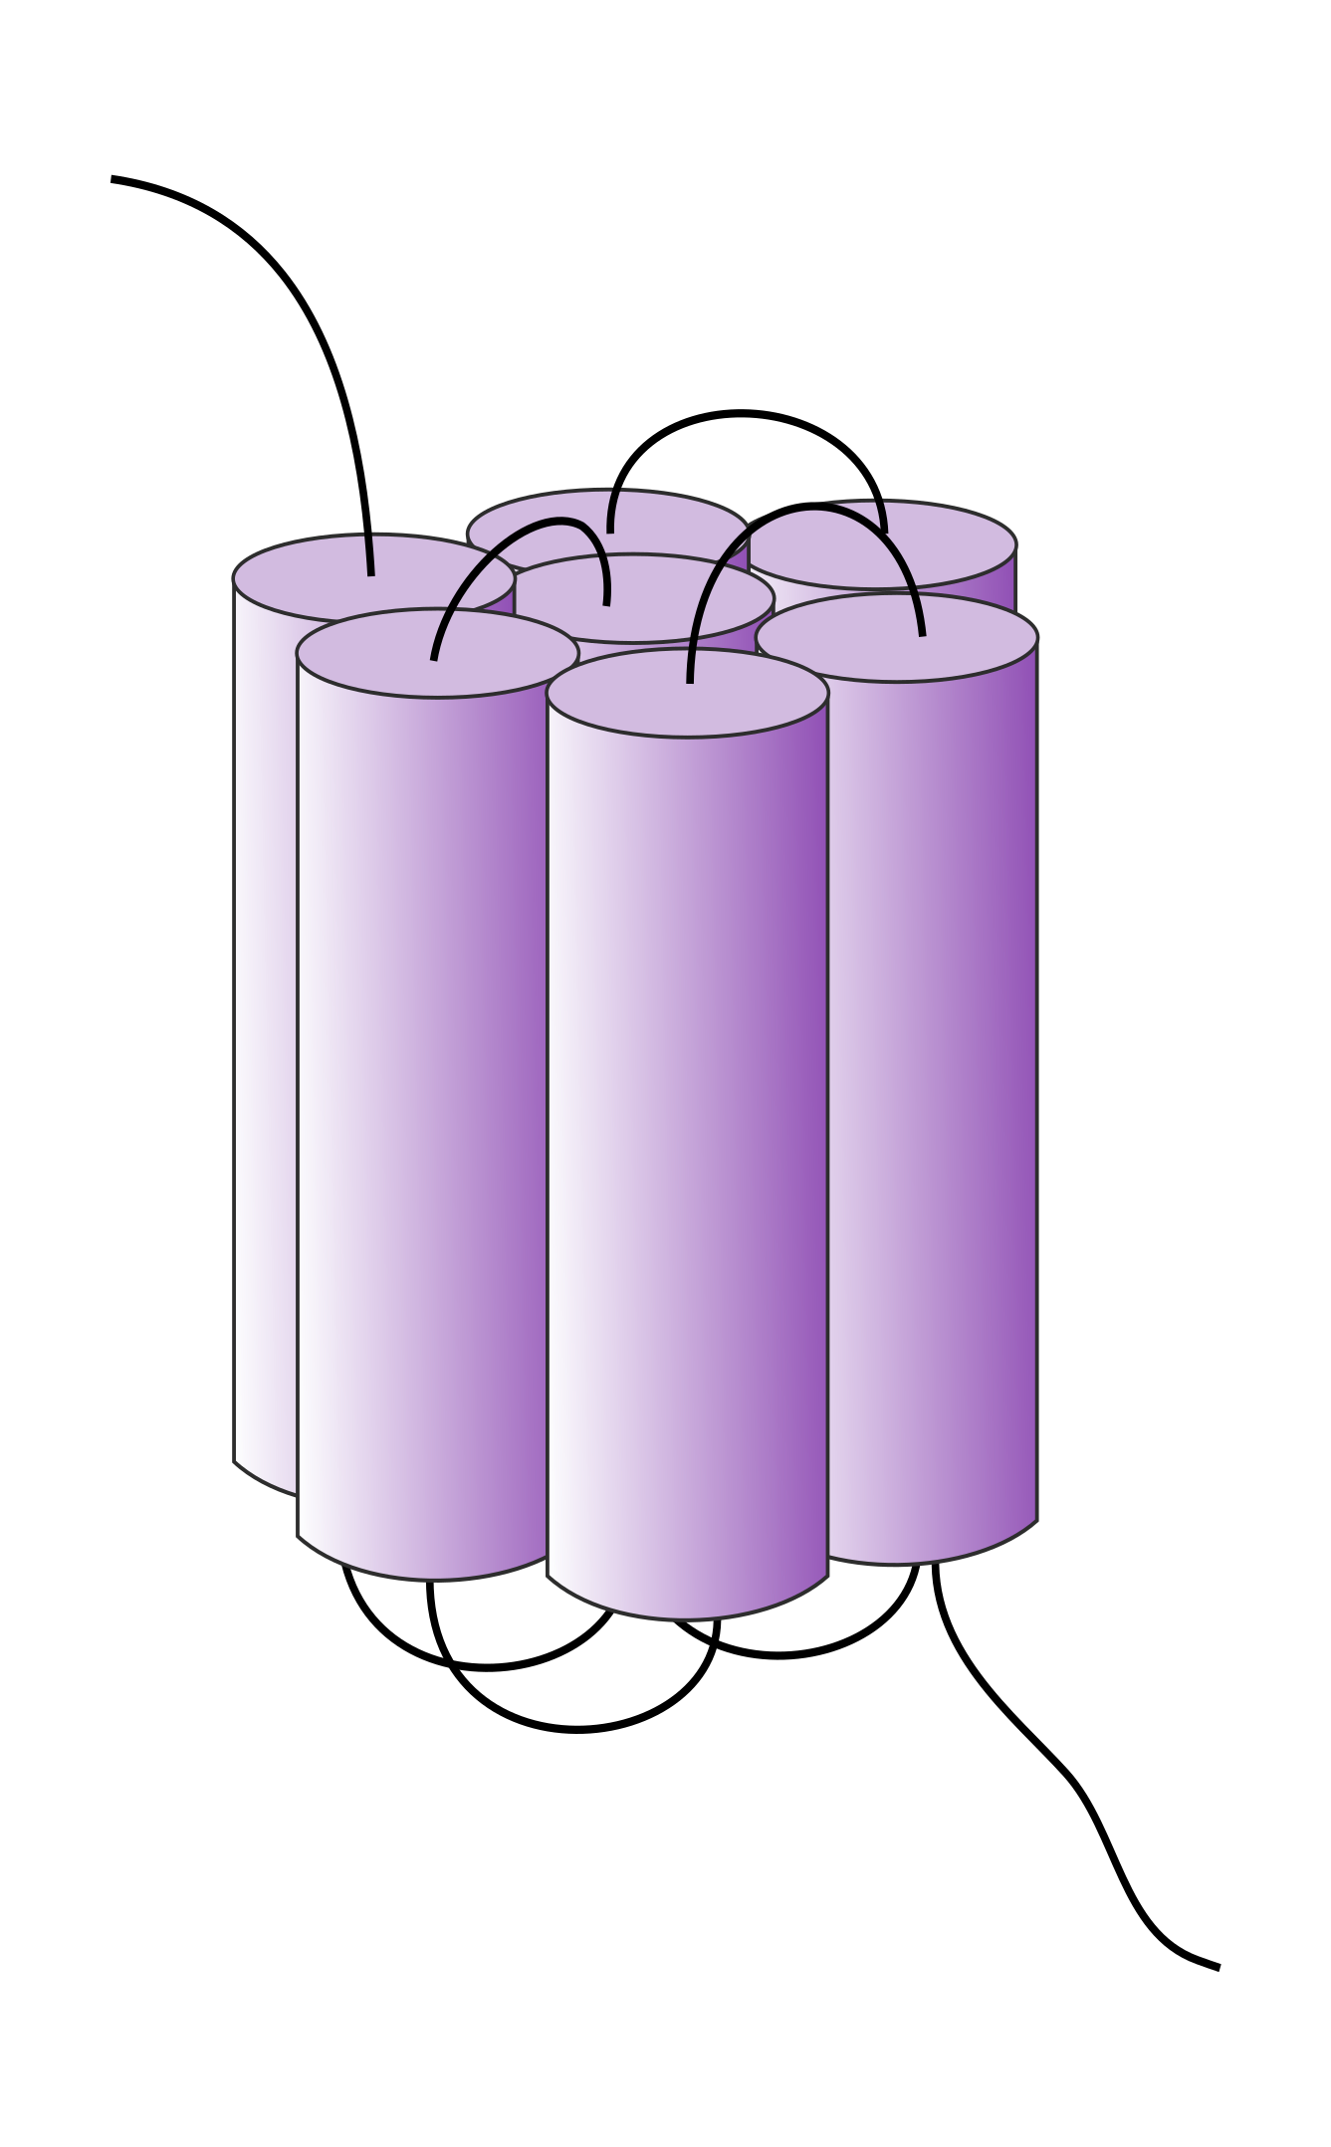

G protein-coupled receptor (GPCR) intracellular adhesion molecule-1 (ICAM-1)

Slide 17


G protein-coupled receptor (GPCR) T cell receptor

Slide 18















virus bacteria antigens dsDNA ssDNA RNA pollens

Slide 19






man pregnant women

Slide 20








kids women

Slide 21






infants/babies

Slide 22

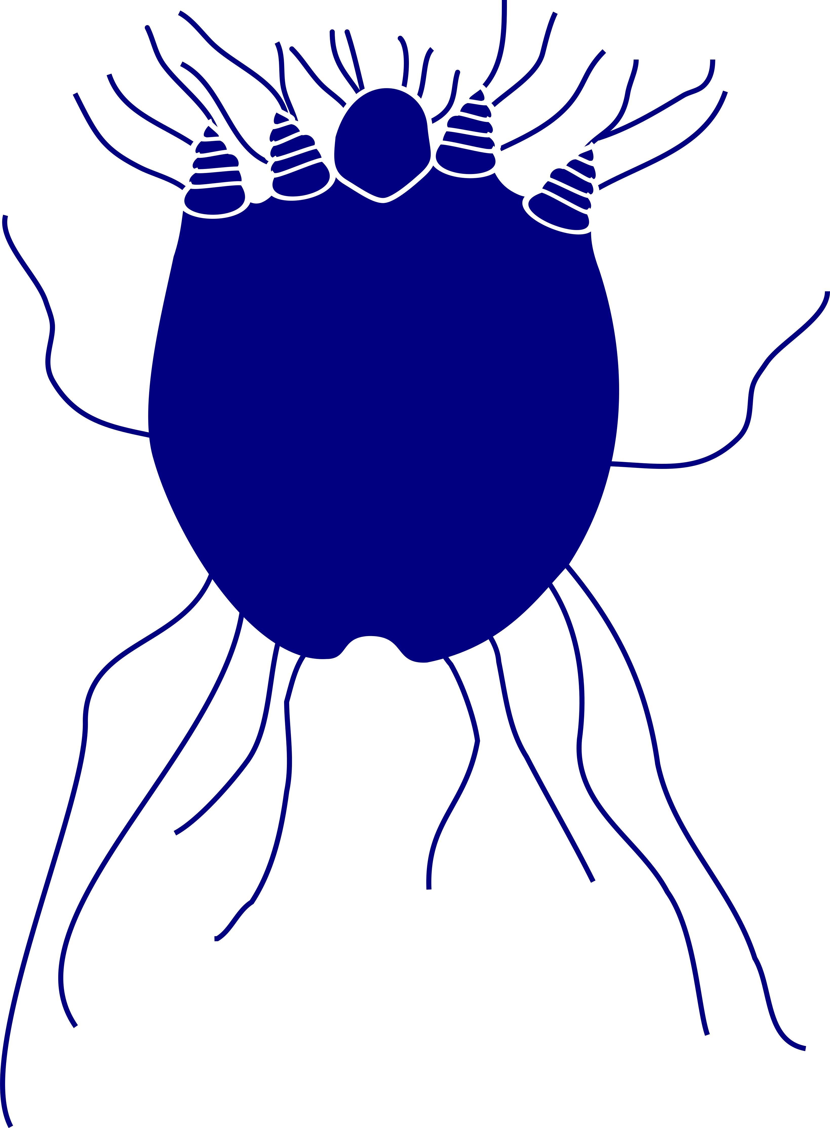


mouse cat house dust mite scabies mite

Slide 23



dogs

Slide 24


cod salmon tuna

Slide 25












people icons

Slide 26
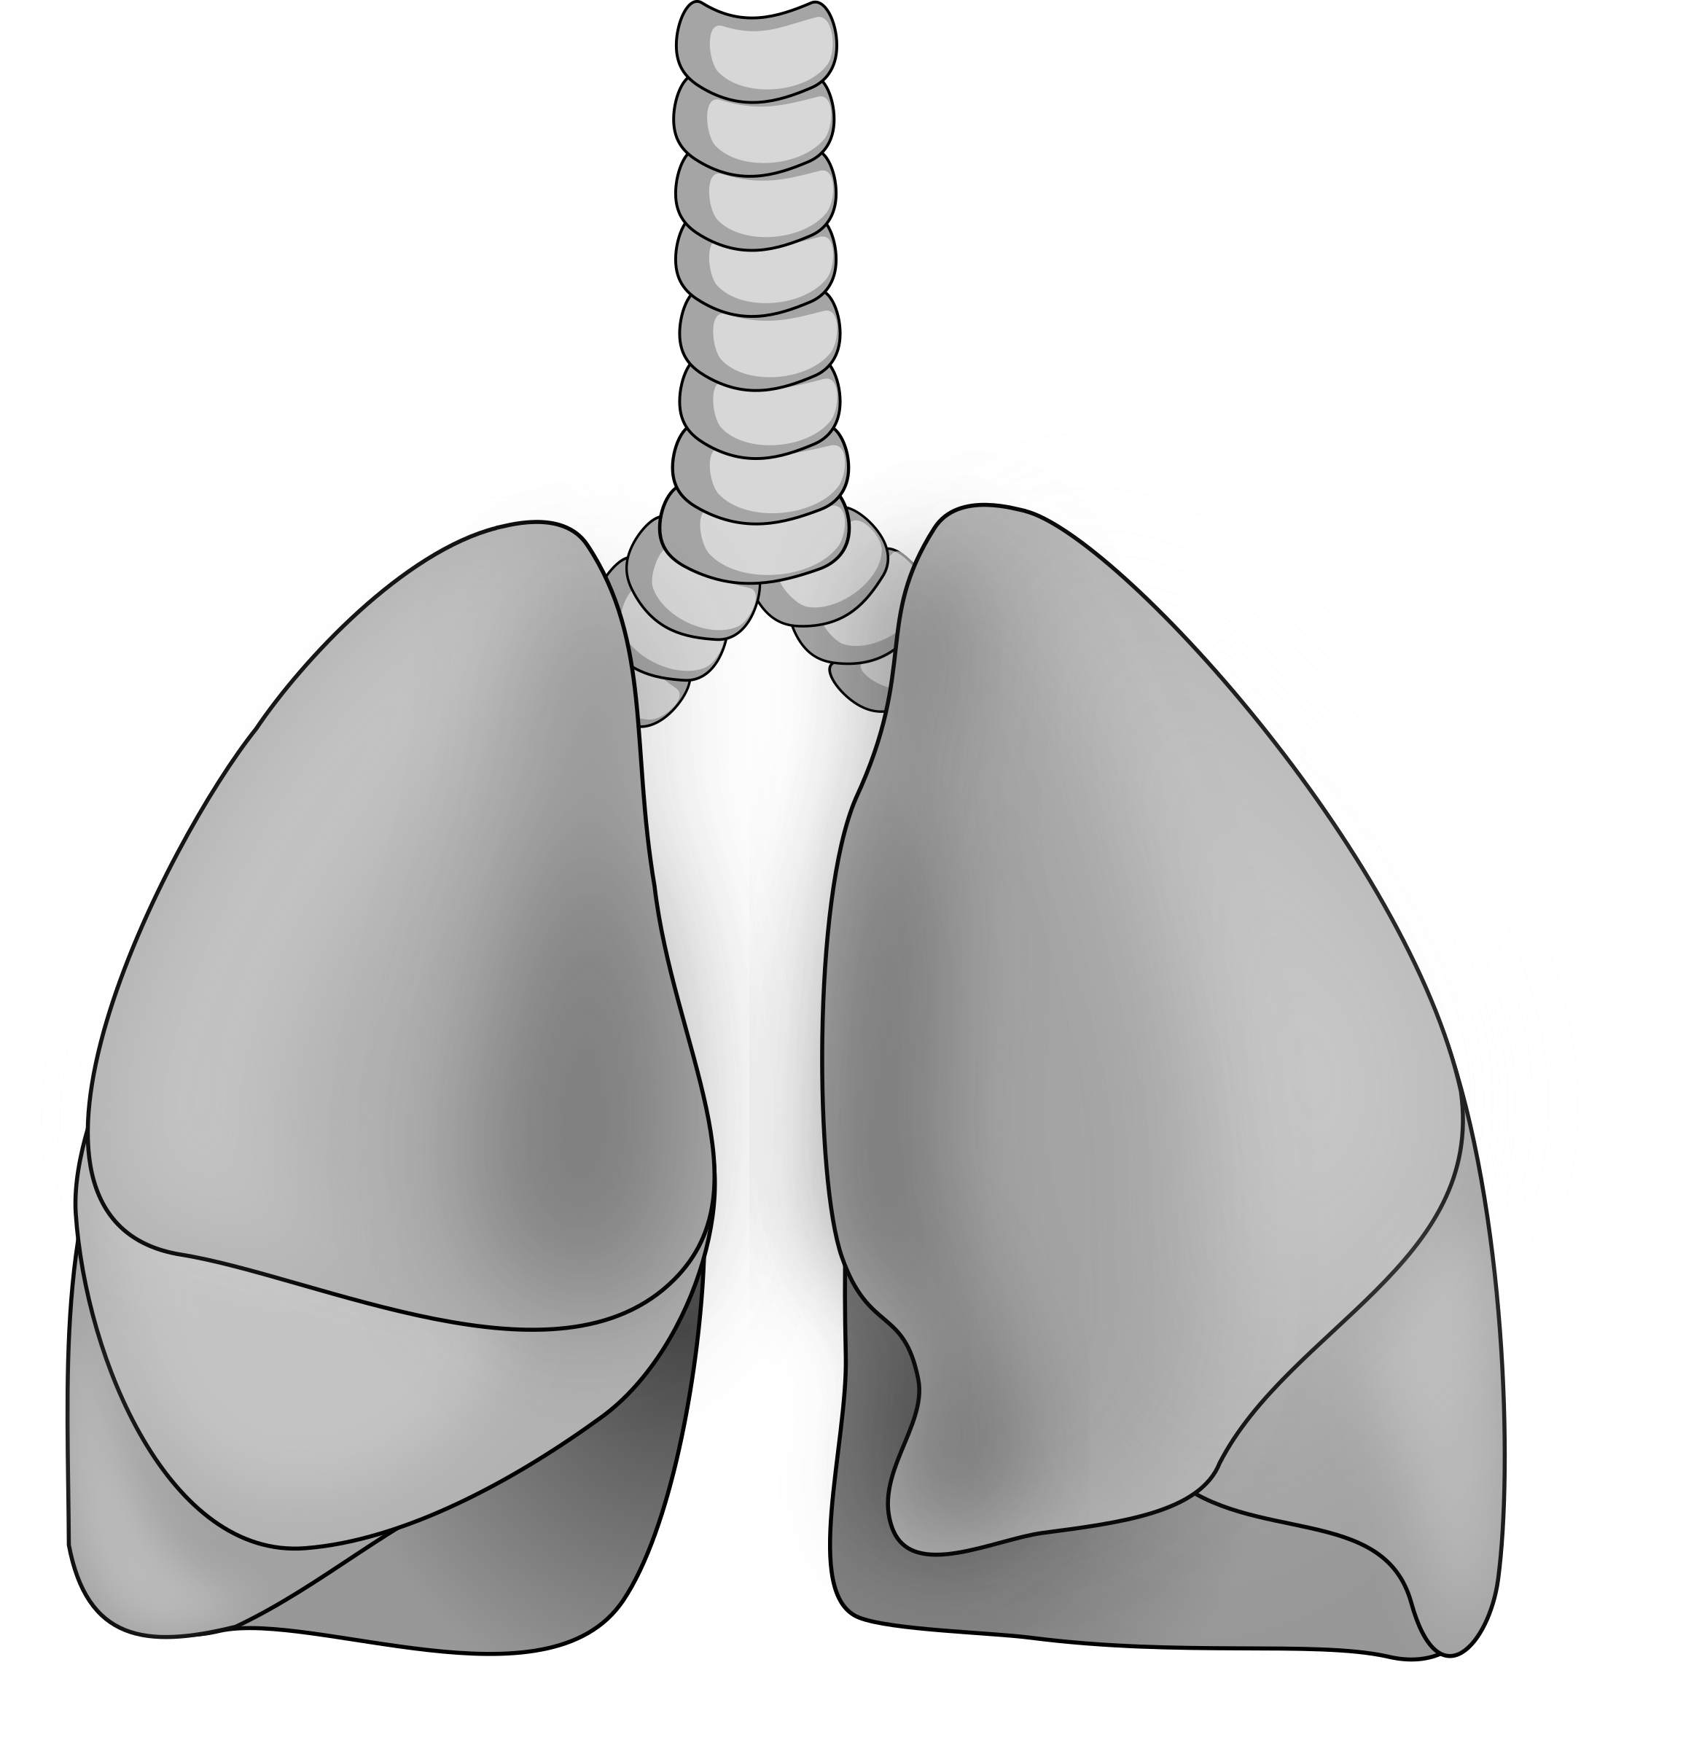
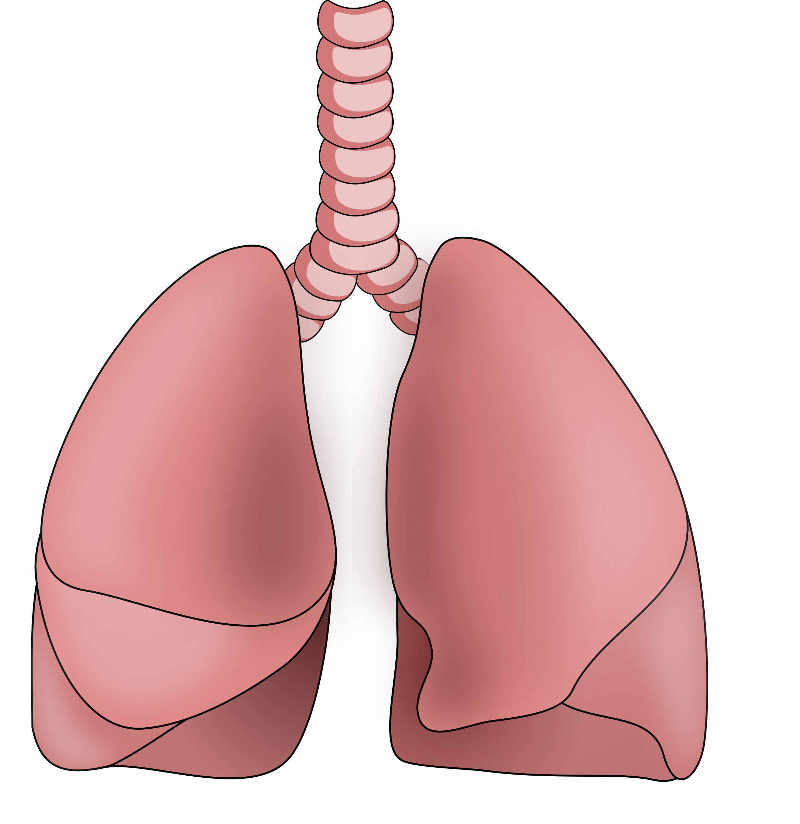
lungs

Slide 27

neuron lymph node

Slide 28
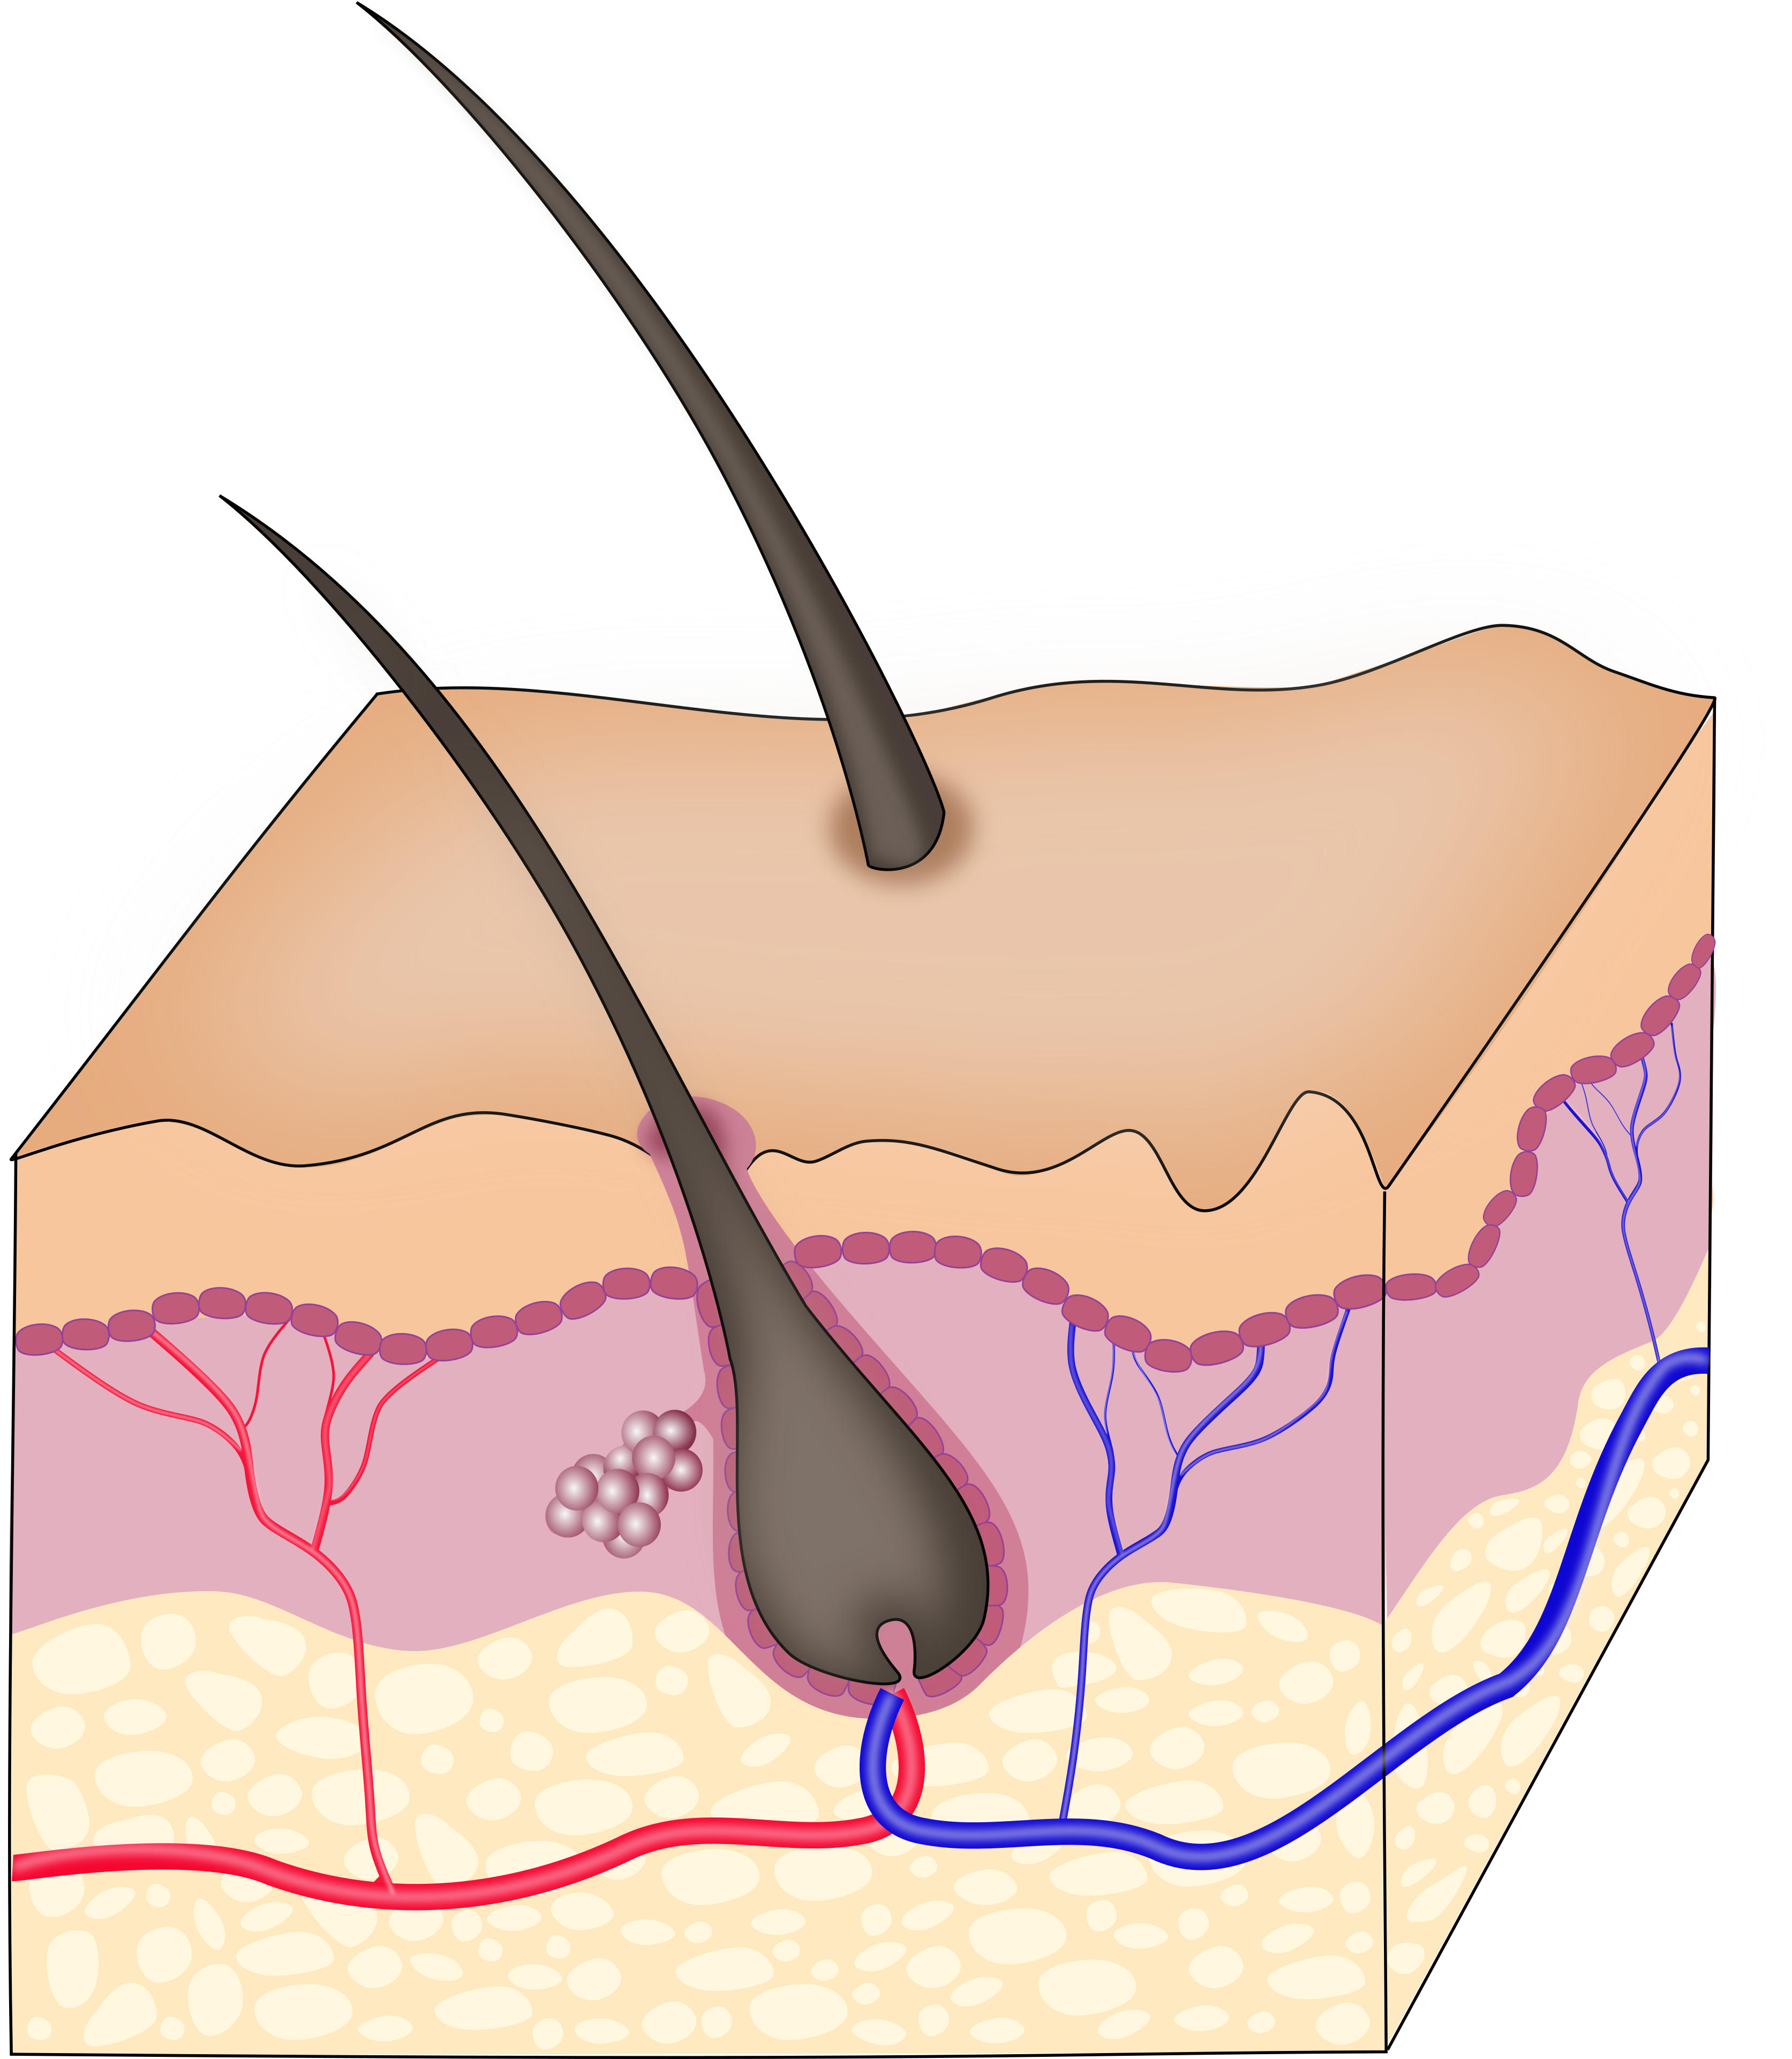
skin

Slide 29
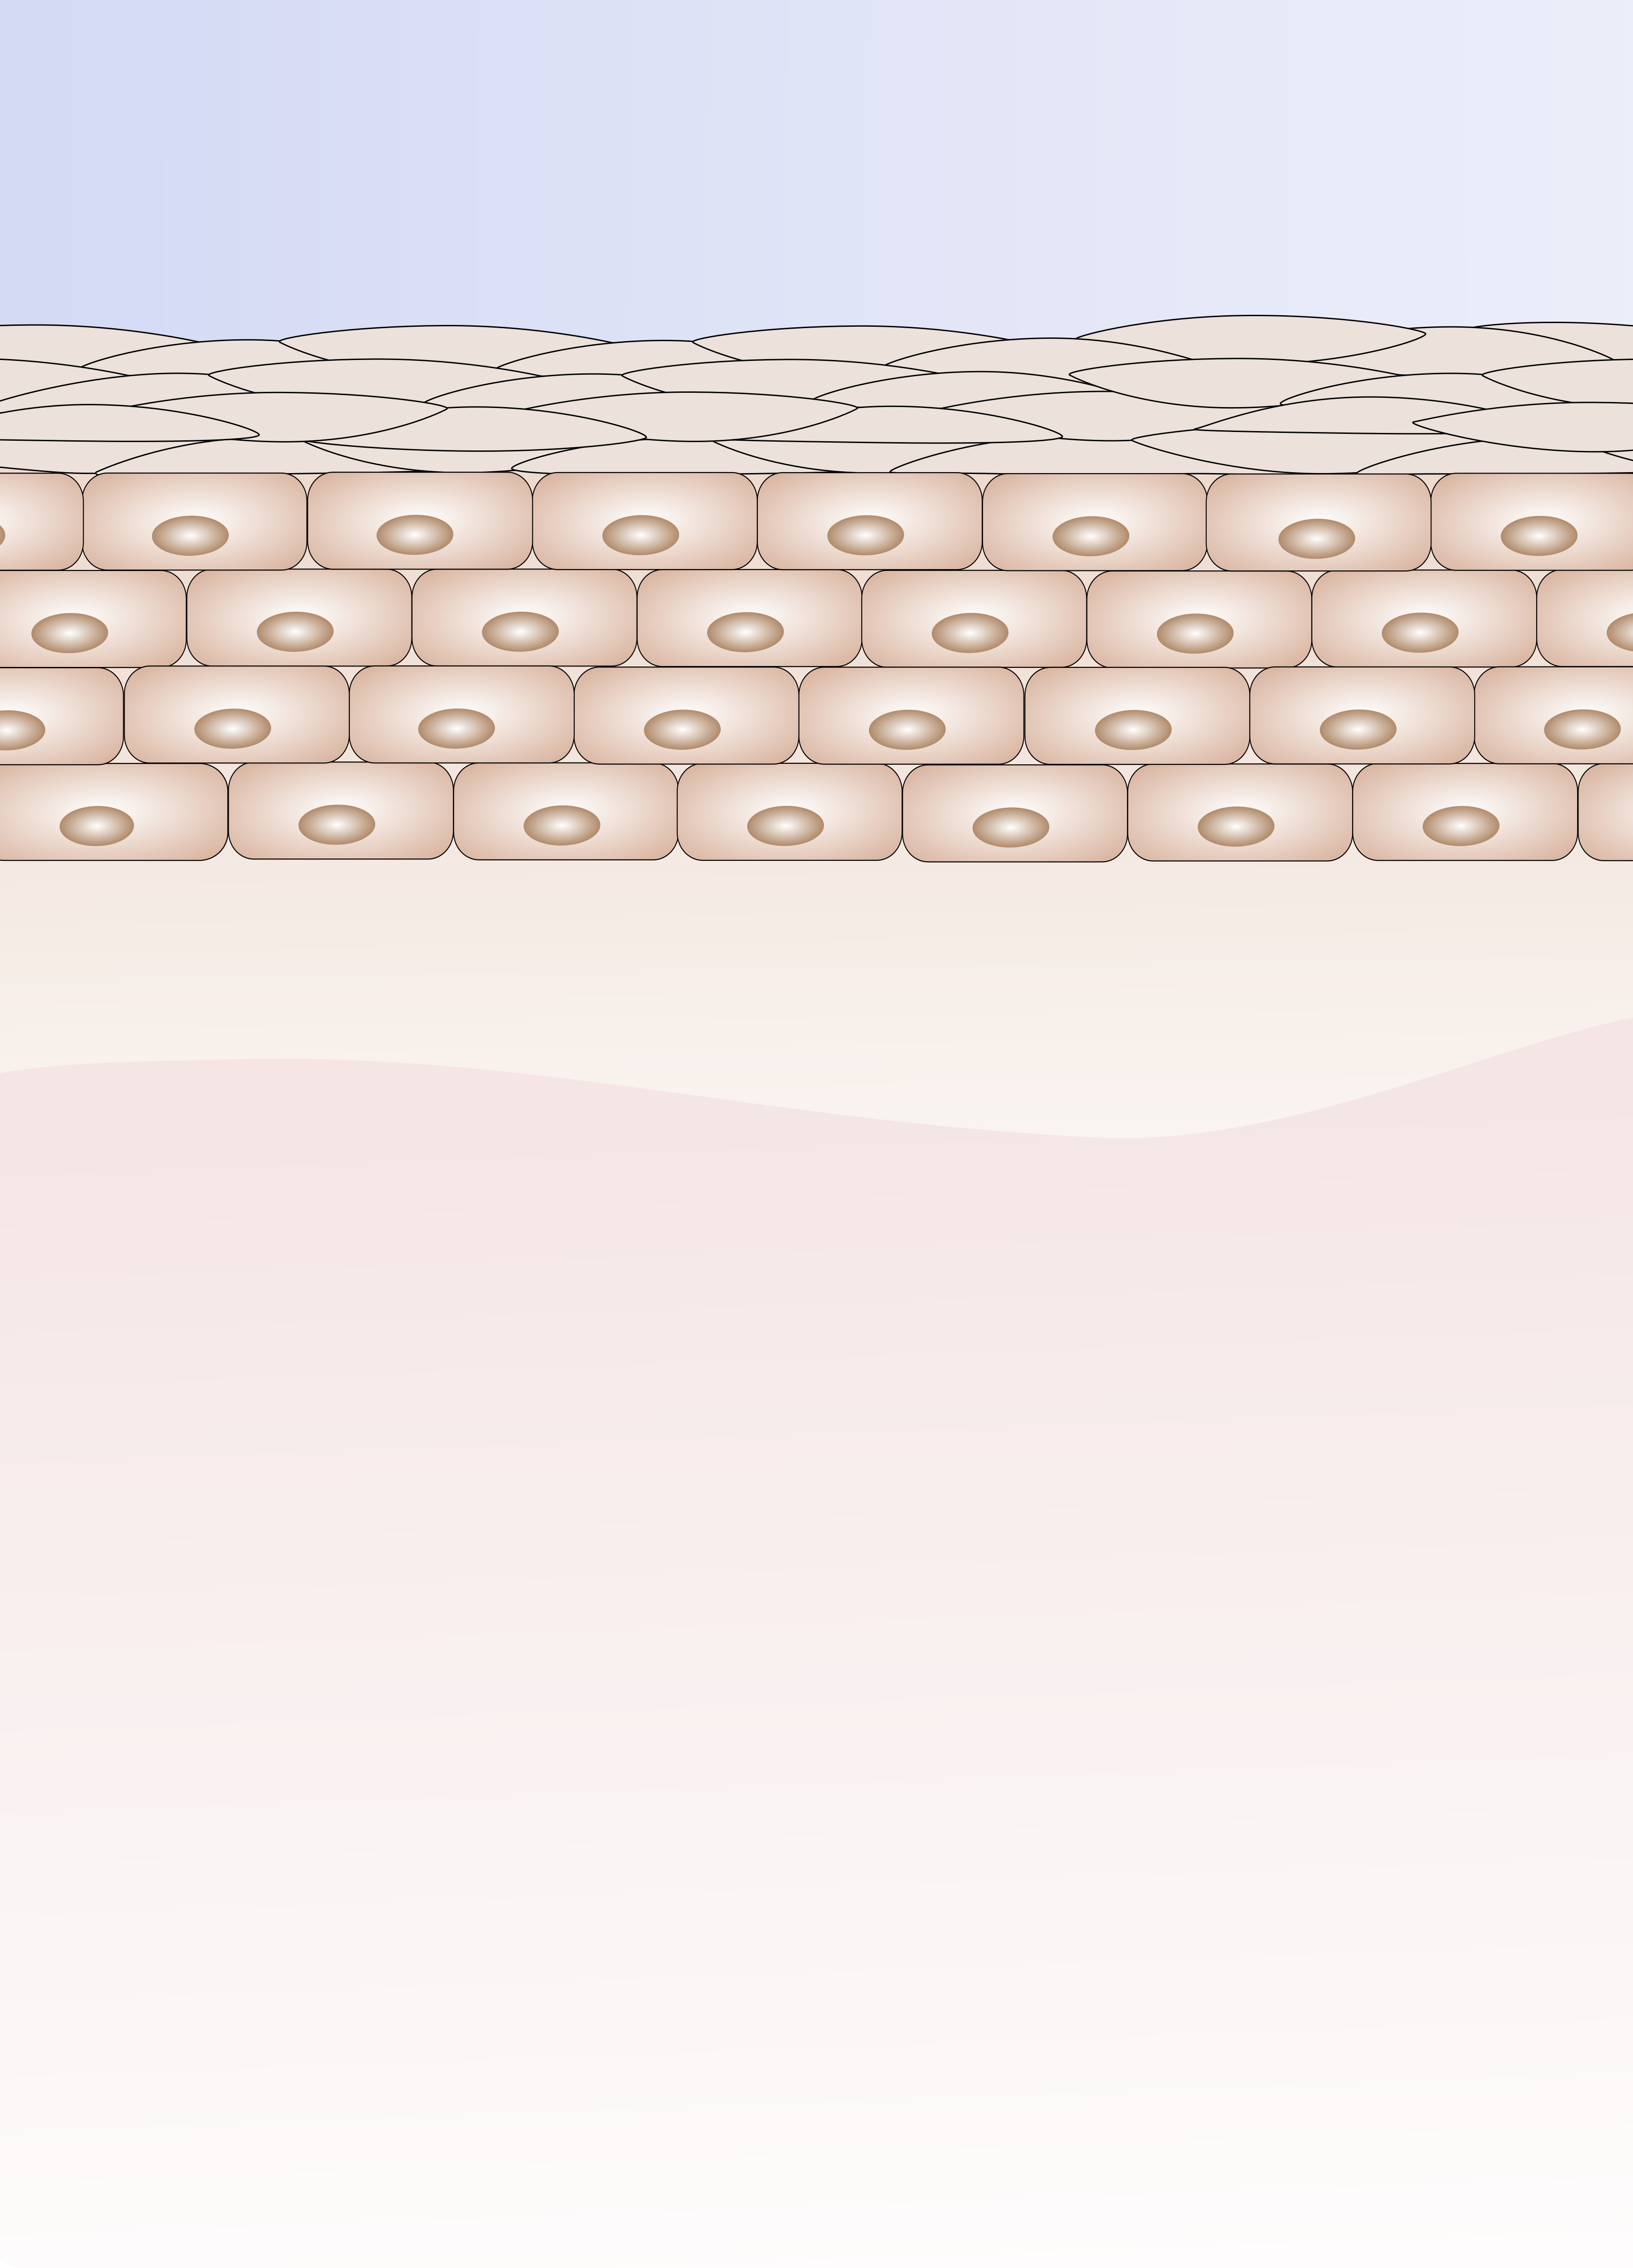
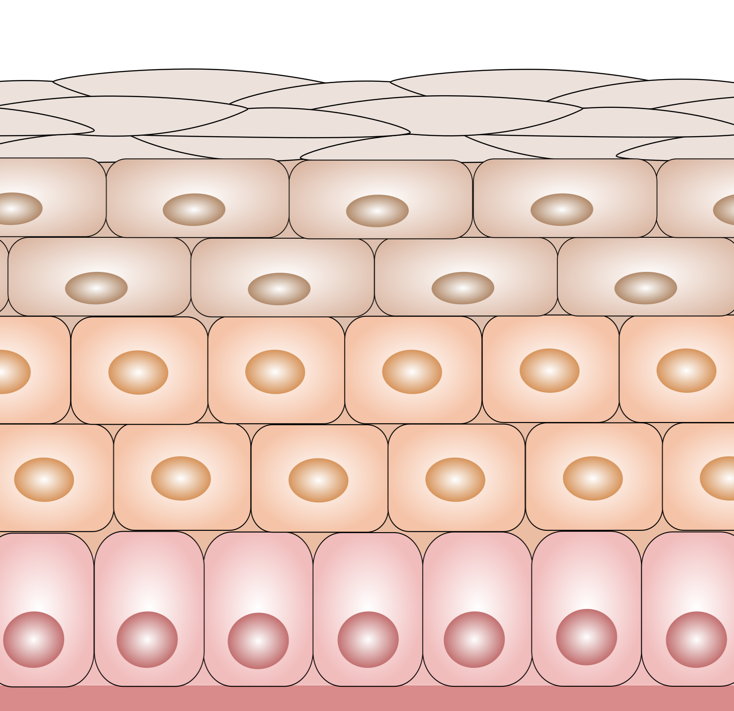
normal skin

Slide 30
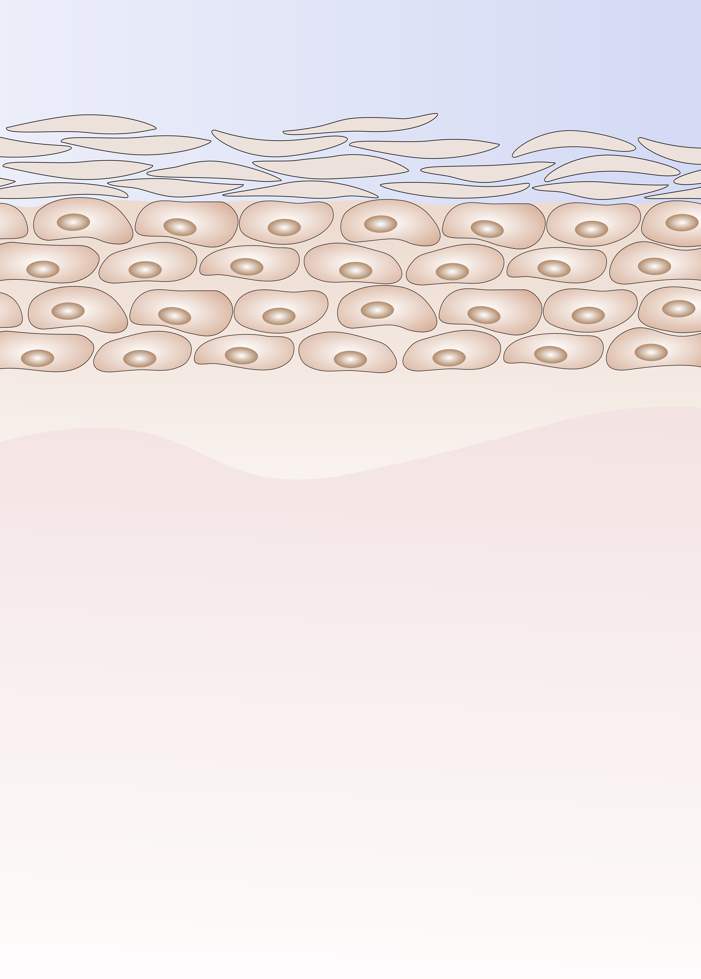
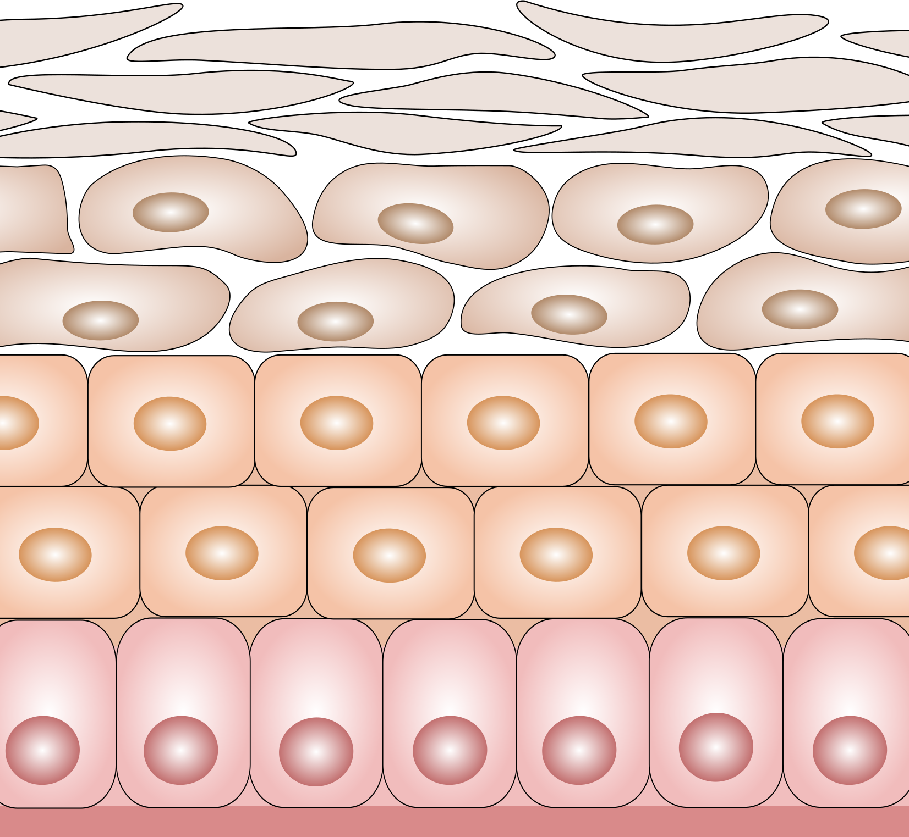
damaged skin

Slide 31
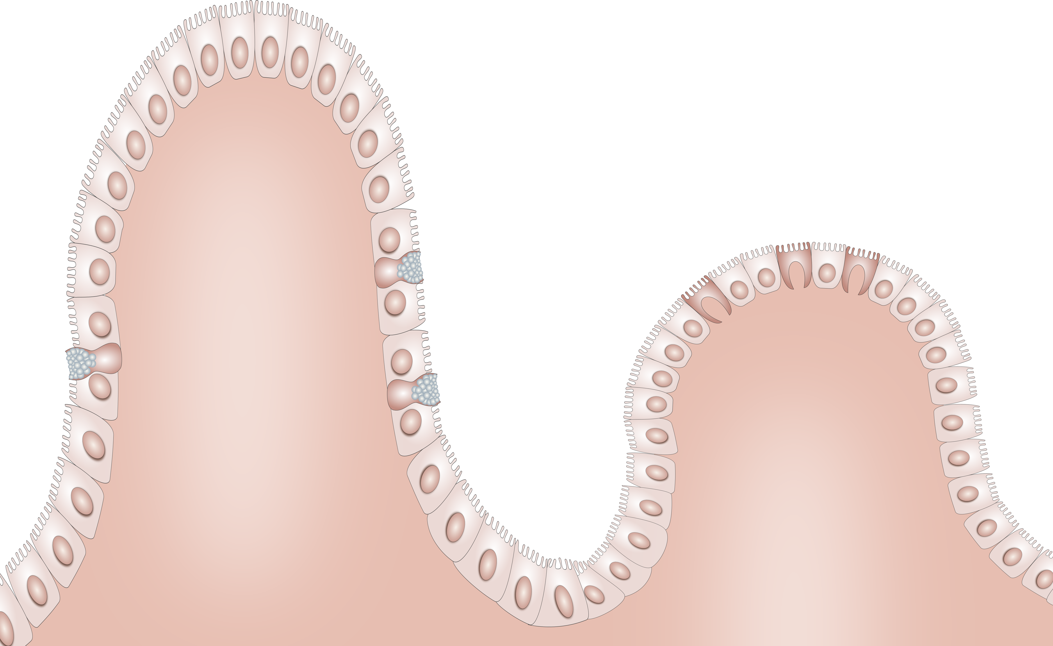
intestinal epithelium

Slide 32



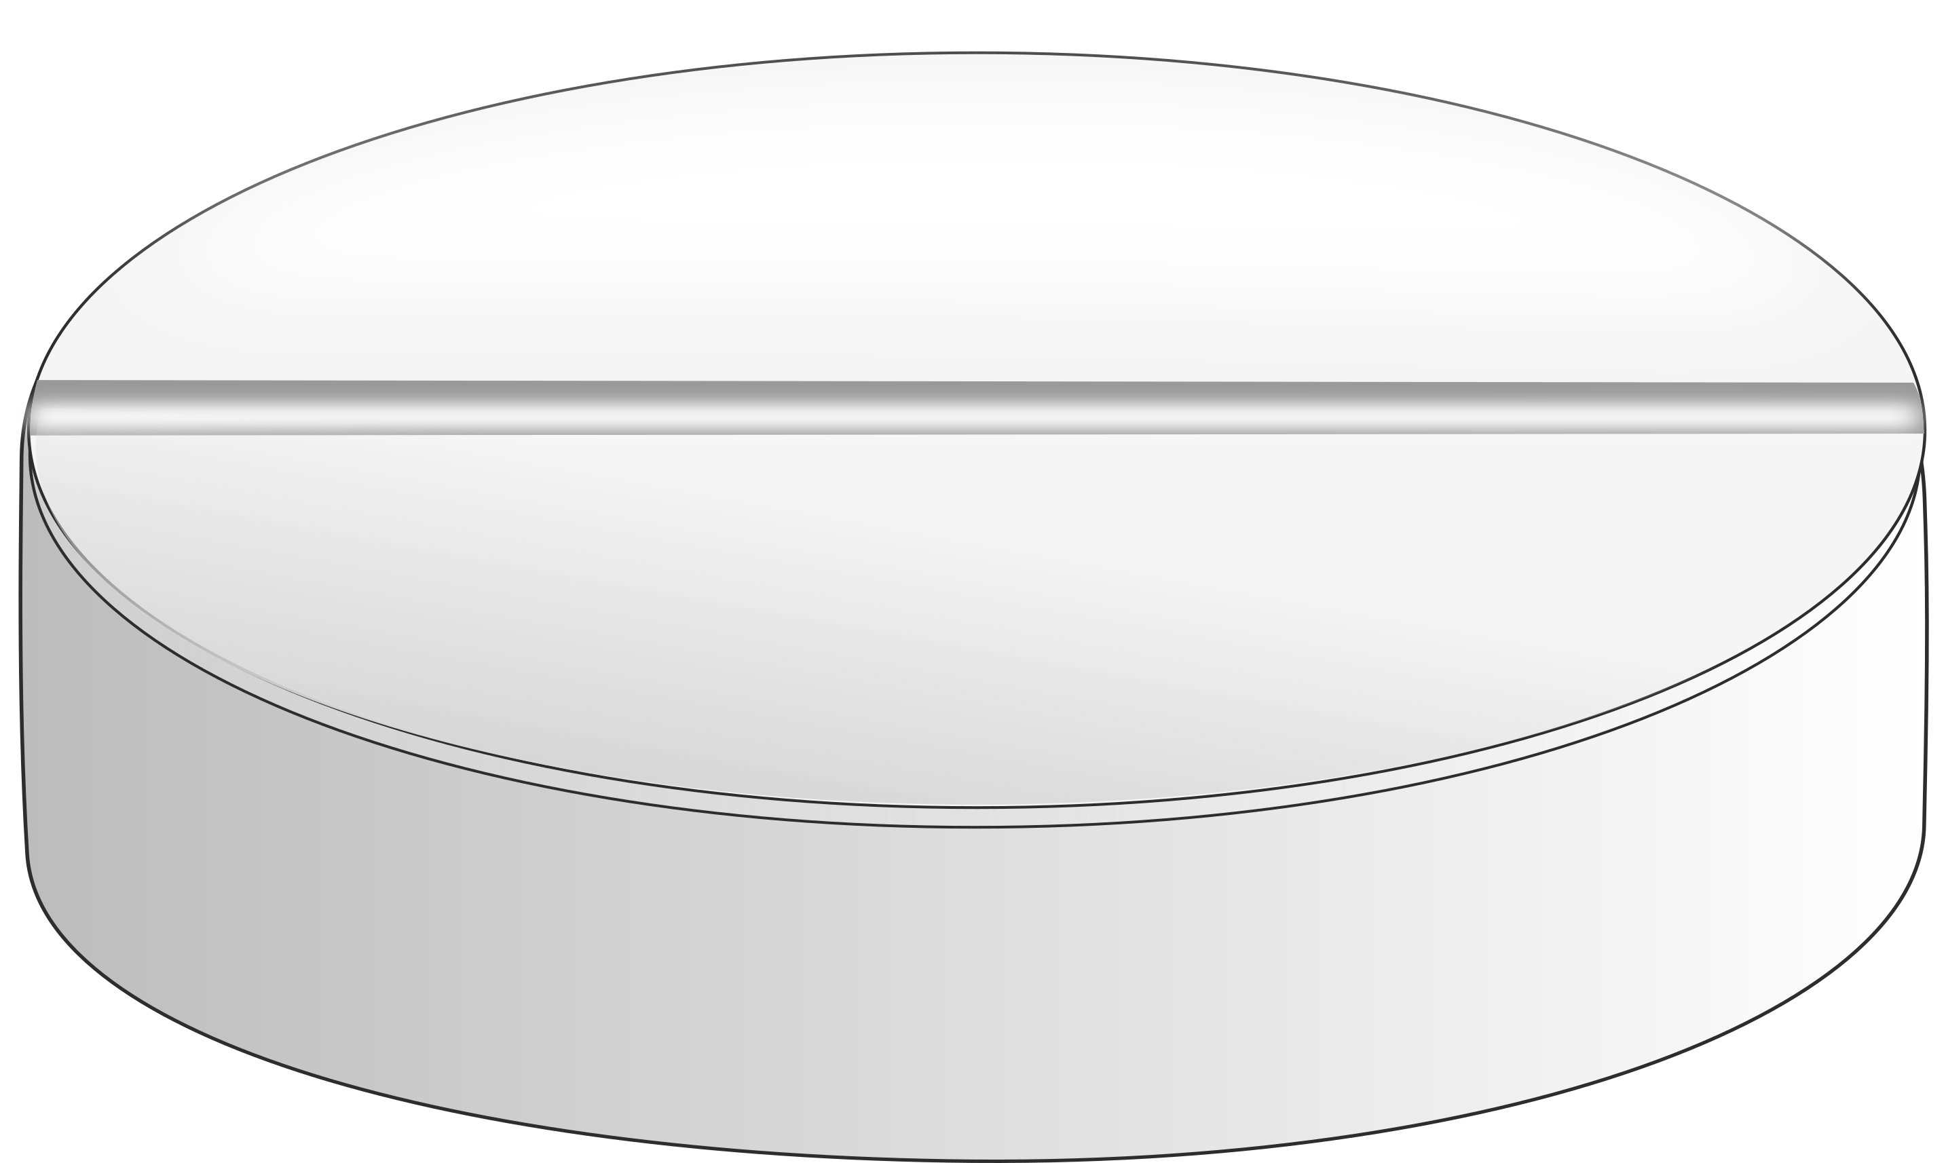
syringes pills

Slide 33



magnifier tubes

Slide 34


mobile browser

Slide 35

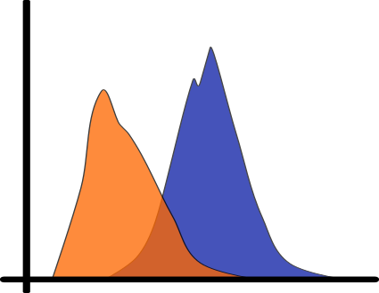

correlation flow cytometry transcriptomics

Slide 36








icons

Slide 37






icons

Slide 38

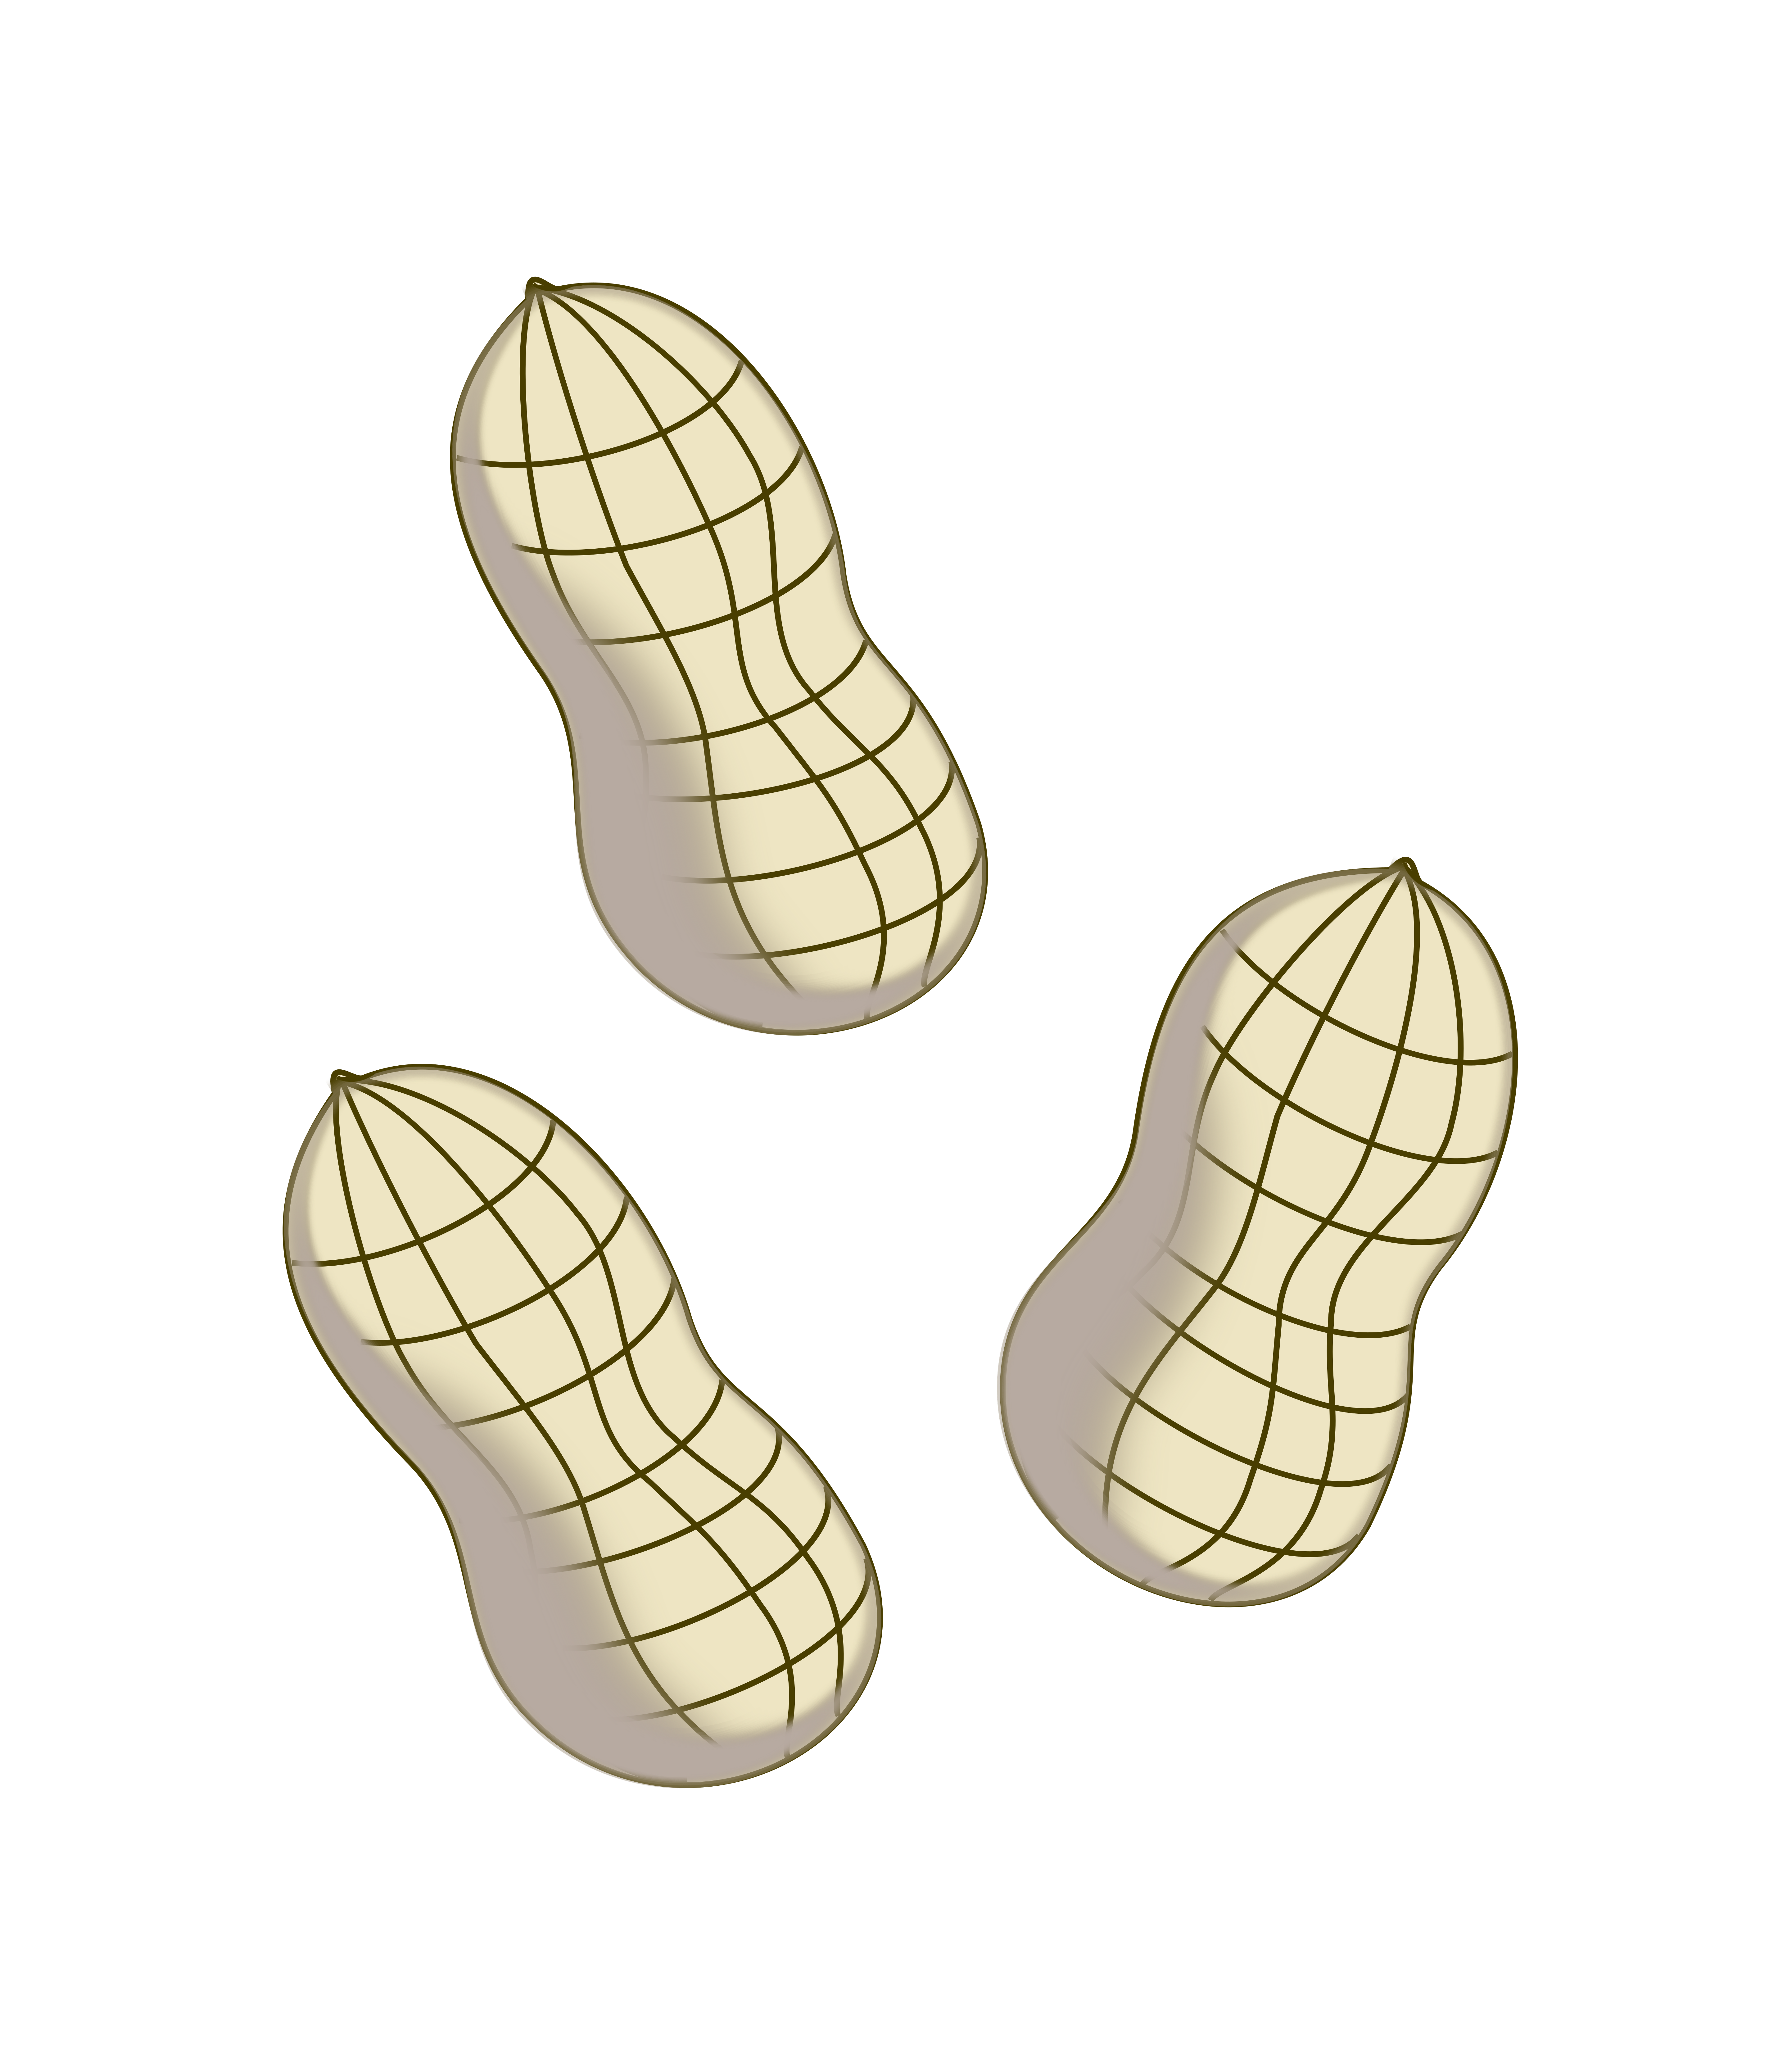


peanuts egg milk farm

Slide 39



detergent cigarette factory

Slide 40

activation inhibition downregulation upregulation

Slide 41
Did not find what you were looking for?
Please contact: allergy.graphics@siaf.uzh.ch

