Slide 1


Allergy
How to publish in high-impact journals
Cezmi Akdis
Editor-in-Chief
journalallergy.com

Slide 2


Prioritize novel and significant research
High-impact journals seek papers that…
ADDRESS
INTRODUCE
CHALLENGE
major scientific questions
innovative methodologies
existing paradigms
The study should have broad implications beyond a narrow subfield
Allergy
Allergy

Slide 3



Construct a clear, story-driven manuscript
Write the paper in the way that it tells a ‘coherent story’, guiding readers:
address
PROBLEM
FINDINGS
IMPLICATIONS
Allergy
Allergy

Slide 4
Construct a clear, story-driven manuscript
Figures and tables should convey key insights visually
Abstract should summarize the logic of the research, not just list the results
Clear and concise language is critical
Allergy
Allergy

Slide 5
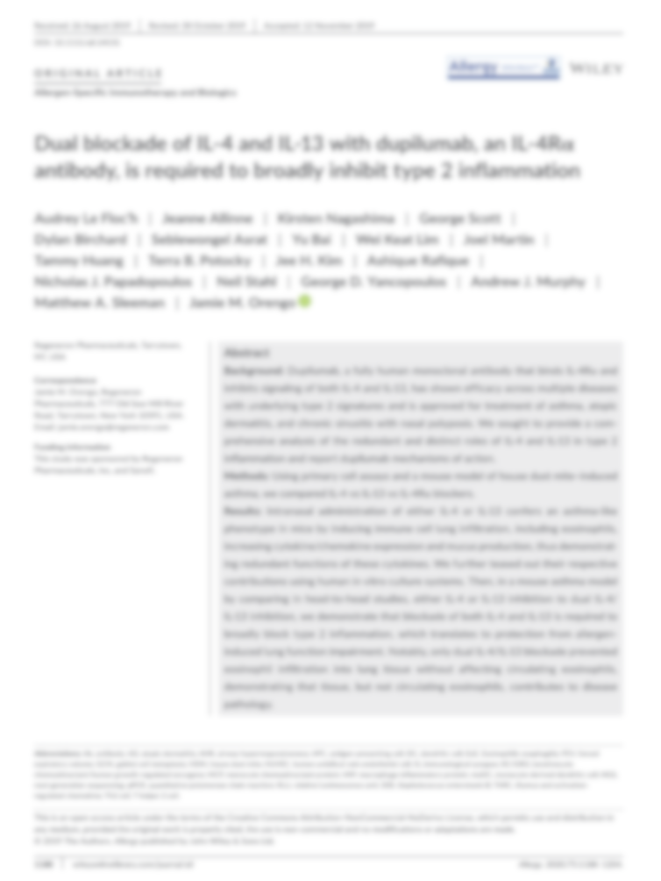

Make a strong first impression
Craft a compelling title and abstract
Emphasize novelty and importance
⏵ Why your article matters?
⏵ How it fits the journal’s aims and readership?
Cover
letter
This is often the editor’s first filer
Allergy
Allergy

Slide 6

Engage actively with the review process
If invited to revise your manuscript, respond to reviewer comment ‘point-by-point’, with evidence and reasoned arguments.
Being respectful and thorough in your revisions can significantly increase acceptance odds.
Allergy
Allergy

Slide 7

Build visibility and credibility
Enhance your scientific profile through collaborations, international society working groups, networks, press releases, and conference presence.
Editors usually support highly credible groups
Allergy
Allergy

Slide 8

Use pre-submission tools and editorial insights
For many high journals, a ’pre-submission inquiry’ allows authors to gauge editorial interest before full submission - saving time and effort while refining focus according to editor feedback.
Allergy
Allergy

Slide 9
Being a good reviewer makes you a good scientist and an author
If you review good papers, you become a good author, you can publish high-impact journal papers
Journal Clubs are an essential part of your education
Allergy
Allergy

Slide 10

Suitability of your paper for a high-impact journal
Is the topic relevant to the scope of the journal?
Is the topic timely?
Is the topic significant?
Is the study unique?
What is the level of evidence for major findings?
Are the findings relevant to in vivo and disease conditions?
Ω
Ω
Allergy
Allergy

Slide 11

GENERAL POINTS: Is the study of good quality
Does it have proper ethical guarantees?
Are the methods and their reproducibility stated clearly?
Are the methods suitable for the problem being investigated?
Are there enough numbers of patients/experiments to draw clear conclusions?
Answer these questions and try to make your research and paper a good quality one
Allergy
Allergy

Slide 12

GENERAL POINTS: Is there a clear hypothesis/aim?
This should be stated in the abstract
Justified in the introduction
Established before results are mentioned
Investigated with suitable methods
Allergy
Allergy

Slide 13

QUESTIONS TO ADDRESS: Methods
Technical aspects
Are the methods correctly described and performed?
Are the number of subjects/experiments sufficient?
Are appropriate positive/negative/disease/tissue controls used?
Is the methodology used up-to-date?
Are the main findings supported by other methods?
Is there any risk that impure or contaminated reagents have been used?
Is the dose of reagents and time of analysis appropriate?
Allergy
Allergy

Slide 14

QUESTIONS TO ADDRESS: Methods
Statistics
Are the correct analyses, tests used?
Are the test results accurately interpreted?
Is the statistical analysis clearly presented?
Is an expert consulted for sophisticated tests?
Should the reviewer suggest having a biostatistics expert review the manuscript?
Big data era has started and good statistics will be eternally important
Allergy
Allergy

Slide 15

DATA PRESENTATION: Tables and Figures
Is the decision to use either a table or graph correct?
If a graph is used, is the type of the selected graph correct?
Is the data presentation accurate and well-structured?
Do the numbers add up, if total number is known or percentage is used?
Are the data consistent with the body of the paper?
Allergy
Allergy

Slide 16
DATA PRESENTATION: Tables and Figures
Are the tables and figures clearly labelled?
Is there any missing or duplicate information?
Are the numbers of tables and figures within the limits of the journal?
Are the number of study samples and ‘n’ matching and differences reasonably explained?
Are conclusions from the shown data consistent?
Allergy
Allergy

Slide 17
DATA PRESENTATION: Tables and Figures
Is original data shown (flow cytometry, western blots, immune histology) instead of bar graphs?
Are all the shown data necessary to be kept in the original text?
Are the controls clearly presented?
Is the Online repository efficiently used?
Allergy
Allergy

Slide 18

QUESTIONS TO ADDRESS: Discussion
Is the discussion relevant and focused?
Is the study discussed against the background of current knowledge?
Do the references appear correctly cited and accurate?
Are uncertainties, limitations of the study and biases discussed?
Is there a clear clinical or scientific message?
Could the discussion (or any other section) be shorter?
Allergy
Allergy

Slide 19

Degree of novelty and scientific integrity
Cross Check / Scopus will help you!
Check for similar articles in Medline (Knowledge Finder, etc.)
Cross reference (check for title, senior author search)
Use the institutional resources available to alert for possible duplicate publication/plagiarism
Allergy
Allergy

Slide 20

Good cover letter
Explain the editors, why your study is important and should be published in a high-impact journal.
What are the novelties, methods, study population, drug, study size?
What is the in vivo relevance?
Will it change the daily practice?
Will it develop a new hypothesis?
Is it transdisciplinary?
Allergy
Allergy

Slide 21

LAST STEP: Re-read the manuscript
Is the manuscript content conveyed accurately?
Look for missing important data, overinterpretations, misinterpretations
Usually 6-7 drafts are necessary
Allergy
Allergy

Slide 22

SECTION: Confidential comments to the Editor
Please feel free to mention any issue related to the publication of the manuscript:
Ethical issues
Bias issues
Uncertainties of reviewer
Other ‘private’ concerns
Additional justifications for decision/scoring
Confidence in validity, reliability
Issues to be re-reviewed in case of a major revision
Allergy
Allergy

Slide 23

Re-revision of the revised manuscript
Review all new experiments and newly included parts in detail, as if it is the first revision
Are all the suggested experiments performed or appropriate answers given to justify the reason why they are not performed in the point-by-point reply?
Is the newly included data coherent with the message of the main manuscript, is it appropriately presented and discussed?
Allergy
Allergy

Slide 24
Summary
To publish in a high-impact scientific journal, a researcher must produce outstanding, novel, and methodologically rigorous work while mastering the art of scientific storytelling, journal alignment, and should have professional communication with editors and reviewers
Allergy
Allergy

