Slide 1
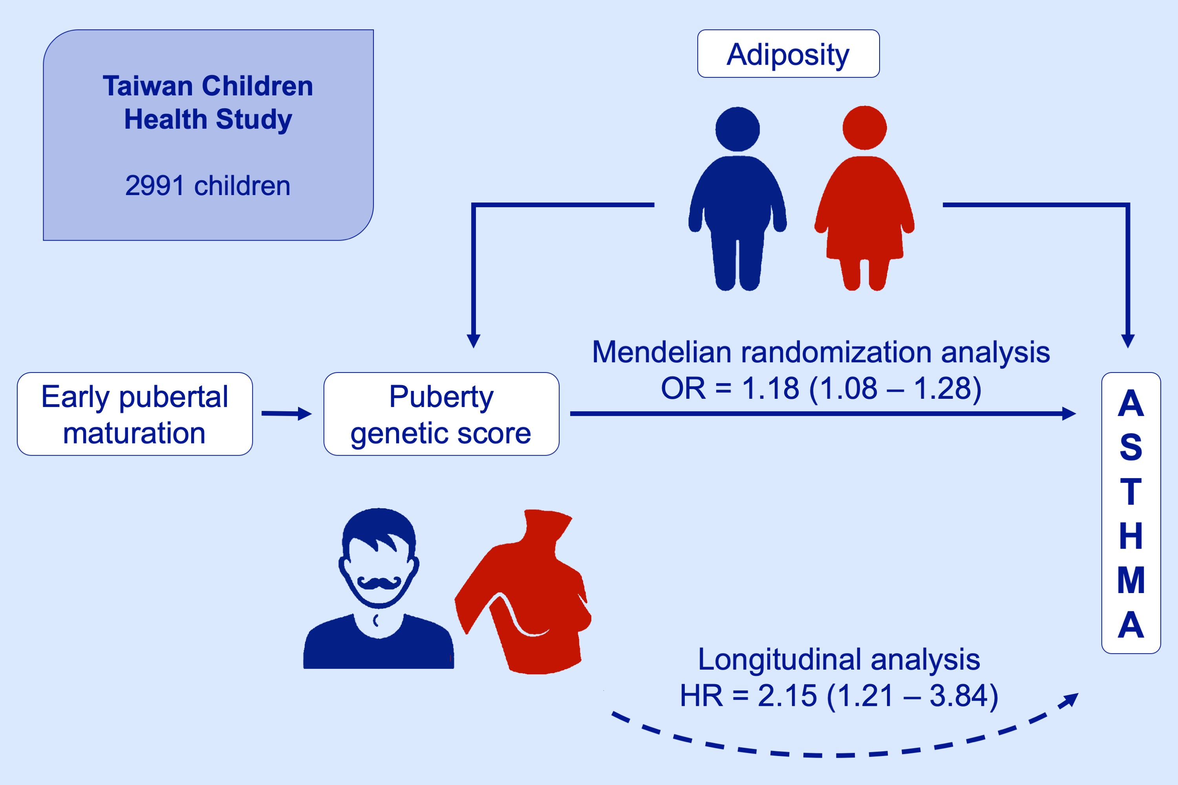
Early pubertal maturation and risk of childhood asthma: A Mendelian randomization and longitudinal study
Yang‐Ching Chen, Hsien‐Yu Fan, Chen Yang, Yungling L. Lee
Allergy. 2020; 892-900 https://doi.org/10.1111/all.14009
© 2019 EAACI and John Wiley and Sons A/S. Published by John Wiley and Sons Ltd.
Notes:
HIGHLIGHTS
•
•
•
ABBREVIATIONS

