Slide 1
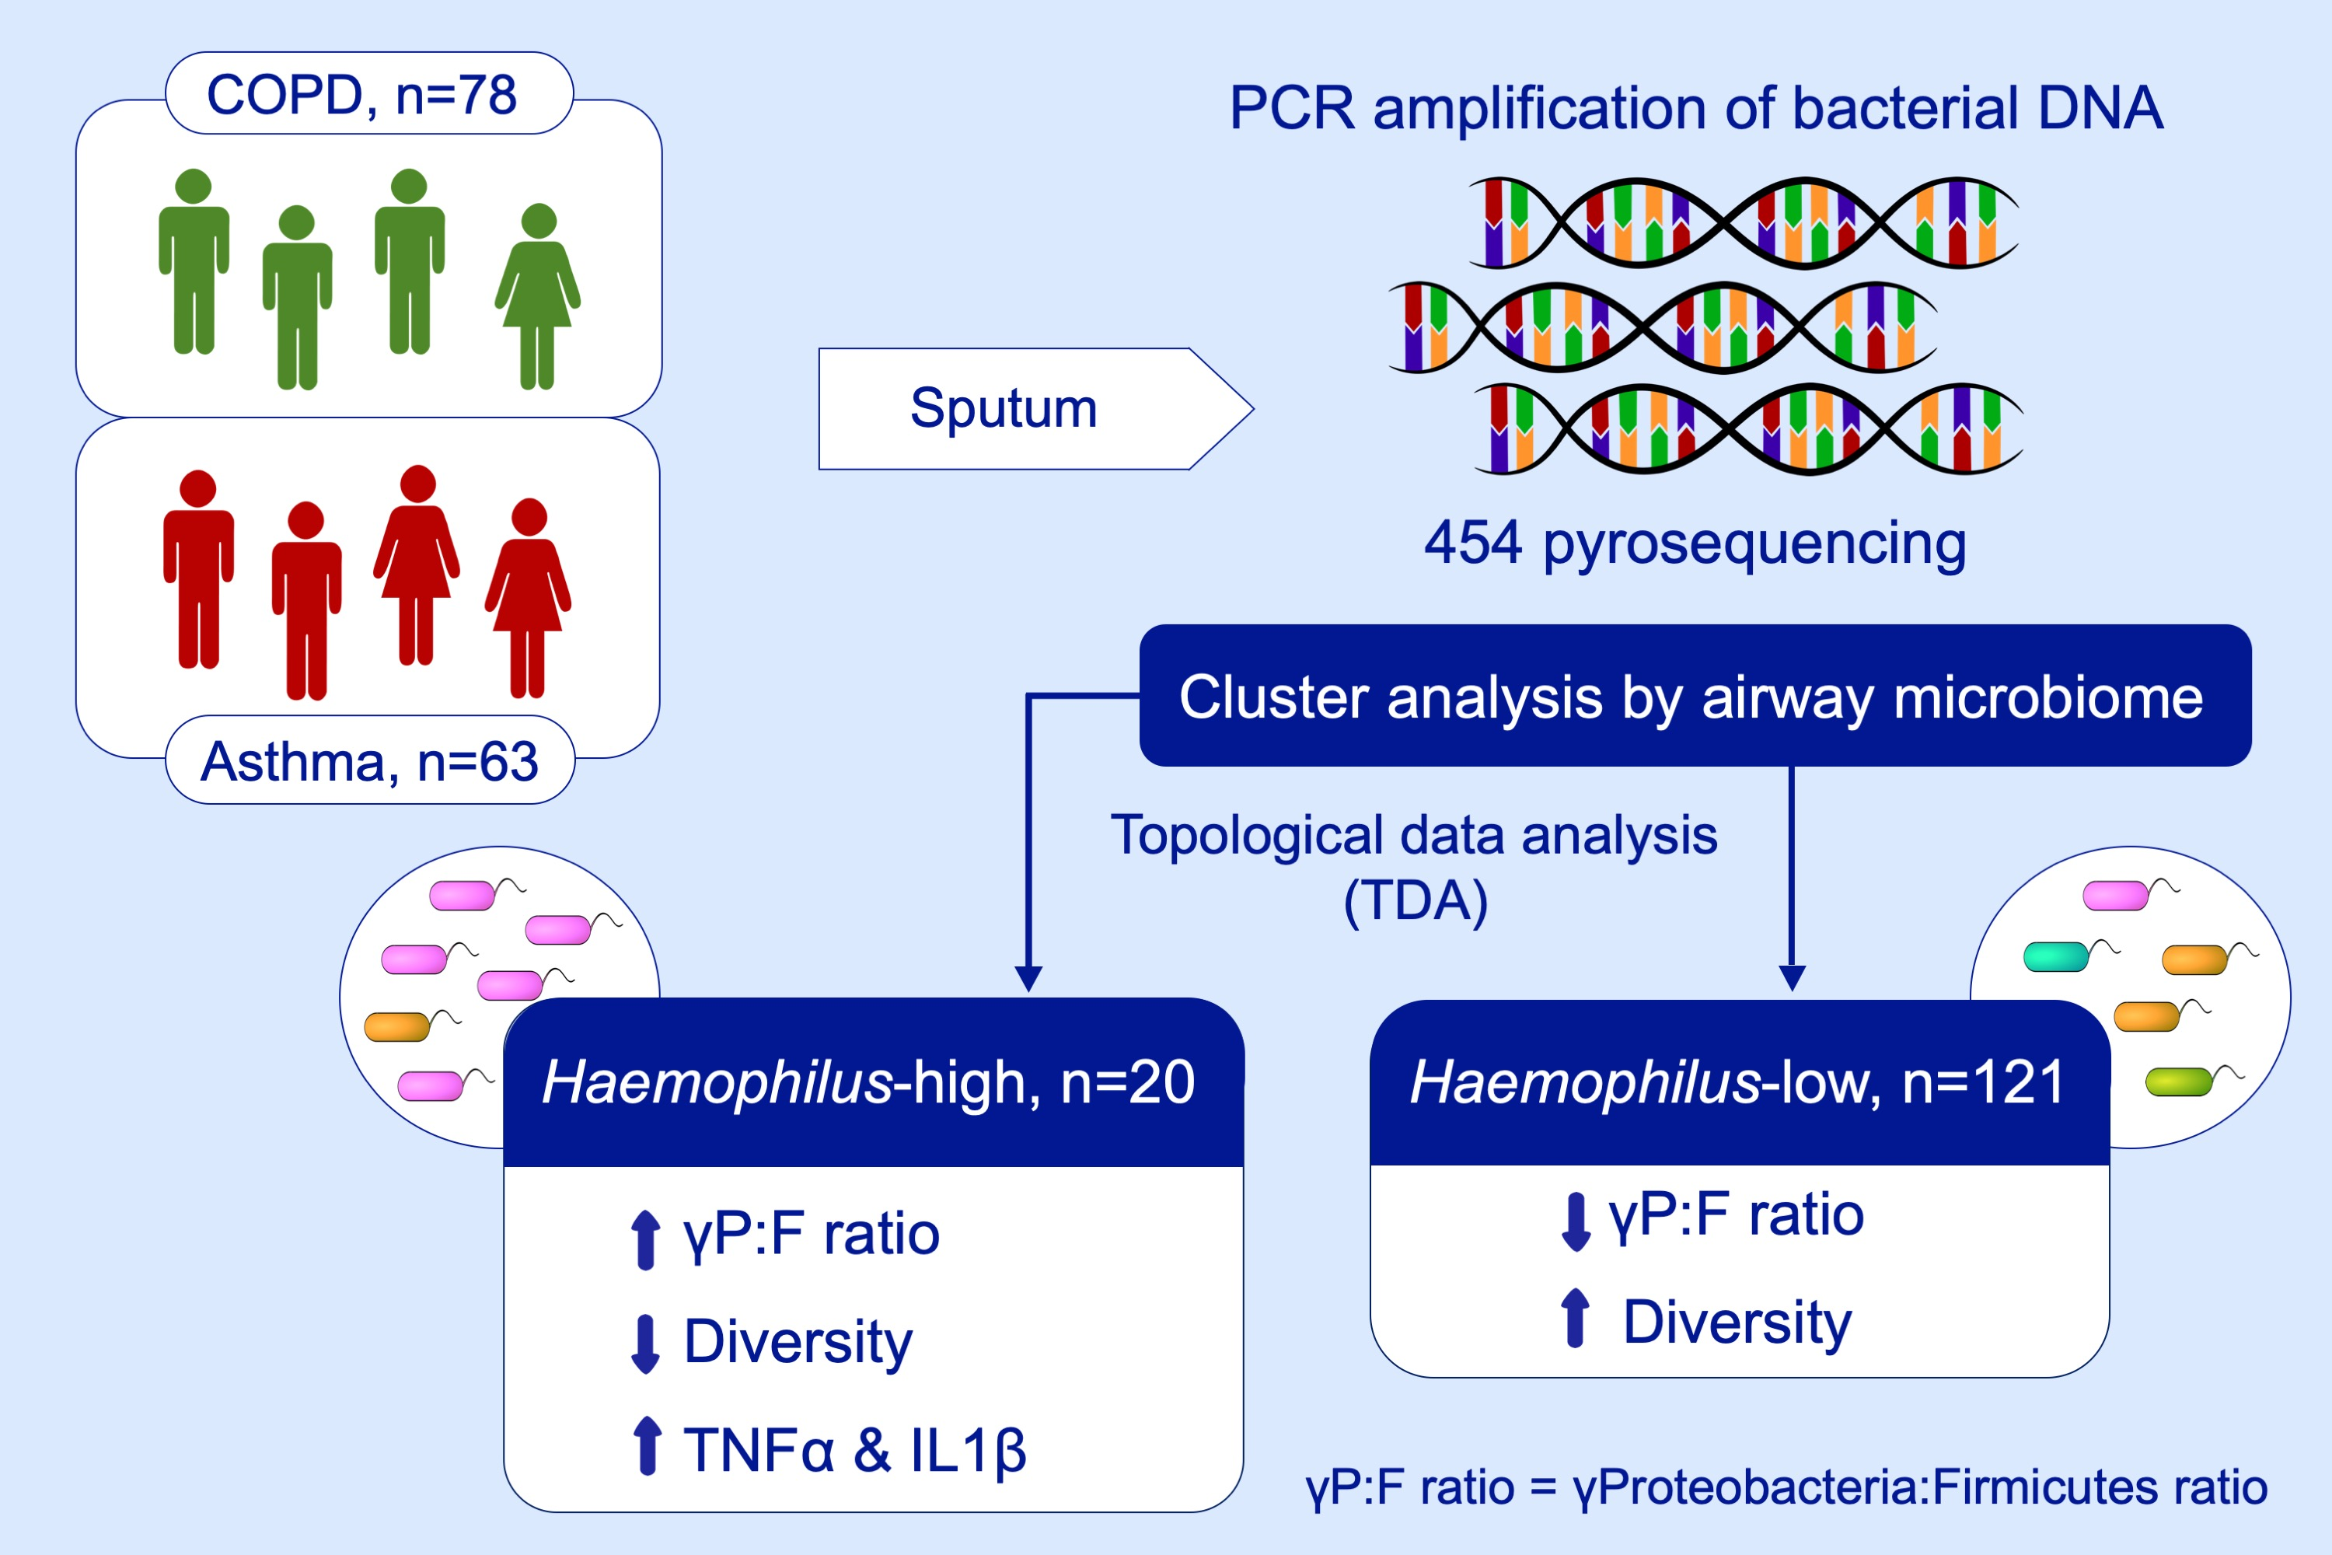
Sputum microbiomic clustering in asthma and chronic obstructive pulmonary disease reveals a Haemophilus ‐predominant subgroup
Sarah Diver, Matt Richardson, Koirobi Haldar, Michael A. Ghebre, Mohammadali Y. Ramsheh, et al.
Allergy. 2020; 808-817 https://doi.org/10.1111/all.14058
© 2019 EAACI and John Wiley and Sons A/S. Published by John Wiley and Sons Ltd.
Notes:
HIGHLIGHTS
•
•
•
ABBREVIATIONS

