Slide 1
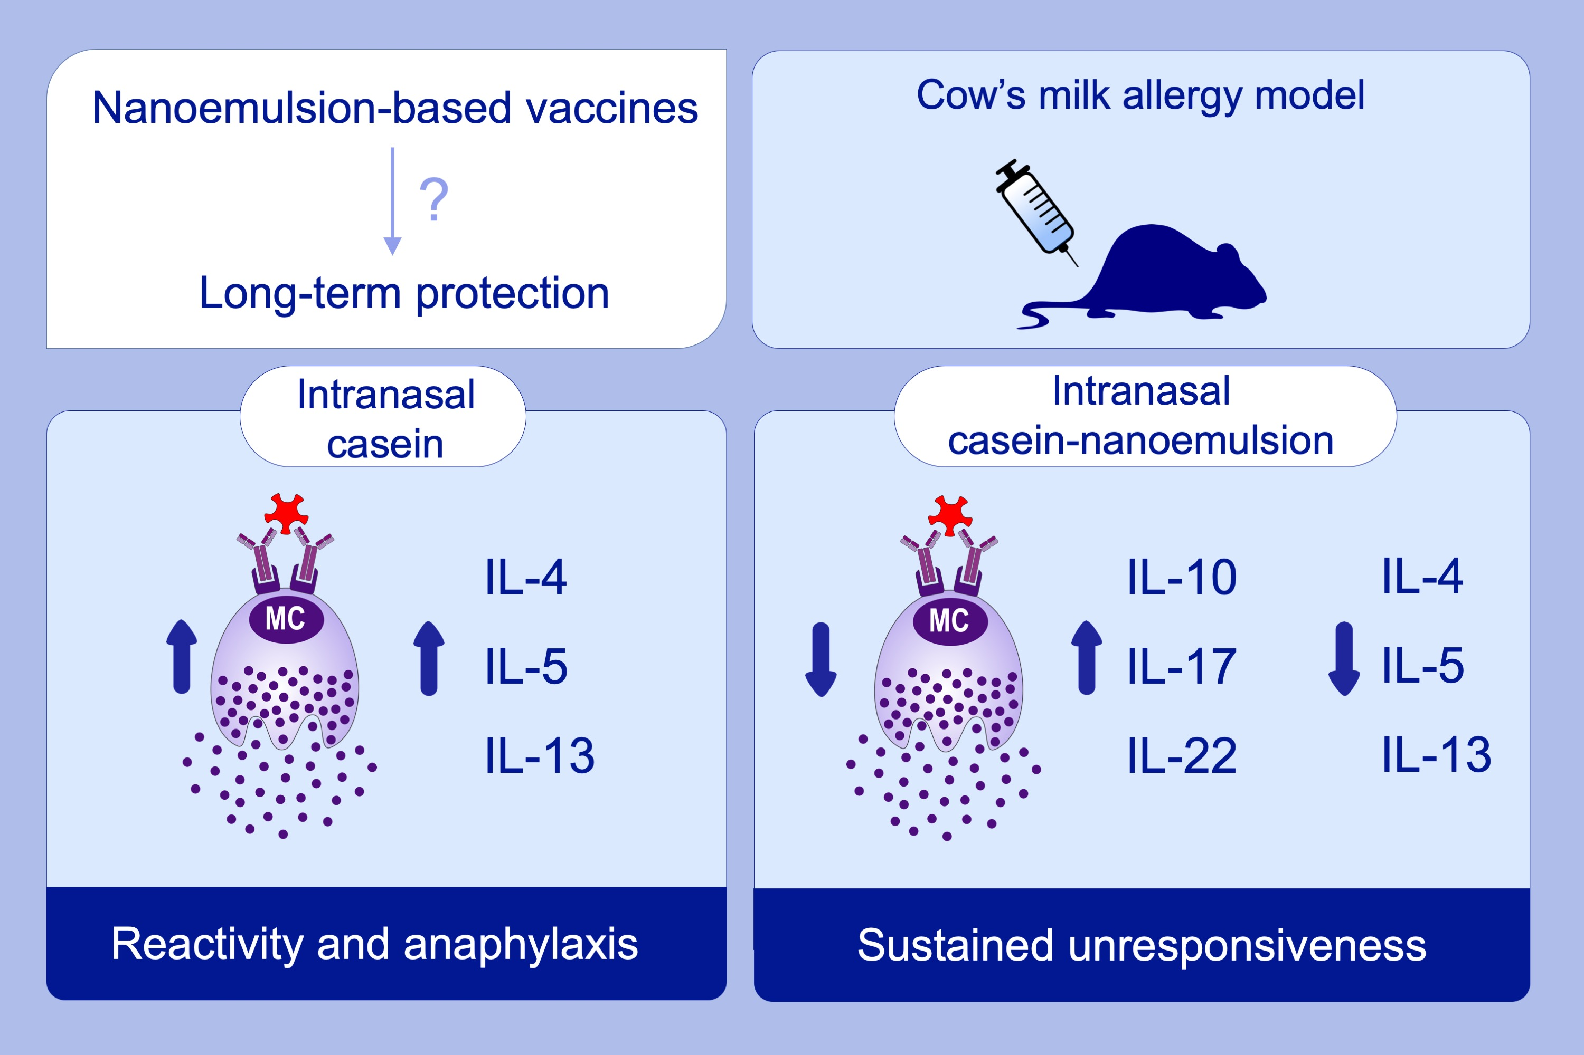
Intranasal nanoemulsion vaccine confers long‐lasting immunomodulation and sustained unresponsiveness in a murine model of milk allergy
Jessica J. O'Konek, Jeffrey J. Landers, Katarzyna W. Janczak, Hayley K. Lindsey, Anna M. Mondrusov, et al.
Allergy. 2020; 872-881 https://doi.org/10.1111/all.14064
© 2019 EAACI and John Wiley and Sons A/S. Published by John Wiley and Sons Ltd.
Notes:
HIGHLIGHTS
•
•
•
ABBREVIATIONS

