Slide 1
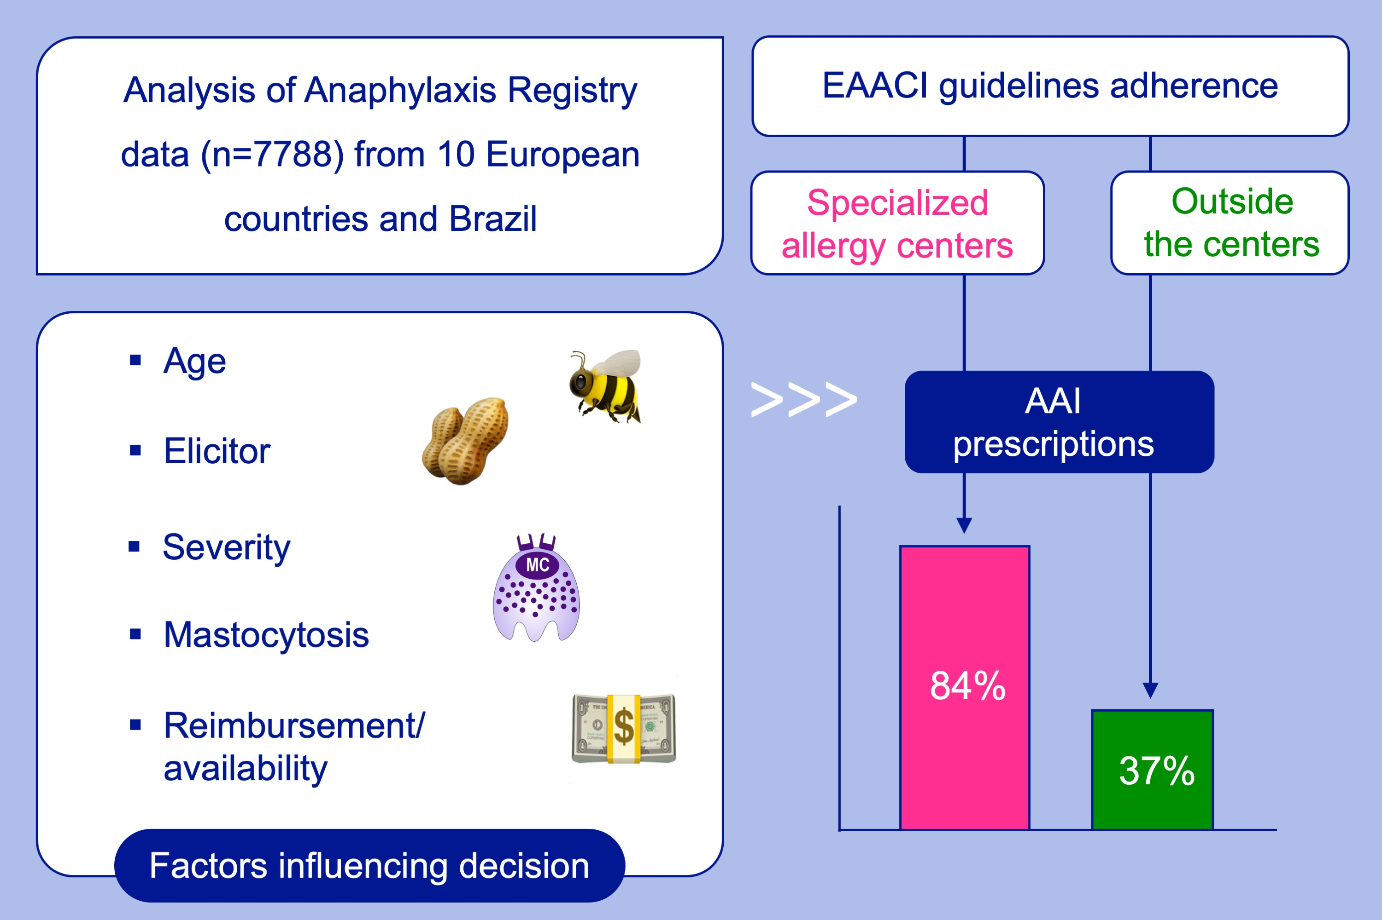
Secondary prevention measures in anaphylaxis patients: Data from the anaphylaxis registry
Magdalena Kraft, Macarena Pia Knop, Jean‐Marie Renaudin, Kathrin Scherer Hofmeier, Claudia Pföhler, et al.
Allergy. 2020; 901-910 https://doi.org/10.1111/all.14069
© 2019 EAACI and John Wiley and Sons A/S. Published by John Wiley and Sons Ltd.
Notes:
HIGHLIGHTS
•
•
•
ABBREVIATIONS

