Slide 1
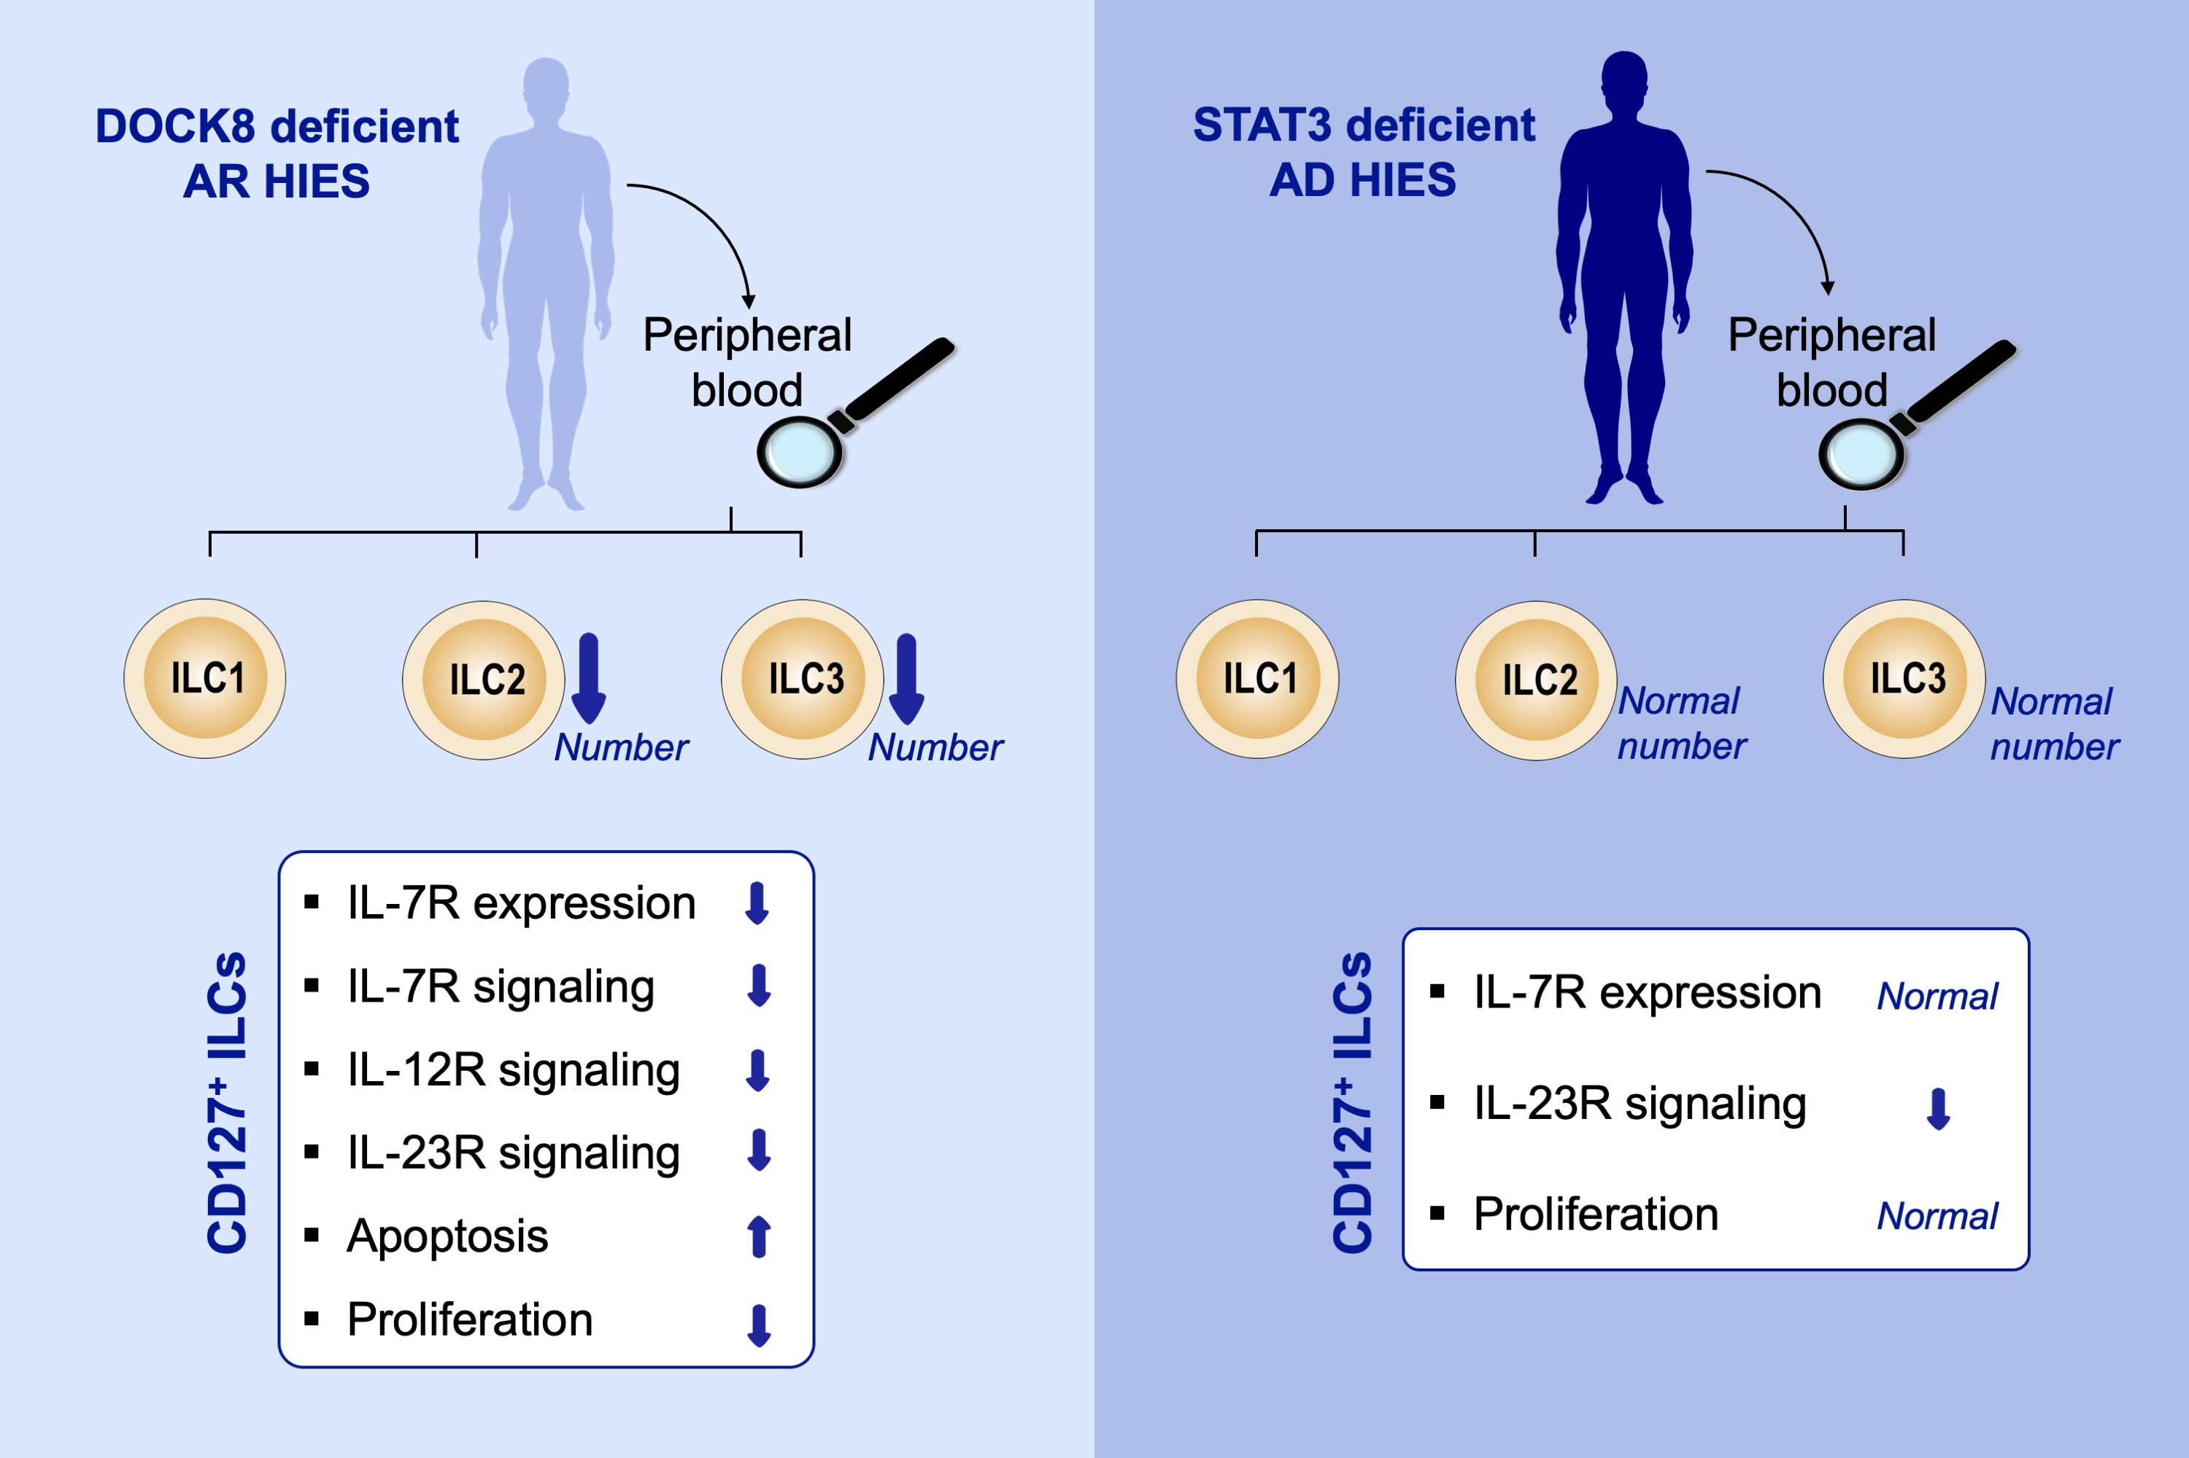
ILC3 deficiency and generalized ILC abnormalities in DOCK8‐deficient patients
Ahmet Eken, Murat Cansever, Fatma Zehra Okus, Serife Erdem, Ercan Nain, et al.
Allergy. 2020; 921-932 https://doi.org/10.1111/all.14081
© 2019 EAACI and John Wiley and Sons A/S. Published by John Wiley and Sons Ltd.
Notes:
HIGHLIGHTS
•
•
•
ABBREVIATIONS

