Slide 1
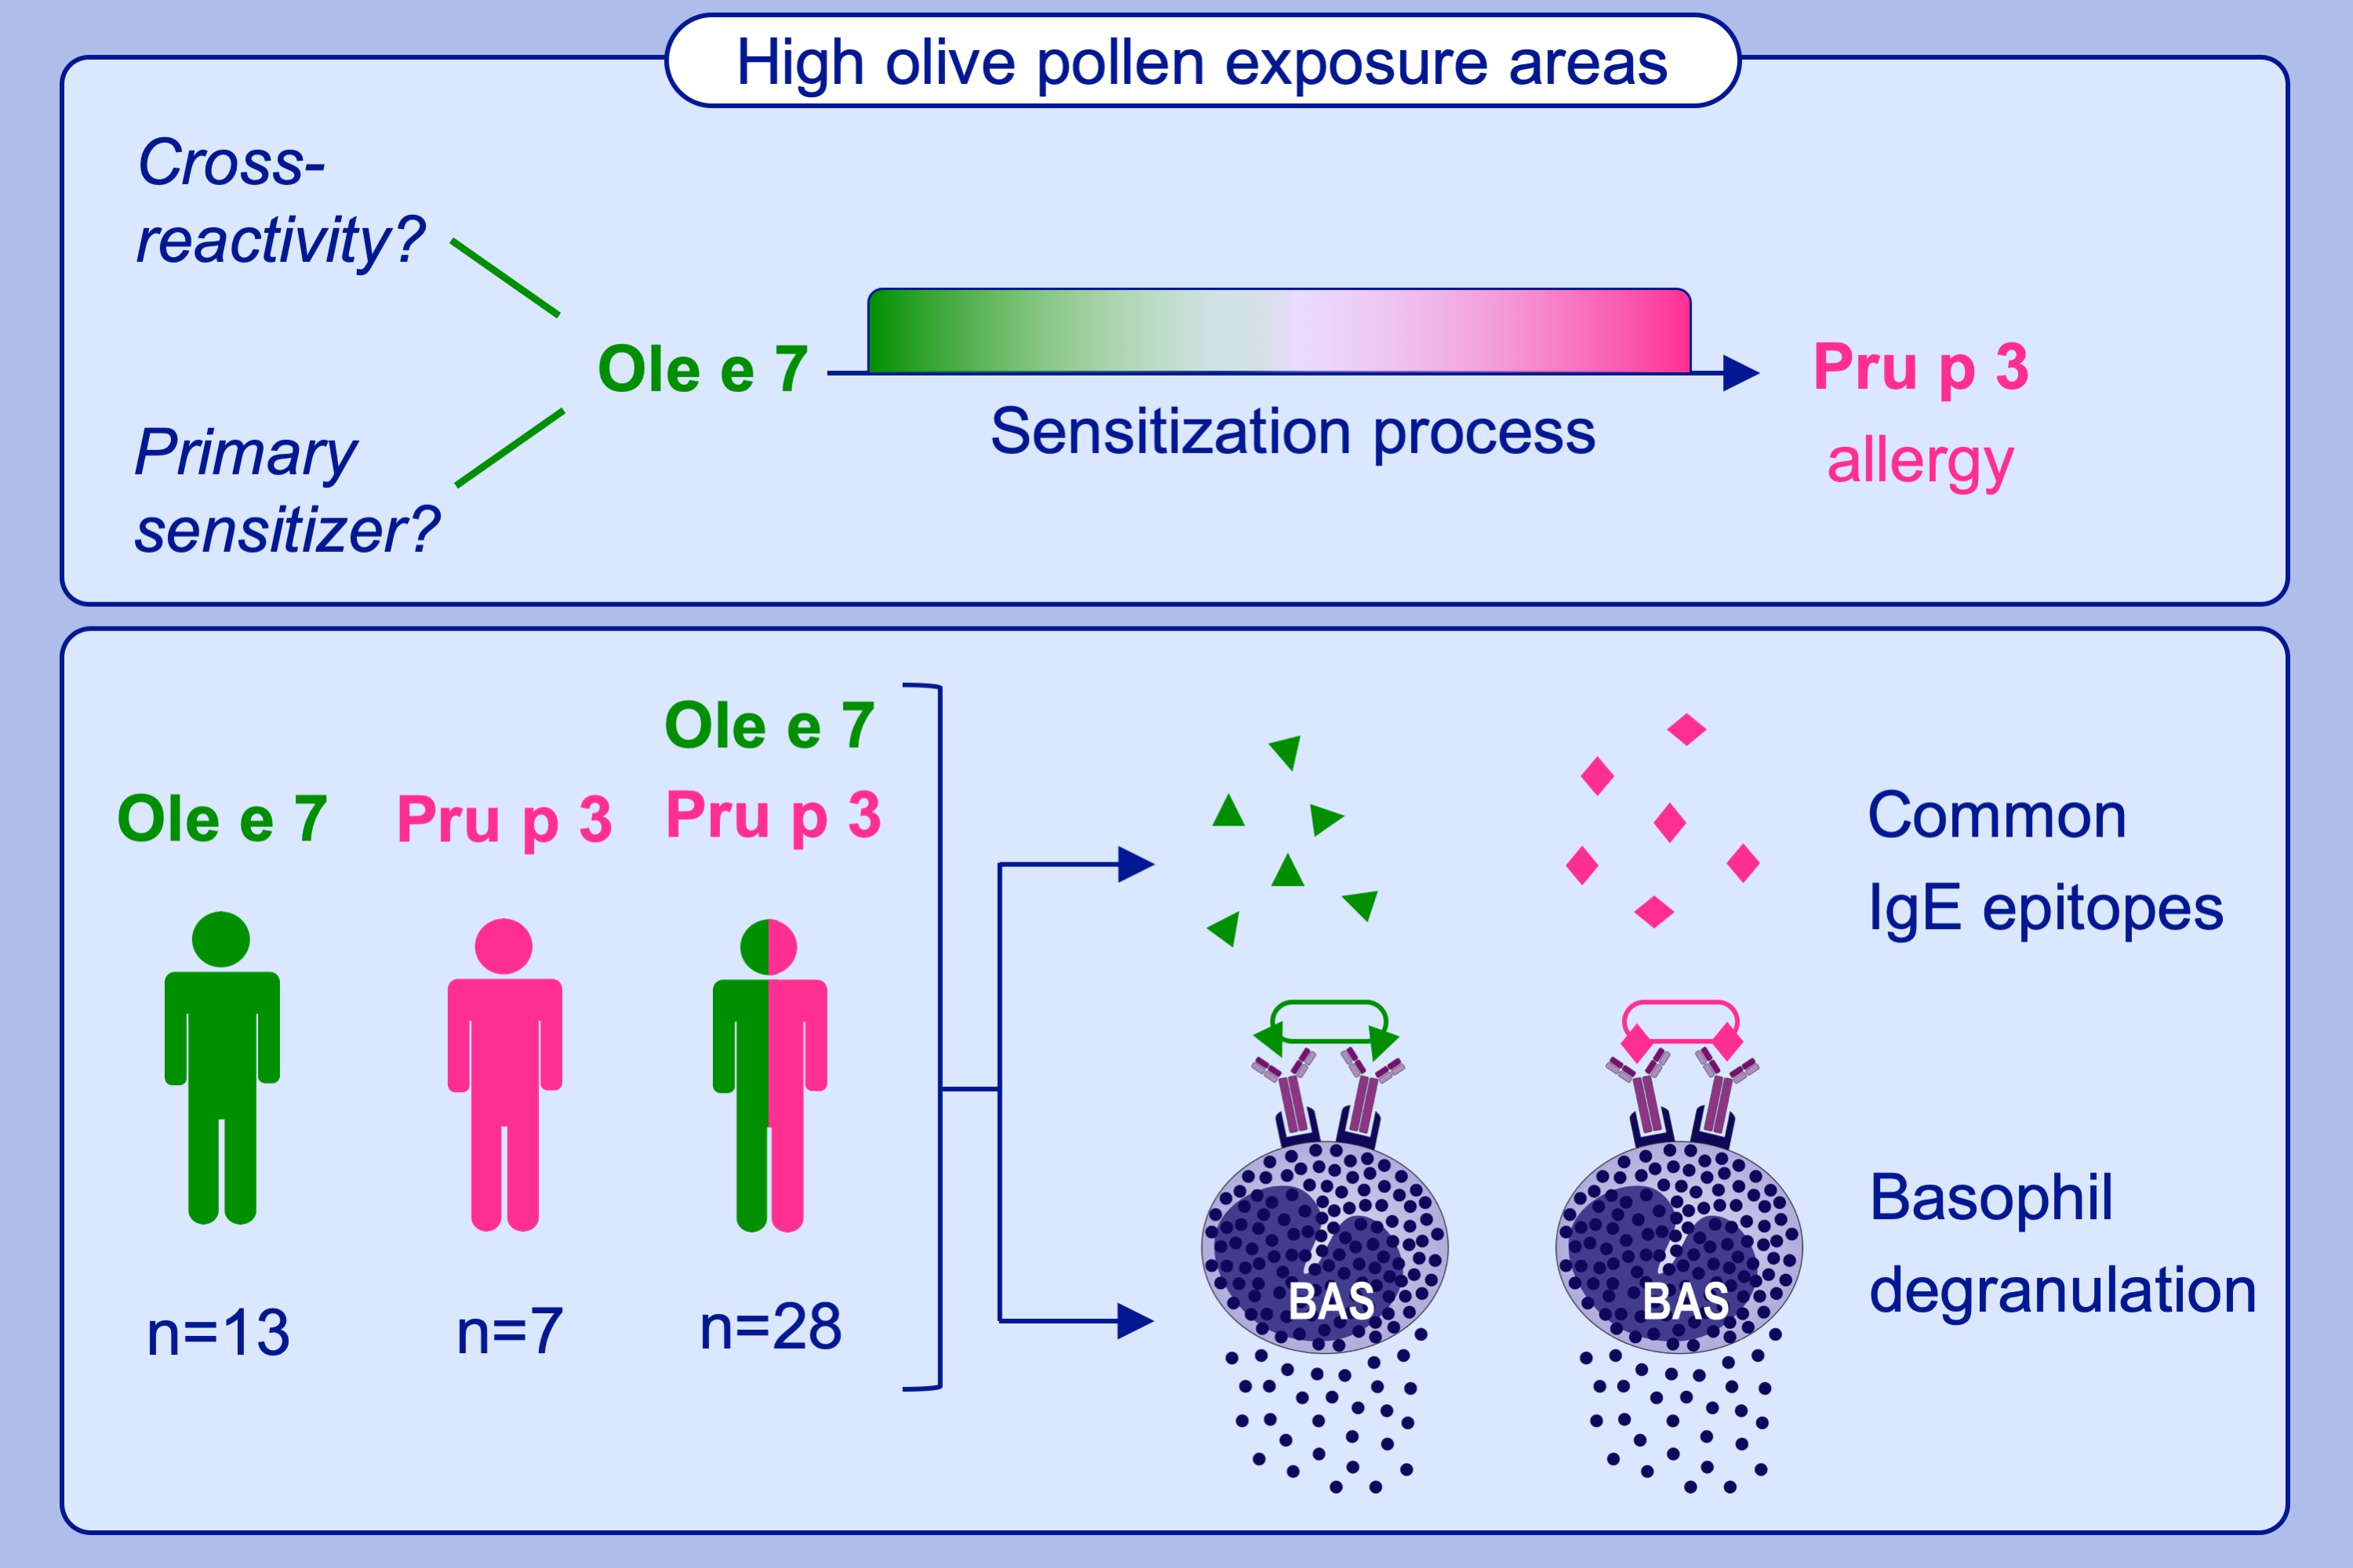
New insights into the sensitization to nonspecific lipid transfer proteins from pollen and food: New role of allergen Ole e 7
Carmen Oeo‐Santos, Ana Navas, Sara Benedé, Berta Ruíz‐León, Araceli Díaz‐Perales, et al.
Allergy. 2020; 798-807 https://doi.org/10.1111/all.14086
© 2019 EAACI and John Wiley and Sons A/S. Published by John Wiley and Sons Ltd.
Notes:
HIGHLIGHTS
•
•
•
ABBREVIATIONS

