Slide 1
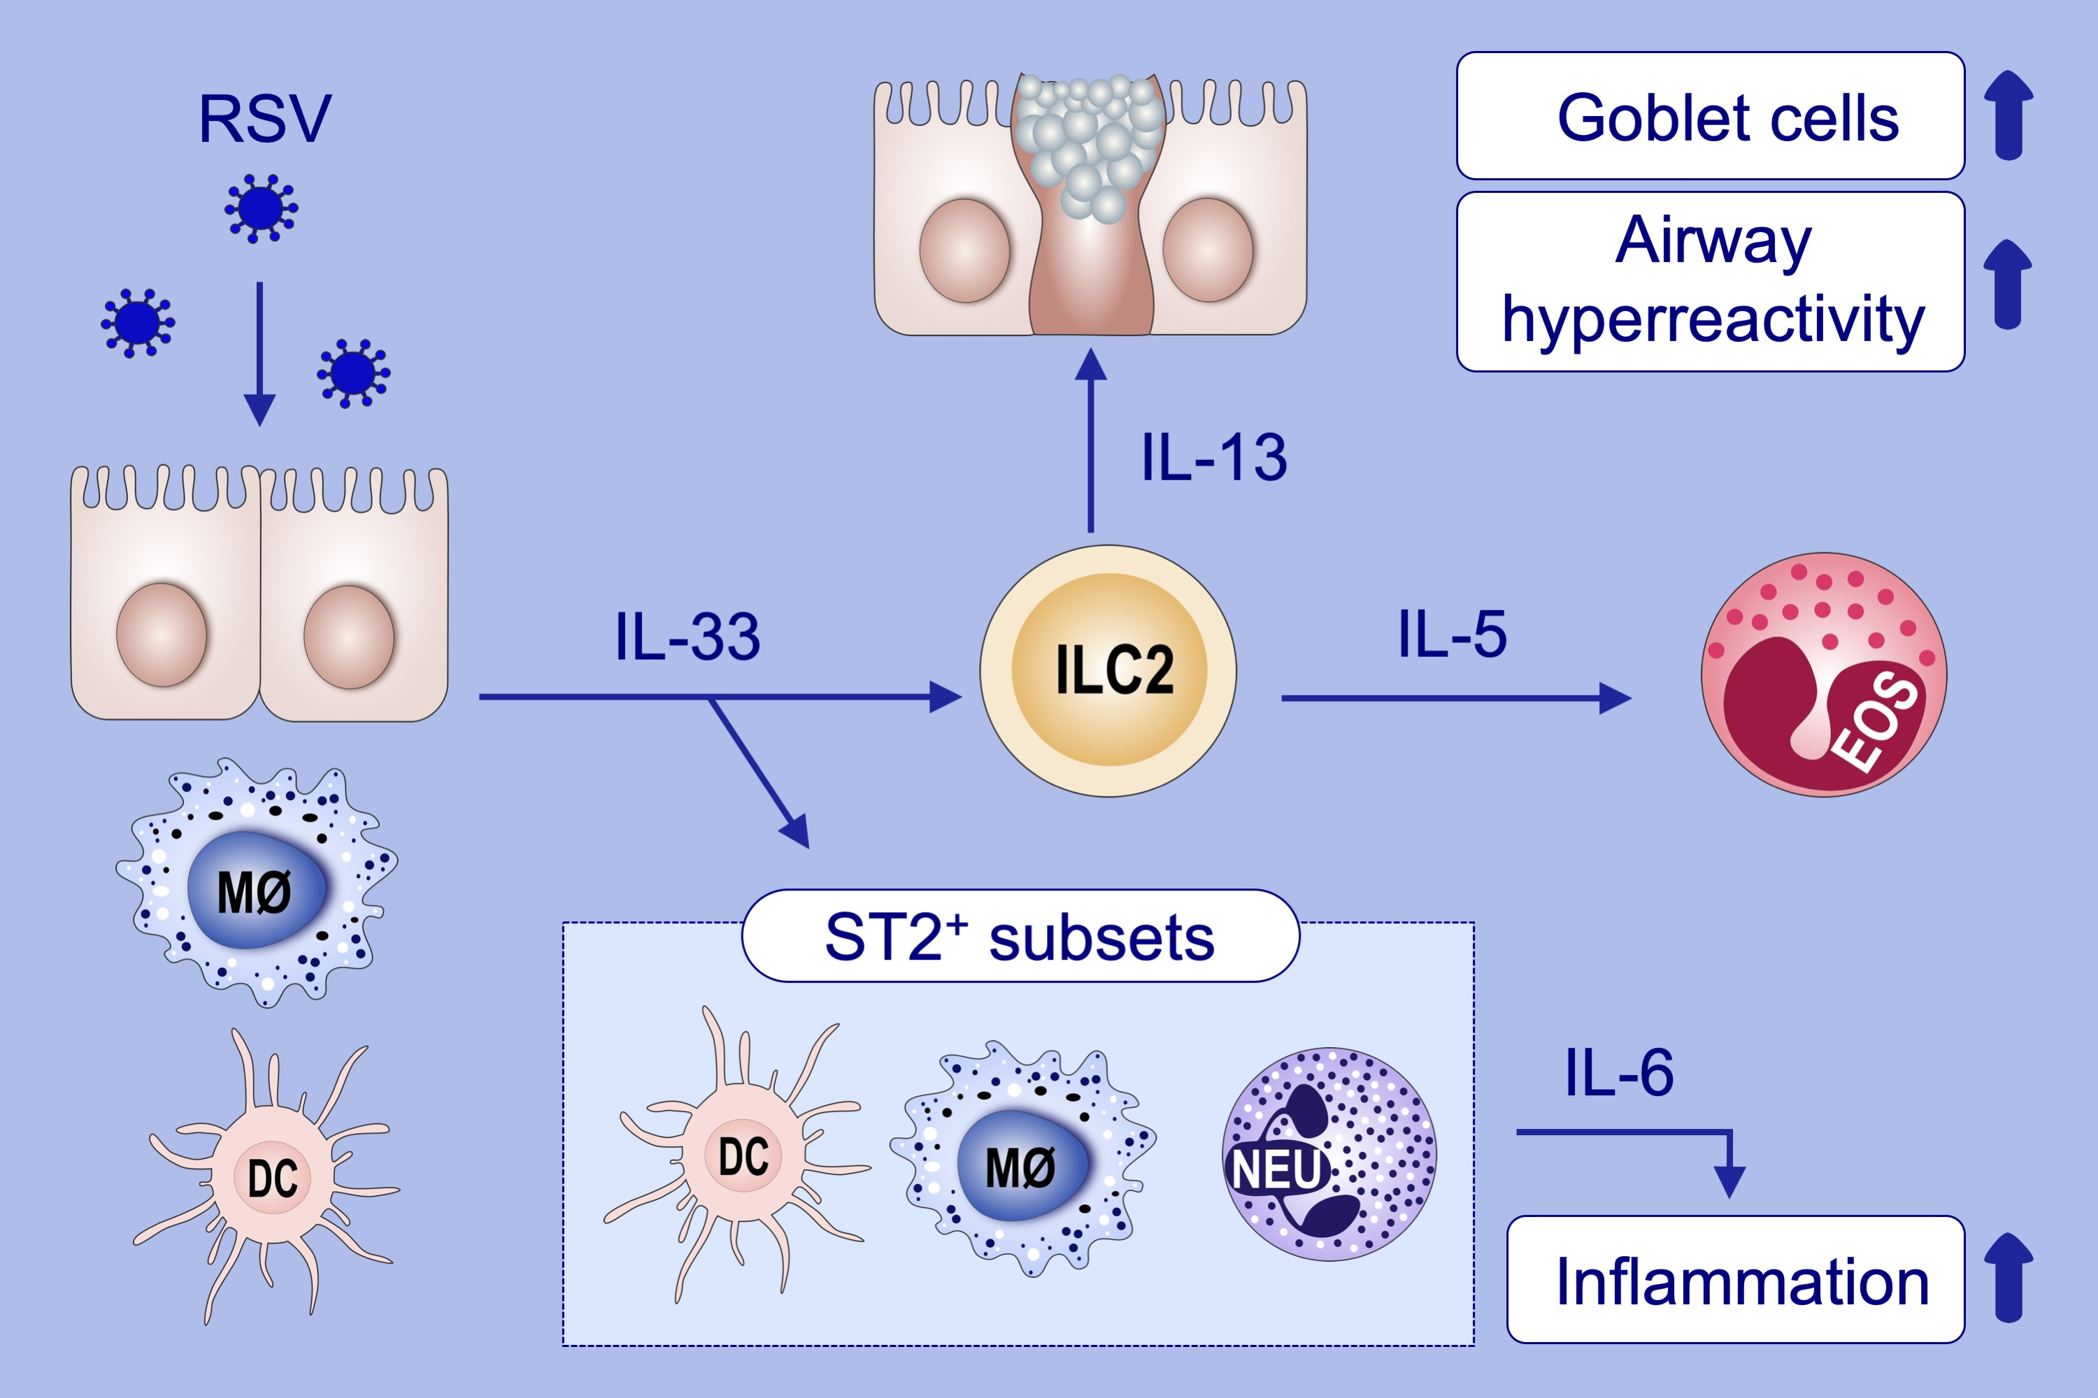
Pulmonary IL‐33 orchestrates innate immune cells to mediate respiratory syncytial virus‐evoked airway hyperreactivity and eosinophilia
Yi‐Hsiu Wu, Alan Chuan‐Ying Lai, Po‐Yu Chi, Christina Li‐Ping Thio, Wei‐Yu Chen, et al.
Allergy. 2020; 818-830 https://doi.org/10.1111/all.14091
© 2019 EAACI and John Wiley and Sons A/S. Published by John Wiley and Sons Ltd.
Notes:
HIGHLIGHTS
•
•
•
ABBREVIATIONS

