Slide 1
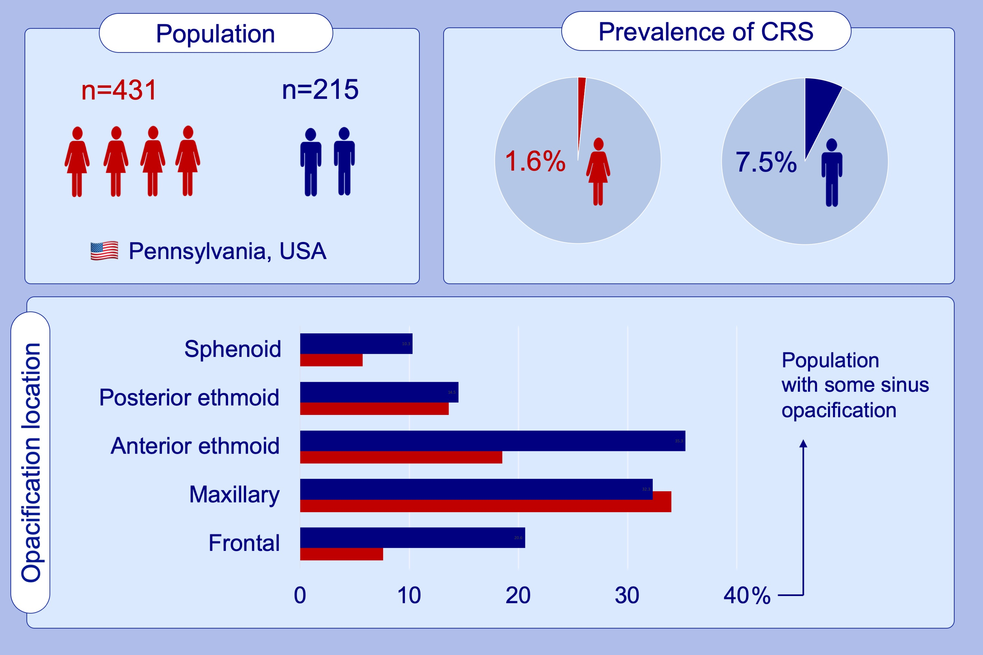
Radiologic sinus inflammation and symptoms of chronic rhinosinusitis in a population‐based sample
Annemarie G. Hirsch, Cara Nordberg, Karen Bandeen‐Roche, Bruce K. Tan, Robert P. Schleimer, et al.
Allergy. 2020; 911-920 https://doi.org/10.1111/all.14106
© 2019 EAACI and John Wiley and Sons A/S. Published by John Wiley and Sons Ltd.
Notes:
HIGHLIGHTS
•
•
•
ABBREVIATIONS

