Slide 1
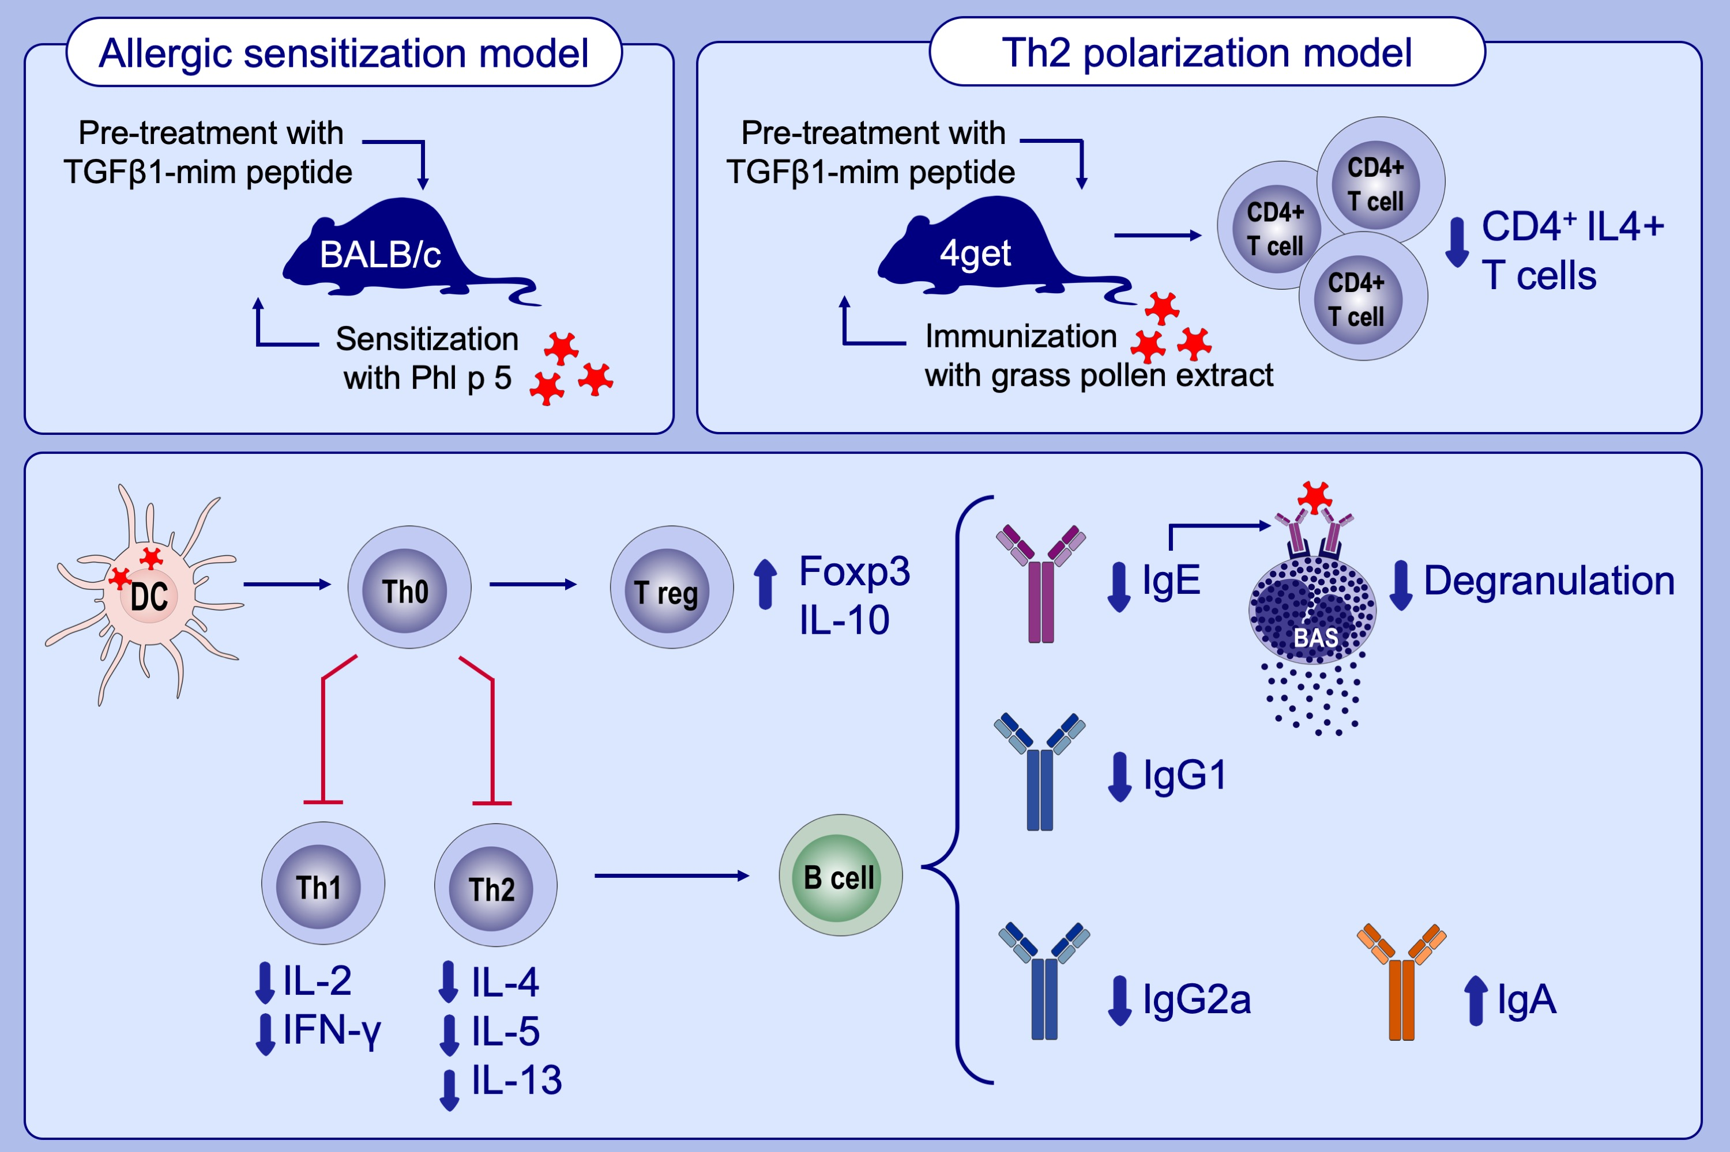
TGFβ1 mimetic peptide modulates immune response to grass pollen allergens in mice
Galber R. Araujo, Lorenz Aglas, Emília R. Vaz, Yoan Machado, Sara Huber, et al.
Allergy. 2020; 882-891 https://doi.org/10.1111/all.14108
© 2019 EAACI and John Wiley and Sons A/S. Published by John Wiley and Sons Ltd.
Notes:
HIGHLIGHTS
•
•
•
ABBREVIATIONS

