Slide 1
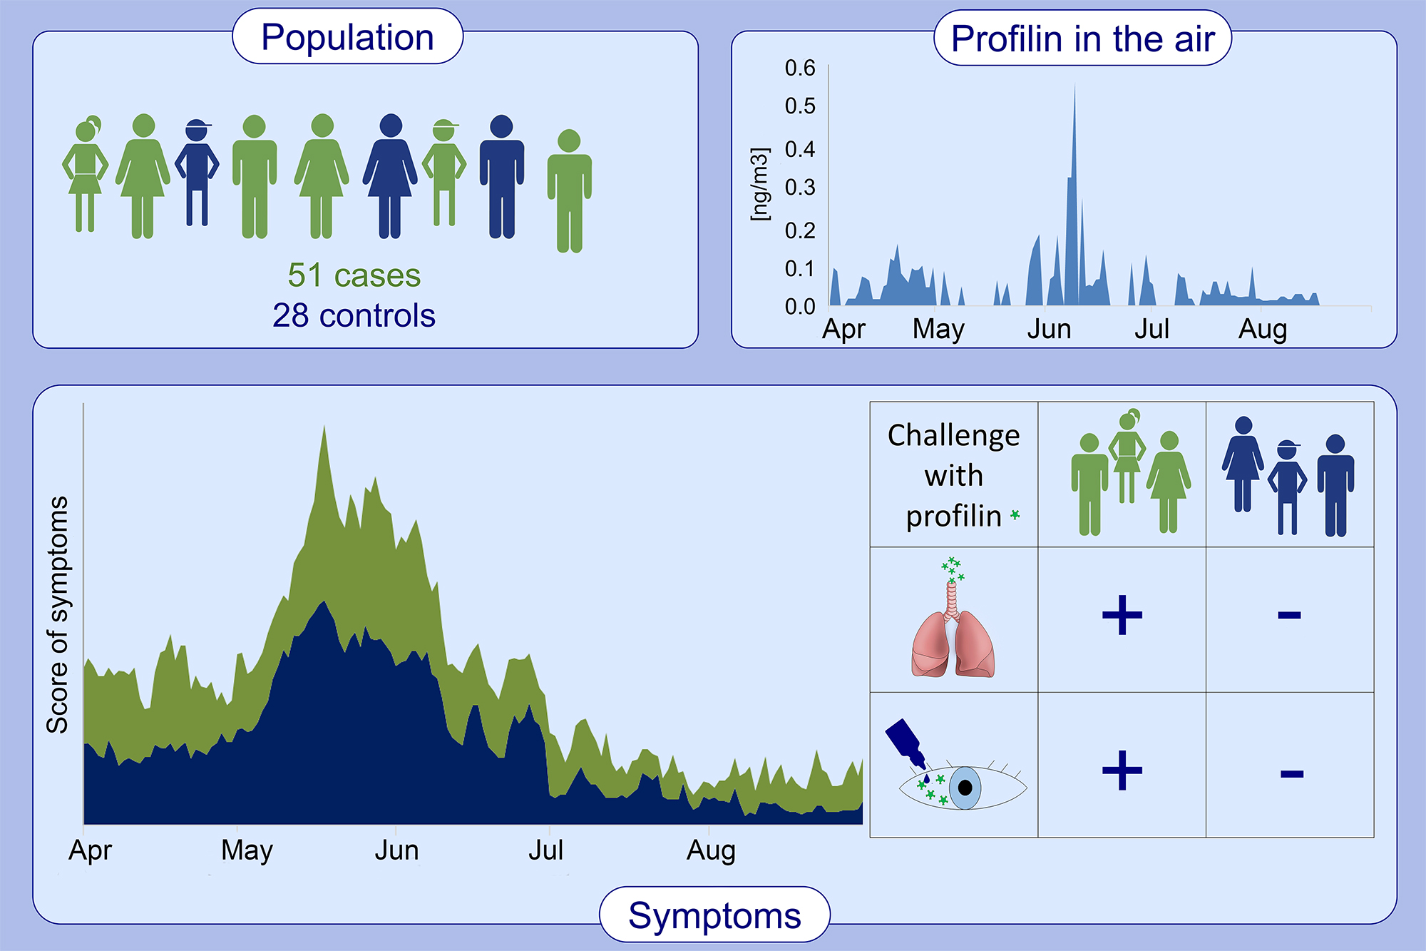
Profilin is a marker of severity in allergic respiratory diseases
Javier Ruiz‐Hornillos, M. Angeles López‐Matas, Pilar Berges Jimeno, Aythamy Henríquez, Sandra Blanco, et al.
Allergy. 2020; 853-861 https://doi.org/10.1111/all.14140
© 2019 EAACI and John Wiley and Sons A/S. Published by John Wiley and Sons Ltd.
Notes:
HIGHLIGHTS
•
•
•
ABBREVIATIONS

