Slide 1
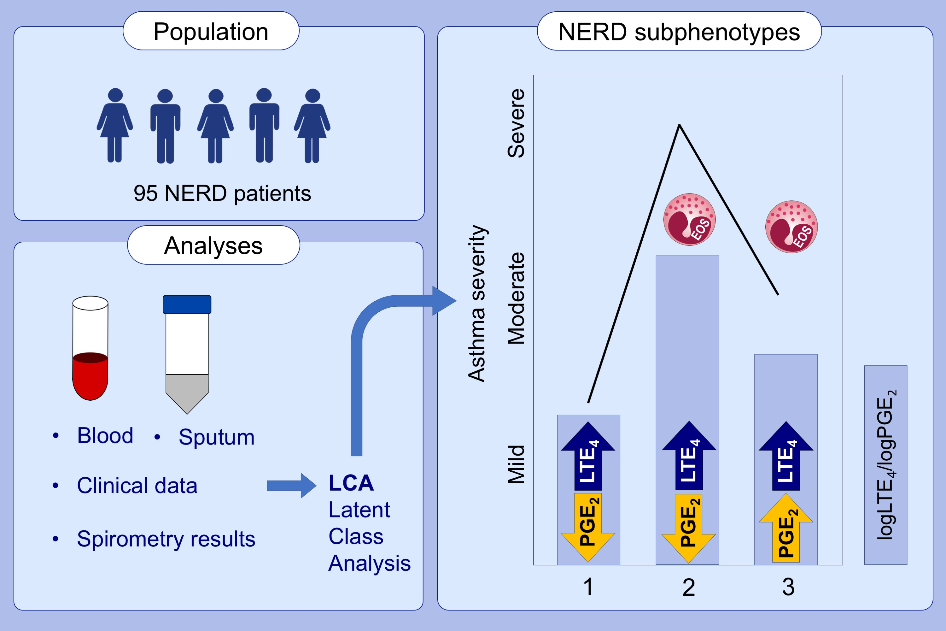
Subphenotypes of nonsteroidal antiinflammatory disease‐exacerbated respiratory disease identified by latent class analysis
Natalia Celejewska‐Wójcik, Krzysztof Wójcik, Maria Ignacak‐Popiel, Adam Ćmiel, Katarzyna Tyrak, et al.
Allergy. 2020; 831-840 https://doi.org/10.1111/all.14141
© 2019 EAACI and John Wiley and Sons A/S. Published by John Wiley and Sons Ltd.
Notes:
HIGHLIGHTS
•
•
•
ABBREVIATIONS

