Slide 1
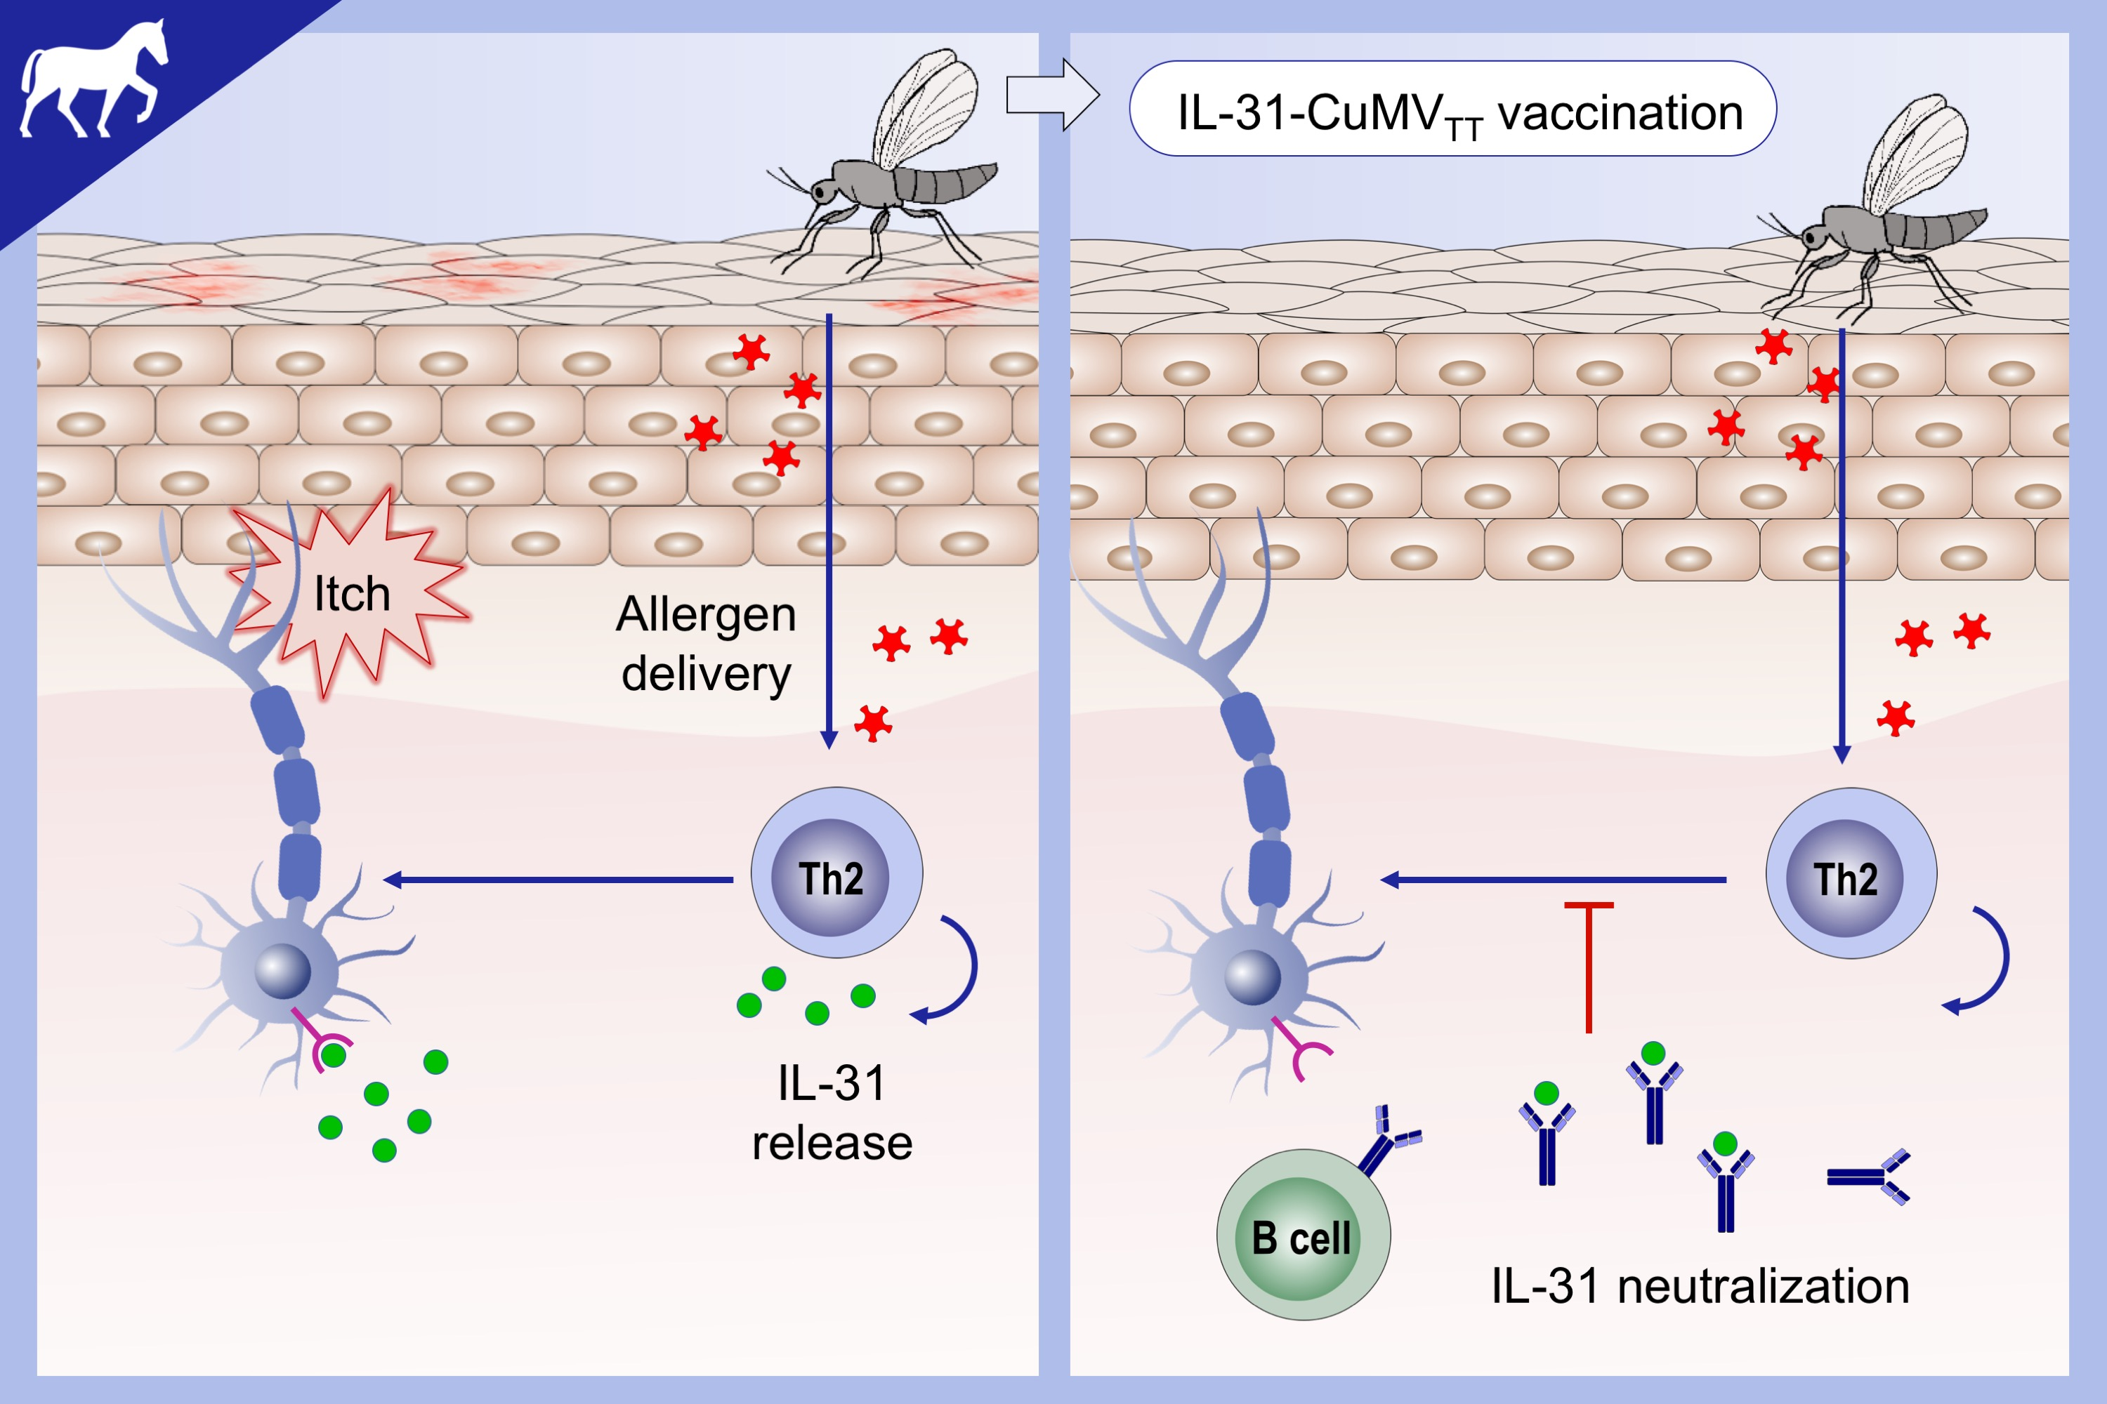
Interleukin 31 in insect bite hypersensitivity—Alleviating clinical symptoms by active vaccination against itch
Florian Olomski, Victoria Fettelschoss, Sigridur Jonsdottir, Katharina Birkmann, Franziska Thoms, et al.
Allergy. 2020; 862-871 https://doi.org/10.1111/all.14145
© 2019 EAACI and John Wiley and Sons A/S. Published by John Wiley and Sons Ltd.
Notes:
HIGHLIGHTS
•
•
•
ABBREVIATIONS

