Slide 1
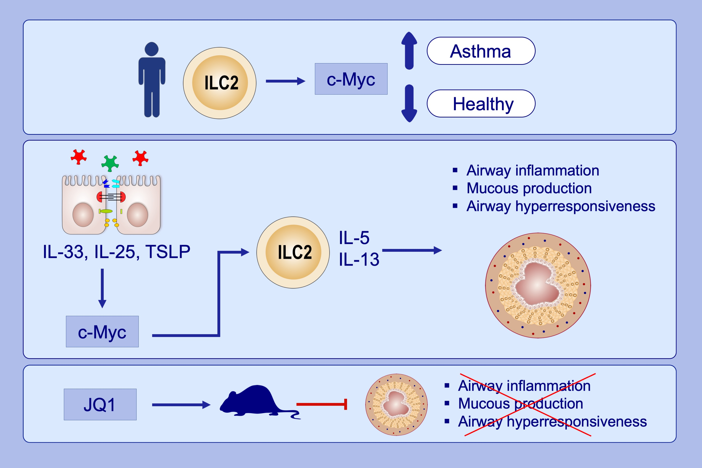
A critical role for c‐Myc in group 2 innate lymphoid cell activation
Longyun Ye, Jiexue Pan, Mingwei Liang, Muhammad Asghar Pasha, Xiaofei Shen, et al.
Allergy. 2020; 841-852 https://doi.org/10.1111/all.14149
© 2019 EAACI and John Wiley and Sons A/S. Published by John Wiley and Sons Ltd.
Notes:
HIGHLIGHTS
•
•
•
ABBREVIATIONS

