Slide 1
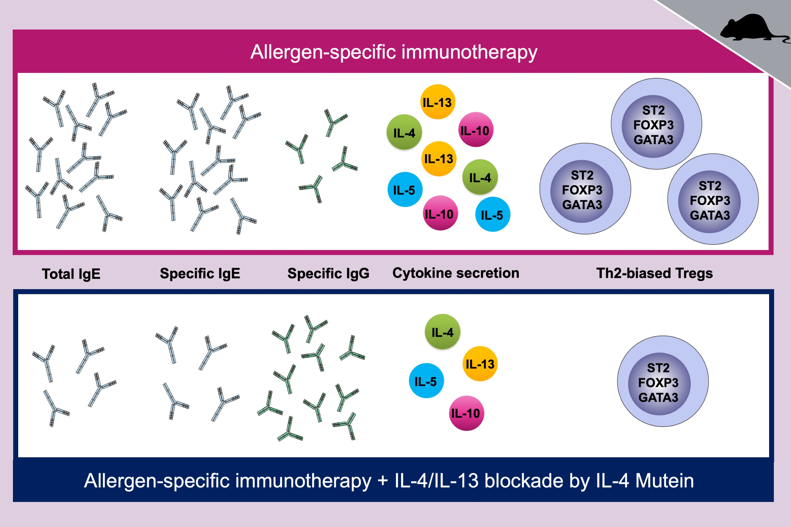
IL‐4 receptor α blockade prevents sensitization and alters acute and long‐lasting effects of allergen‐specific immunotherapy of murine allergic asthma
D. Russkamp, A. Aguilar‐Pimentel, F. Alessandrini, V. Gailus‐Durner, H. Fuchs, et al.
Allergy. 2019; 1549-1560 https://doi.org/10.1111/all.13759
© 2019 EAACI and John Wiley and Sons A/S. Published by John Wiley and Sons Ltd.
Notes:
HIGHLIGHTS
• Blockade of IL-4 and IL-13 signaling during experimental allergen-specific immunotherapy shows beneficial ef-fects on immunological
key parameters such as IgE, IgG, and Th2 cytokine secretion.
• I L-4 and IL-13 blockade during allergen-specific immunotherapy significantly decreases the number of poten-tially disease-triggering
Th2-biased Tregs (ST2 + FOXP3 + GATA3 intermediate).
• Th2 cytokine-inhibiting strategies might be suitable to support allergen-specific immunotherapy in a therapy success-favoring manner.
ABBREVIATIONS
FOXP3: forkhead box P3; GATA3: GATA-binding protein 3; ST2: suppression of tumorigenicity 2

