Slide 1
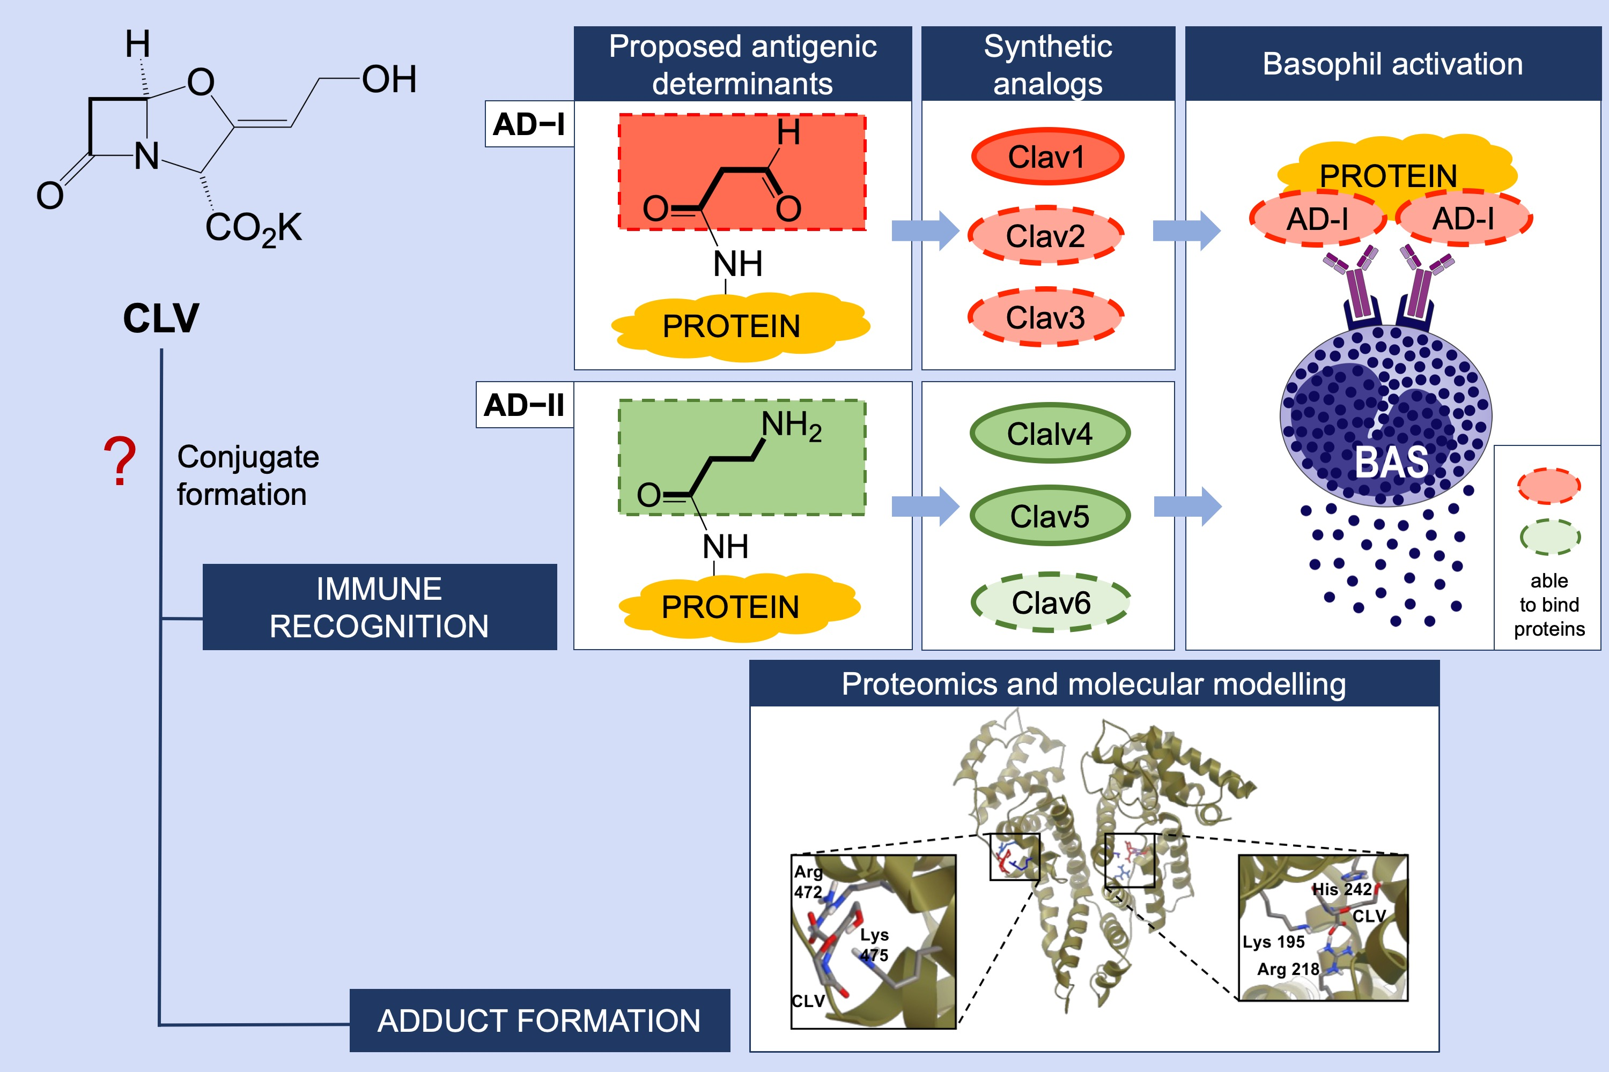
Identification of an antigenic determinant of clavulanic acid responsible for IgE‐mediated reactions
Nekane Barbero, Rubén Fernández‐Santamaría, Cristobalina Mayorga, Ángela Martin‐Serrano, María Salas, et al.
Allergy. 2019; 1490-1501 https://doi.org/10.1111/all.13761
© 2019 EAACI and John Wiley and Sons A/S. Published by John Wiley and Sons Ltd.
Notes:
HIGHLIGHTS
• The ability of synthetic determinants of clavulanic acid (CLV) to activate basophils from patients with immediate reactions to this
drug is influenced by the chemical structure and their reactivity to proteins.
• Antigenic determinant-I (AD-I) has been identified as the fragment of the clavulanic acid structure that remains linked to the
protein, which corresponds to the synthetic analogs (Clav2 and Clav3) able to activate basophils.
• This synthetic determinant analog to AD-I, with ability to bind proteins, can activate basophils in a higher proportion of patients
compared to the native drug, clavulanic acid.

