Slide 1
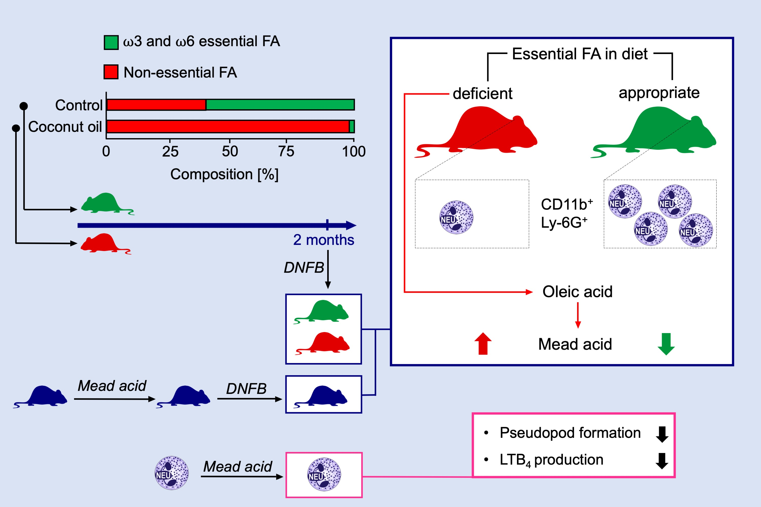
Dietary coconut oil ameliorates skin contact hypersensitivity through mead acid production in mice
Prabha Tiwari, Takahiro Nagatake, So‐ichiro Hirata, Kento Sawane, Azusa Saika, et al.
Allergy. 2019; 1522-1532 https://doi.org/10.1111/all.13762
© 2019 EAACI and John Wiley and Sons A/S. Published by John Wiley and Sons Ltd.
Notes:
HIGHLIGHTS
• Mice maintained on dietary coconut oil show amelioration of skin allergic inflammation and reduction in the number of CD11b+ Ly-6G+ neutrophils.
• Essential fatty acid deficiency changes lipid metabolism in the body to produce mead acid from oleic acid, resulting in increased mead acid levels in serum.
• Mead acid exerts potent anti-inflammatory activity in contact hypersensitivity, inhibits neutrophil migration, leukotriene B4 production, and vascular permeability in skin inflammation.
ABBREVIATIONS
DNFB: 1-fluoro-2,4-dinitrobenzene; FA: Fatty acids; LTB4: Leukotriene B4; Ly-G6: Lymphocyte antigen 6 complex, locus G

