Slide 1
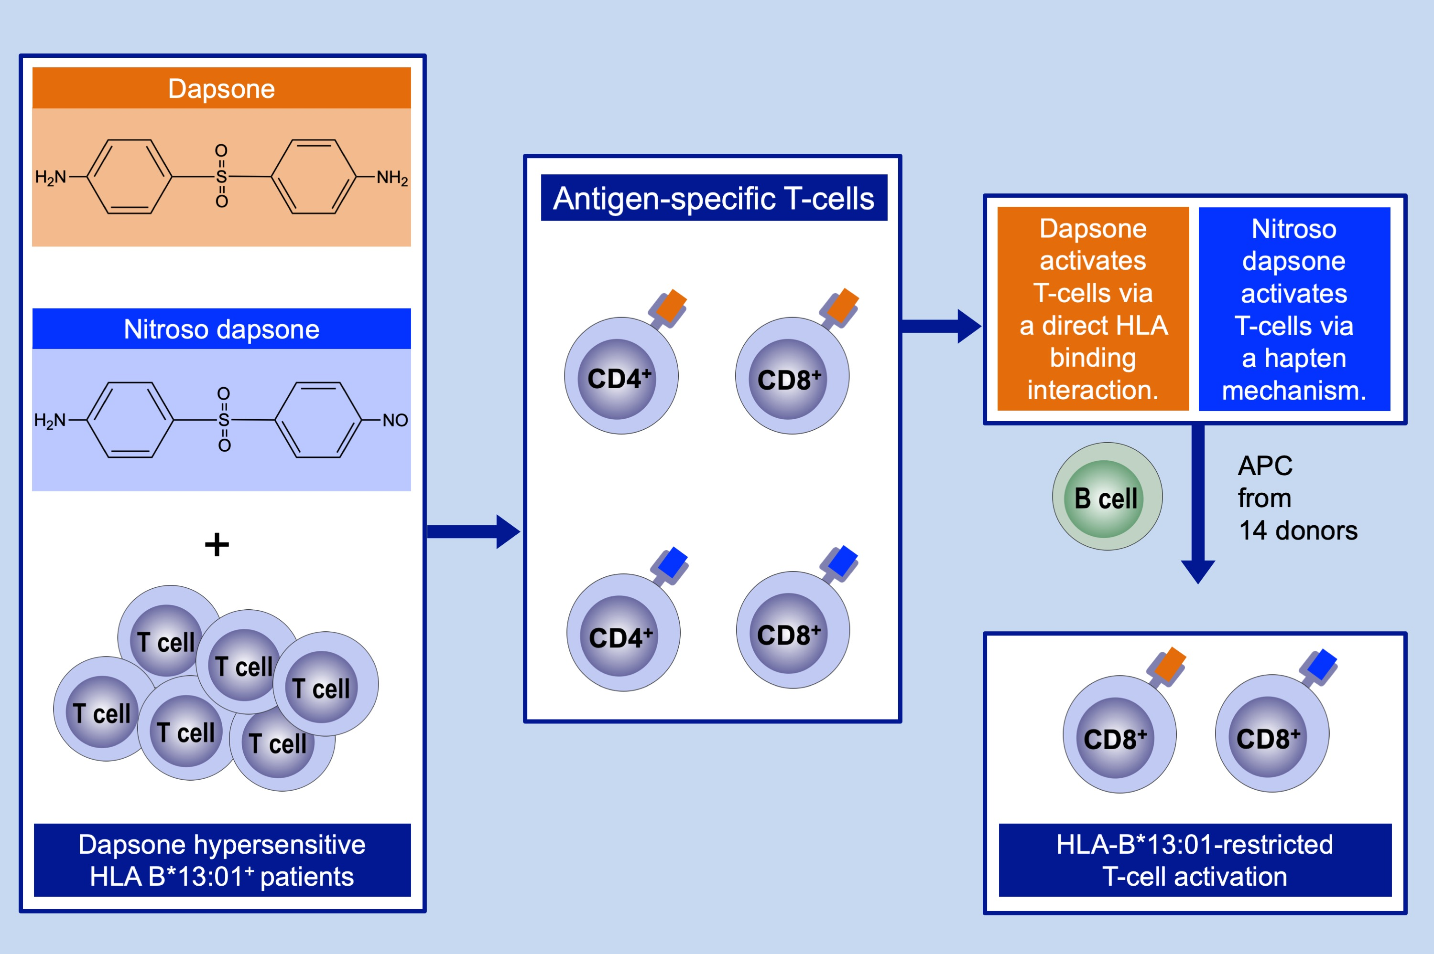
Dapsone‐ and nitroso dapsone‐specific activation of T cells from hypersensitive patients expressing the risk allele HLA‐B*13:01
Qing Zhao, Khetam Alhilali, Abdulaziz Alzahrani, Mubarak Almutairi, Juwaria Amjad, et al.
Allergy. 2019; 1533-1548 https://doi.org/10.1111/all.13769
© 2019 EAACI and John Wiley and Sons A/S. Published by John Wiley and Sons Ltd.
Notes:
HIGHLIGHTS
• Dapsone and nitroso dapsone activate CD4+ and CD8+ T cells from hypersensitive patients via different mechanisms.
• Dapsone and nitroso dapsone interact with HLA-B*13:01 to activate certain CD8+ clones.
• Dapsone hypersensitivity should be used as an example to solve the structure of drug metabolite-modified peptide-HLA interactions
and the relationship between HLA binding and T-cell activation.

