Slide 1
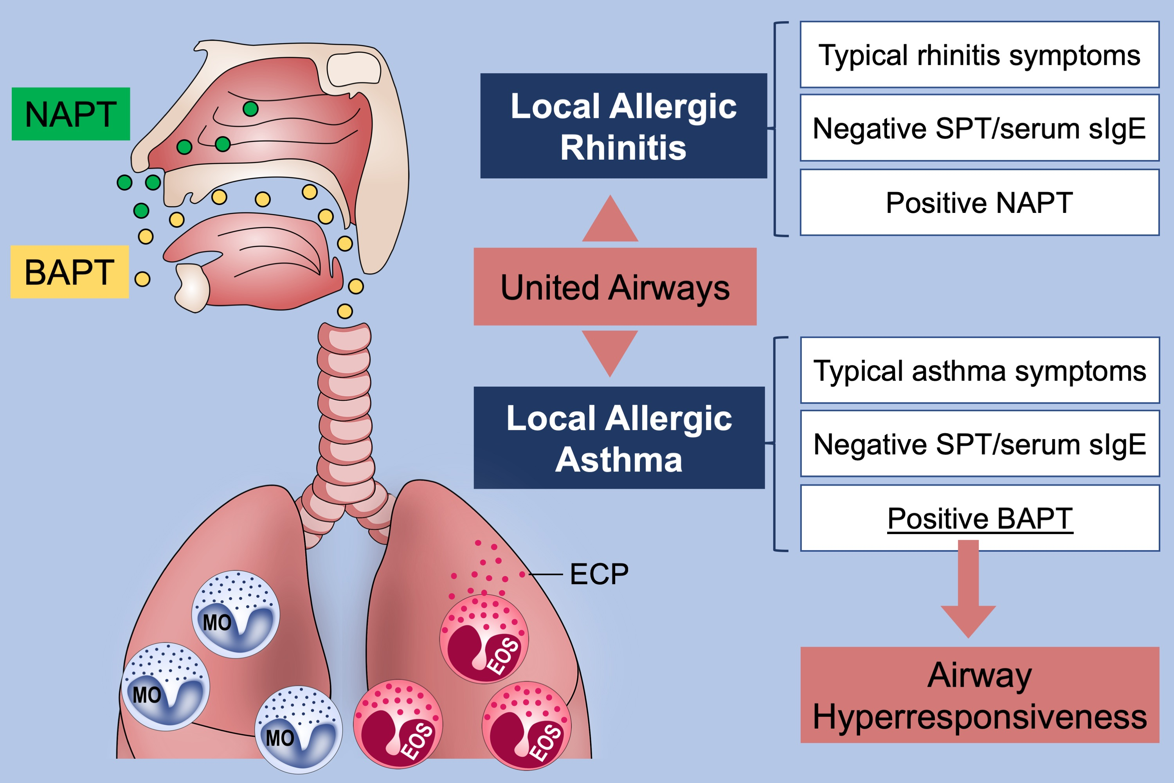
Bronchial asthma triggered by house dust mites in patients with local allergic rhinitis
Paloma Campo, Ibon Eguiluz‐Gracia, María Carmen Plaza‐Serón, María Salas, María José Rodríguez, et al.
Allergy. 2019; 1502-1510 https://doi.org/10.1111/all.13775
© 2019 EAACI and John Wiley and Sons A/S. Published by John Wiley and Sons Ltd.
Notes:
HIGHLIGHTS
• Twenty-eight percent of patients with house dust mite (HDM)– triggered local allergic rhinitis (LAR) and asthma-like symptoms display positive bronchial allergen provocation test (BAPT) responses.
• In LAR patients, BAPT induces a significant increase in the airway hyperresponsiveness together with a recruitment and activation of eosinophils and monocytes.
• Collectively, these findings suggest the existence of differentiated asthma phenotype defined by the absence of atopy and positive response to BAPT.
ABBREVIATIONS
NAPT: Nasal allergen provocation test

