Slide 1
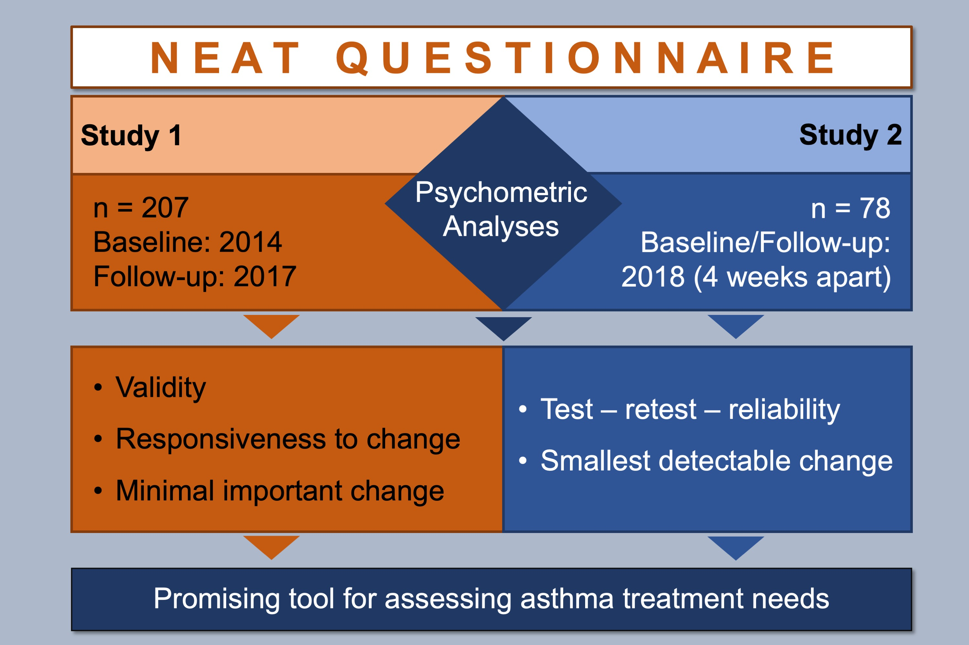
The Patient Needs in Asthma Treatment (NEAT) questionnaire: Further evidence on its psychometric properties
Julia Schreitmüller, Christian Apfelbacher, Aziz Sheikh, Adrian Loerbroks, Julia Schreitmüller, et al.
Allergy. 2019; 1511-1521 https://doi.org/10.1111/all.13782
© 2019 EAACI and John Wiley and Sons A/S. Published by John Wiley and Sons Ltd.
Notes:
HIGHLIGHTS
• The Patient Needs in Asthma Treatment (NEAT) questionnaire is a reliable and valid instrument to predict treatment satisfaction; also, it is responsive to changes in treatment satisfaction and in asthma-related quality of life.
• Our study confirms that participants whose NEAT score has changed by the magnitude of an identified minimal important change reported lower overall treatment satisfaction at follow-up.
• The NEAT seems to be particularly useful for evaluative and diagnostic purposes and may assist endeavors to promote patients’ satisfaction with asthma treatment.

