Slide 1
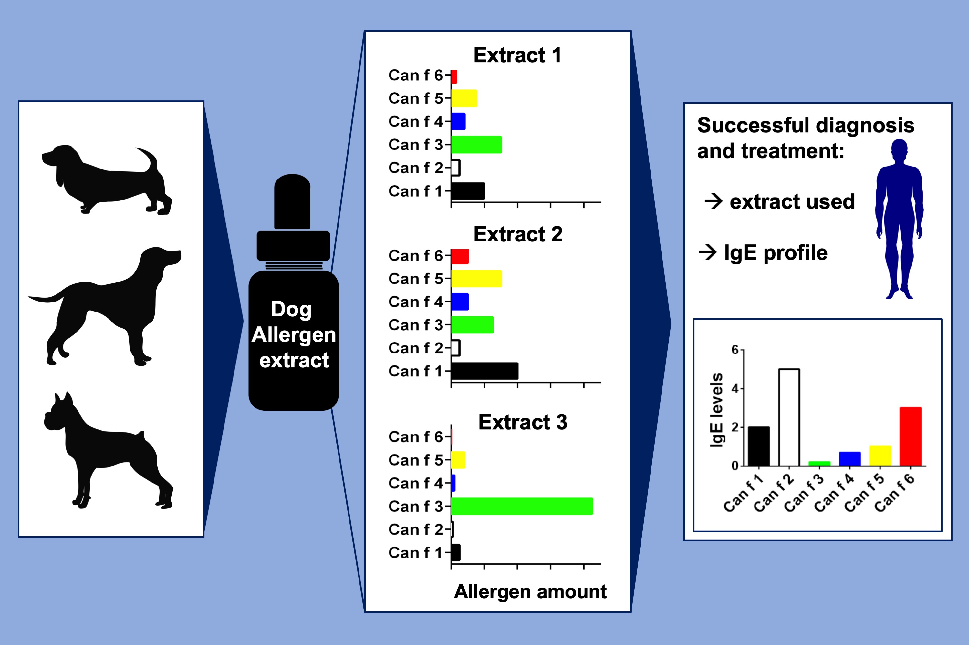
Allergens in dog extracts: Implication for diagnosis and treatment
Anna Wintersand, Klara Asplund, Jonas Binnmyr, Erik Holmgren, Ola B. Nilsson, et al.
Allergy. 2019; 1472-1479 https://doi.org/10.1111/all.13785
© 2019 EAACI and John Wiley and Sons A/S. Published by John Wiley and Sons Ltd.
Notes:
HIGHLIGHTS
• Raw material for dog allergen extracts comes from dogs with various allergen profiles.
• Commercial dog allergen extracts vary in allergen content.
• Successful diagnosis and treatment of a dog allergic patient depends on the extract used for diagnosis/treatment and on the IgE profile of the patient.

