Slide 1
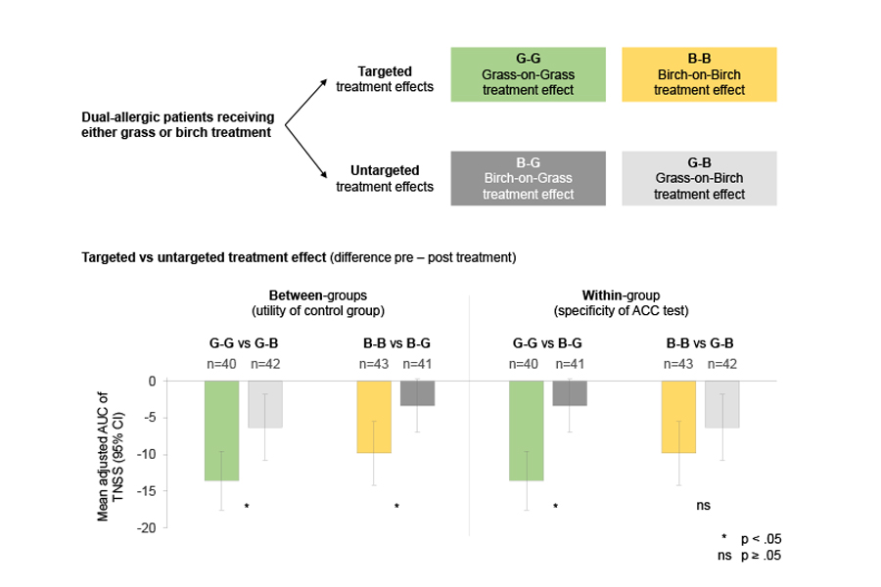
Randomized immunotherapy trial in dual‐allergic patients using “active allergen placebo” as control
Martin Wagenmann, Margitta Worm, Yasemin Akboga, Martin Karjalainen, Jens M. Hohlfeld, et al.
Allergy. 2019; 1480-1489 https://doi.org/10.1111/all.13842
© 2019 EAACI and John Wiley and Sons A/S. Published by John Wiley and Sons Ltd.
Notes:
HIGHLIGHTS
• An “active allergen placebo” design can overcome limitations faced by classical placebo, reduces ethical concerns, improves blinding, and allows longer trial durations.
• Dual-allergic patients were challenged with both allergens in an allergen challenge chamber before and after allergen immunotherapy (AIT); active untargeted treatment effect
served as control.
• Results confirmed the specificity of AIT; therefore, untargeted AIT is an adequate control for targeted AIT.
ABBREVIATIONS
ACC: allergen challenge chamber; AIT: allergen immunotherapy; AUC: area under the curve; B-B: birch-on-birch treatment effect (targeted); B-G: birch-on-grass treatment effect (untargeted); CI: confidence interval; G-B: grass-on-birch treatment effect (untargeted); G-G: grass-on-grass treatment effect (targeted); TNSS: total nasal symptom score

