Slide 1
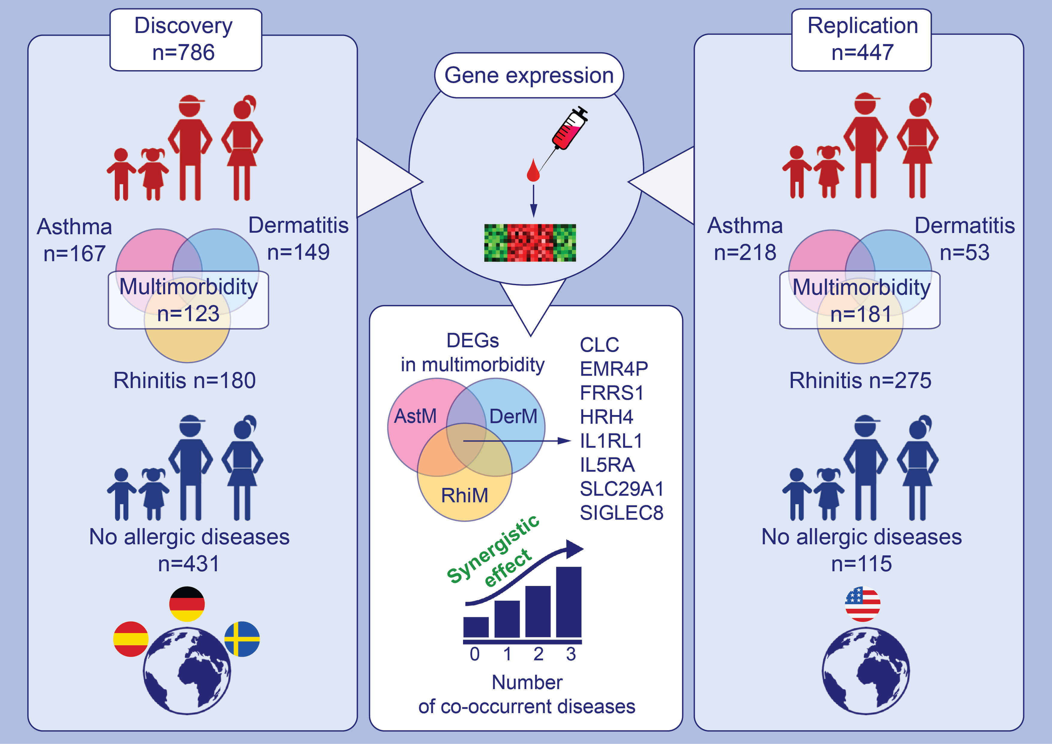
A novel whole blood gene expression signature for asthma, dermatitis, and rhinitis multimorbidity in children and adolescents
Nathanaël Lemonnier, Erik Melén, Yale Jiang, Stéphane Joly, Camille Ménard, et al.
Allergy. 2020; 3248-3260 https://doi.org/10.1111/all.14314
© 2019 EAACI and John Wiley and Sons A/S. Published by John Wiley and Sons Ltd.
Notes:
HIGHLIGHTS
This study compares gene expression from whole blood of European children (4-16 years) with asthma and/or dermatitis and/or rhinitis to controls without allergy.
Eight genes are overlapping among DEGs found in multimorbidity for asthma, dermatitis and rhinitis, which had synergistic effects along the number of co-occurrent diseases.
Results were replicated in North American cohort with similar features.
Abbreviations: AstM, asthma multimorbidity; CLC, charcot-leyden crystal galectin; DEGs, differentially expressed genes; DerM, dermatitis multimorbidity; EMR4P, adhesion G protein-coupled receptor E4; FRRS1, ferric chelate reductase 1; HRH4, histamine receptor H4; IL1RL1, interleukin 1 receptor like 1; IL5RA, interleukin 5 receptor subunit alpha; RhiM, rhinitis multimorbidity; SIGLEC8, sialic acid binding Ig like lectin 8; SLC29A1, solute carrier family 29 member 1
.

