Slide 1
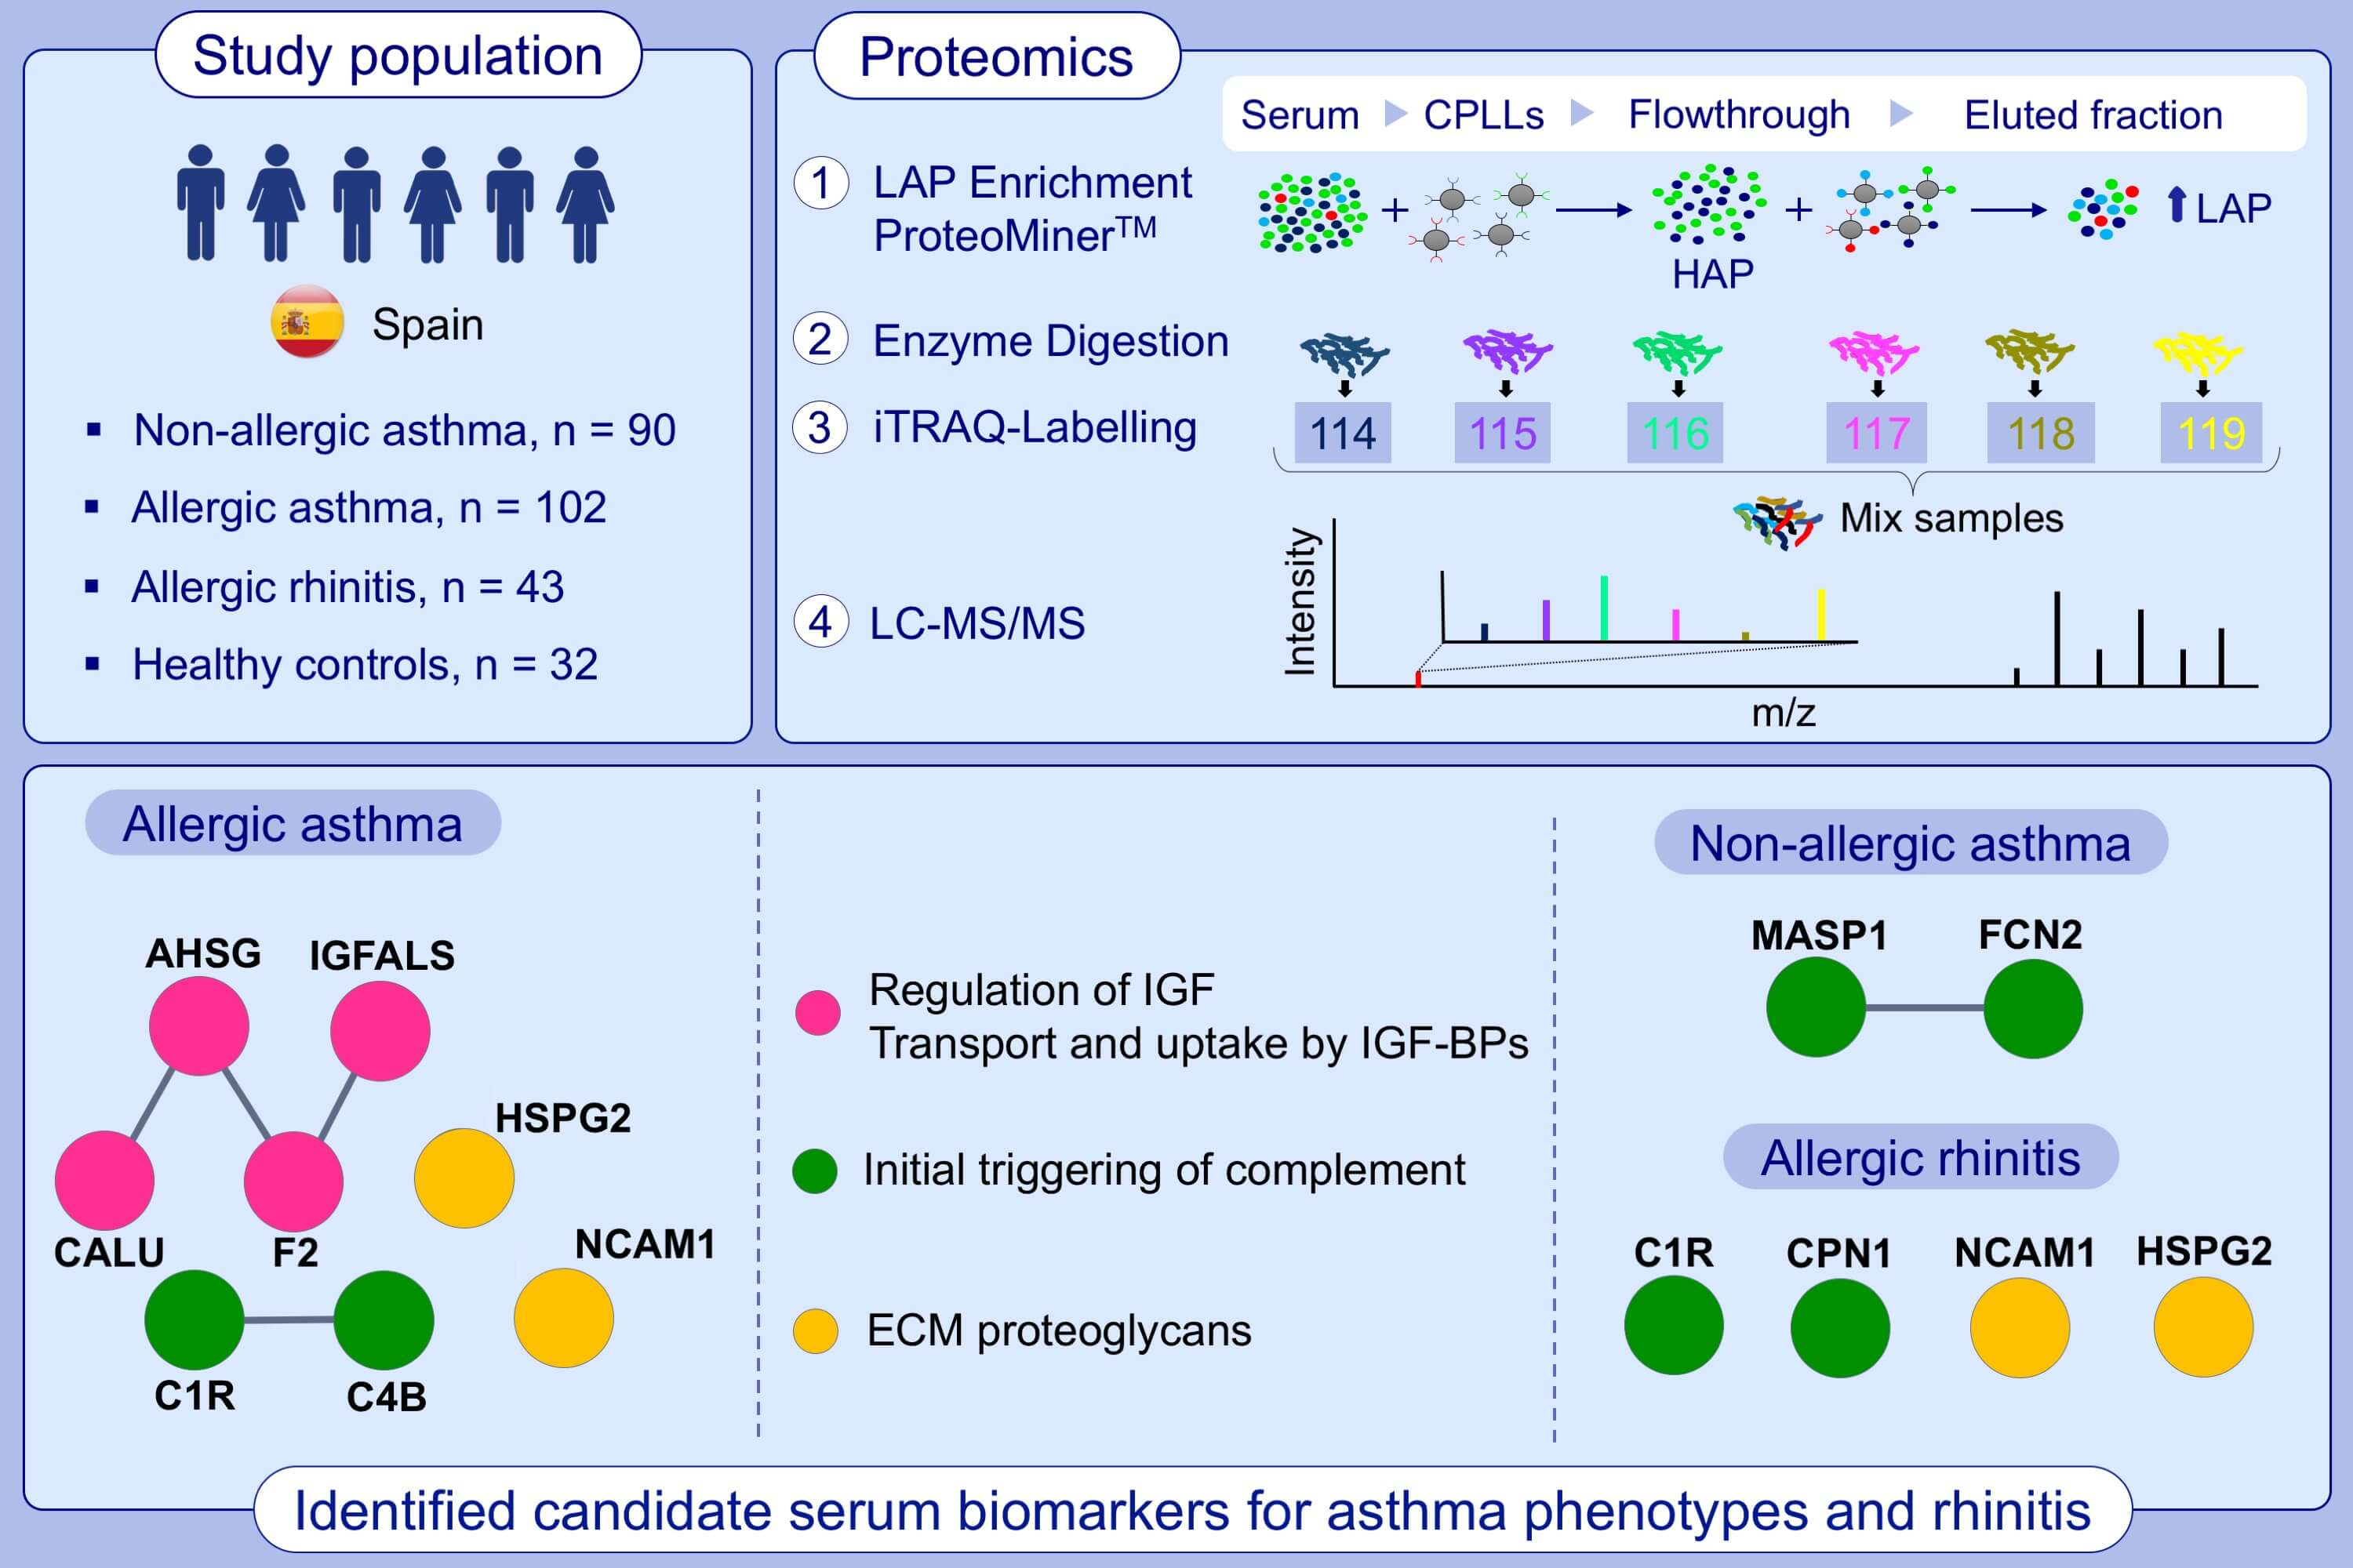
iTRAQ‐based proteomic analysis reveals potential serum biomarkers of allergic and nonallergic asthma
Juan José Nieto‐Fontarigo, Francisco Javier González‐Barcala, Luis Juan Andrade‐Bulos, María Esther San‐José, María Jesús Cruz, et al.
Allergy. 2020; 3171-3183 https://doi.org/10.1111/all.14406
© 2019 EAACI and John Wiley and Sons A/S. Published by John Wiley and Sons Ltd.
Notes:
HIGHLIGHTS
This study identifies serum biomarkers for asthma (allergic and non-allergic asthma) and allergic rhinitis using iTRAQ-based proteomics.
Several proteins from the IGF pathway are increased in allergic asthma. Particularly, IGF-ALS could be a useful biomarker for this phenotype.
Proteins from the lectin pathway of complement activation (FCN2 and MASP1) are increased in non-allergic asthma.
AHSG, alpha-2-HS-glycoprotein; CALU, calumenin; CPN1, carboxypeptidase N subunit 1; CPLLs, combinatorial peptide ligand libraries; C1R, complement C1r subcomponent; C4B, complement component 4B; F2, prothrombin; FCN2, ficolin 2; HAP, high abundant proteins; HSPG2, basement membrane-specific heparan sulfate proteoglycan core protein; IGF-ALS, insulin-like growth factor binding protein acid labile subunit; iTRAQ, isobaric tags for relative and absolute quantitation; LAP, low abundant proteins; LC-MS/MS, liquid chromatography coupled online to tandem mass spectrometry; MASP1, mannan binding lectin serine peptidase 1; NCAM1, neural cell adhesion molecule 1 precursor

