Slide 1
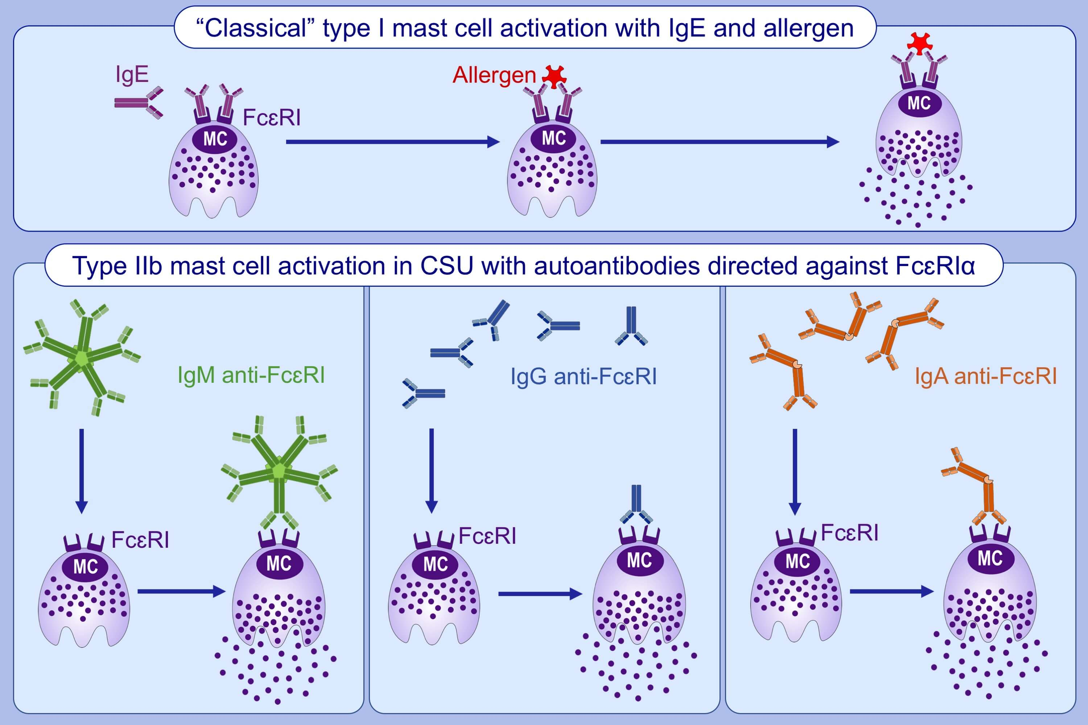
IgM and IgA in addition to IgG autoantibodies against FcɛRIα are frequent and associated with disease markers of chronic spontaneous urticaria
Sabine Altrichter, Vasiliki Zampeli, André Ellrich, Ke Zhang, Martin K Church, et al.
Allergy. 2020; 3208-3215 https://doi.org/10.1111/all.14412
© 2019 EAACI and John Wiley and Sons A/S. Published by John Wiley and Sons Ltd.
Notes:
HIGHLIGHTS
Beside IgG against the high affinity IgE receptor, patients with CSU can also have IgM and IgA directed against the receptor.
IgM antibodies are associated with positive autologous serum skin tests, a feature of type IIb autoimmunity.
FcɛRI cross-linking by these autoantibodies, in skin mast cells, could lead to their degranulation, which drives the development of the clinical symptoms of CSU.
Abbreviations: CSU, chronic spontaneous urticaria; FcɛRI, Fcɛ receptor I

