Slide 1
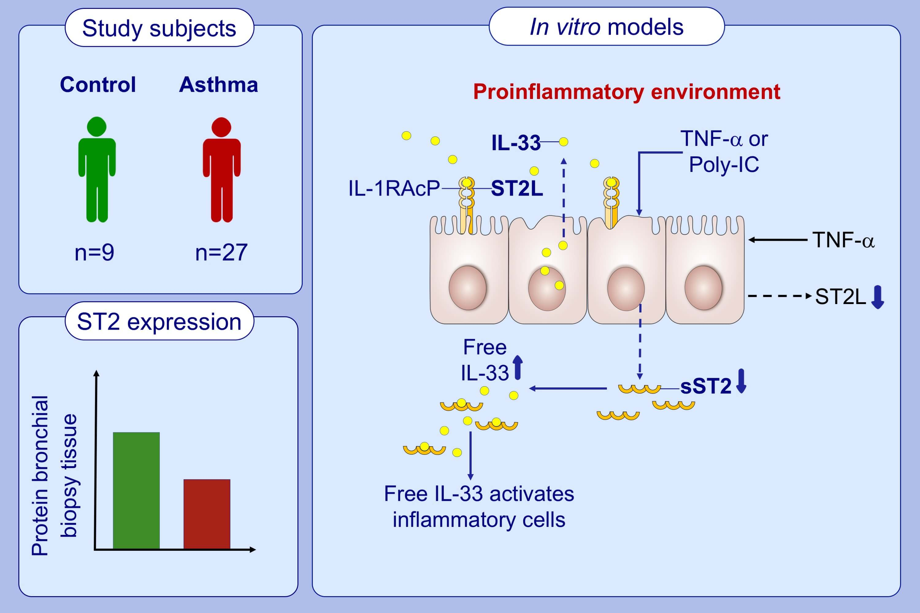
ST2 expression and release by the bronchial epithelium is downregulated in asthma
Davinder Kaur, Latifa Chachi, Edith Gomez, Nicolas Sylvius, Shailendra R. Singh, et al.
Allergy. 2020; 3184-3194 https://doi.org/10.1111/all.14436
© 2019 EAACI and John Wiley and Sons A/S. Published by John Wiley and Sons Ltd.
Notes:
HIGHLIGHTS
ST2 and soluble ST2 was expressed by primary and BEAS-2B epithelial cells in vitro and ST2 expression was significantly lower in bronchial epithelium in subjects with asthma compared to healthy controls.
TNF-α and poly-IC treatment of primary bronchial epithelial cells resulted in down regulation of soluble ST2 whereas only TNF-α contributed to the reduction of ST2 receptor.
Downregulation of the release of soluble ST2 could potentially increase free IL-33 leading to amplification of the underlying airway inflammation in asthma.
Abbreviations: IL-1RAcP, interleukin-1 receptor accessory protein; poly-IC, polyinosinic-polycytidylic acid; ST2L, transmembrane bound isoform; sST2, soluble ST2

