Slide 1
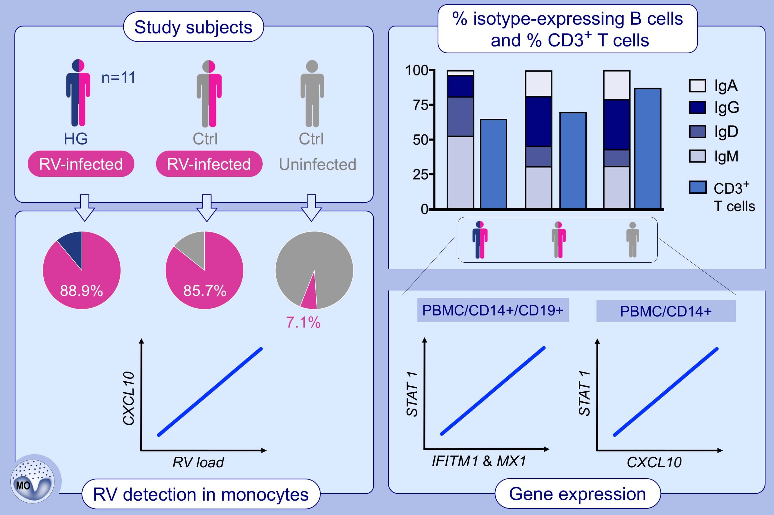
Increased antiviral response in circulating lymphocytes from hypogammaglobulinemia patients
Oliver F. Wirz, Öykü Üzülmez, Kirstin Jansen, Willem van de Veen, Auli Lammela, et al.
Allergy. 2020; 3147-3158 https://doi.org/10.1111/all.14445
© 2019 EAACI and John Wiley and Sons A/S. Published by John Wiley and Sons Ltd.
Notes:
HIGHLIGHTS
HG patients have increased levels of CD3+ T cells, IgM+ and IgG+ memory B cells and reduced number of IgA+ and IgG+ memory B cells compared to infected healthy controls.
Expression of transcription factor STAT1 correlates to downstream antiviral genes and inflammatory cytokine CXCL10 in several blood cell types from healthy and infected individuals.
RV-infection leads to increased peripheral CD14+ monocyte number in the blood and RV RNA can be detected in CD14+ monocytes from infected control subjects and HG patients.
Abbreviations: CXCL10, C-X-C motif chemokine ligand 10; HG, hypogammaglobulinemia; IFITM1, interferon-induced transmembrane protein 1; MX1, interferon-induced GTP-binding protein Mx1; PBMC, peripheral blood mononuclear cells; RV, rhinovirus; STAT1, signal transducer and activator of transcription 1

