Slide 1
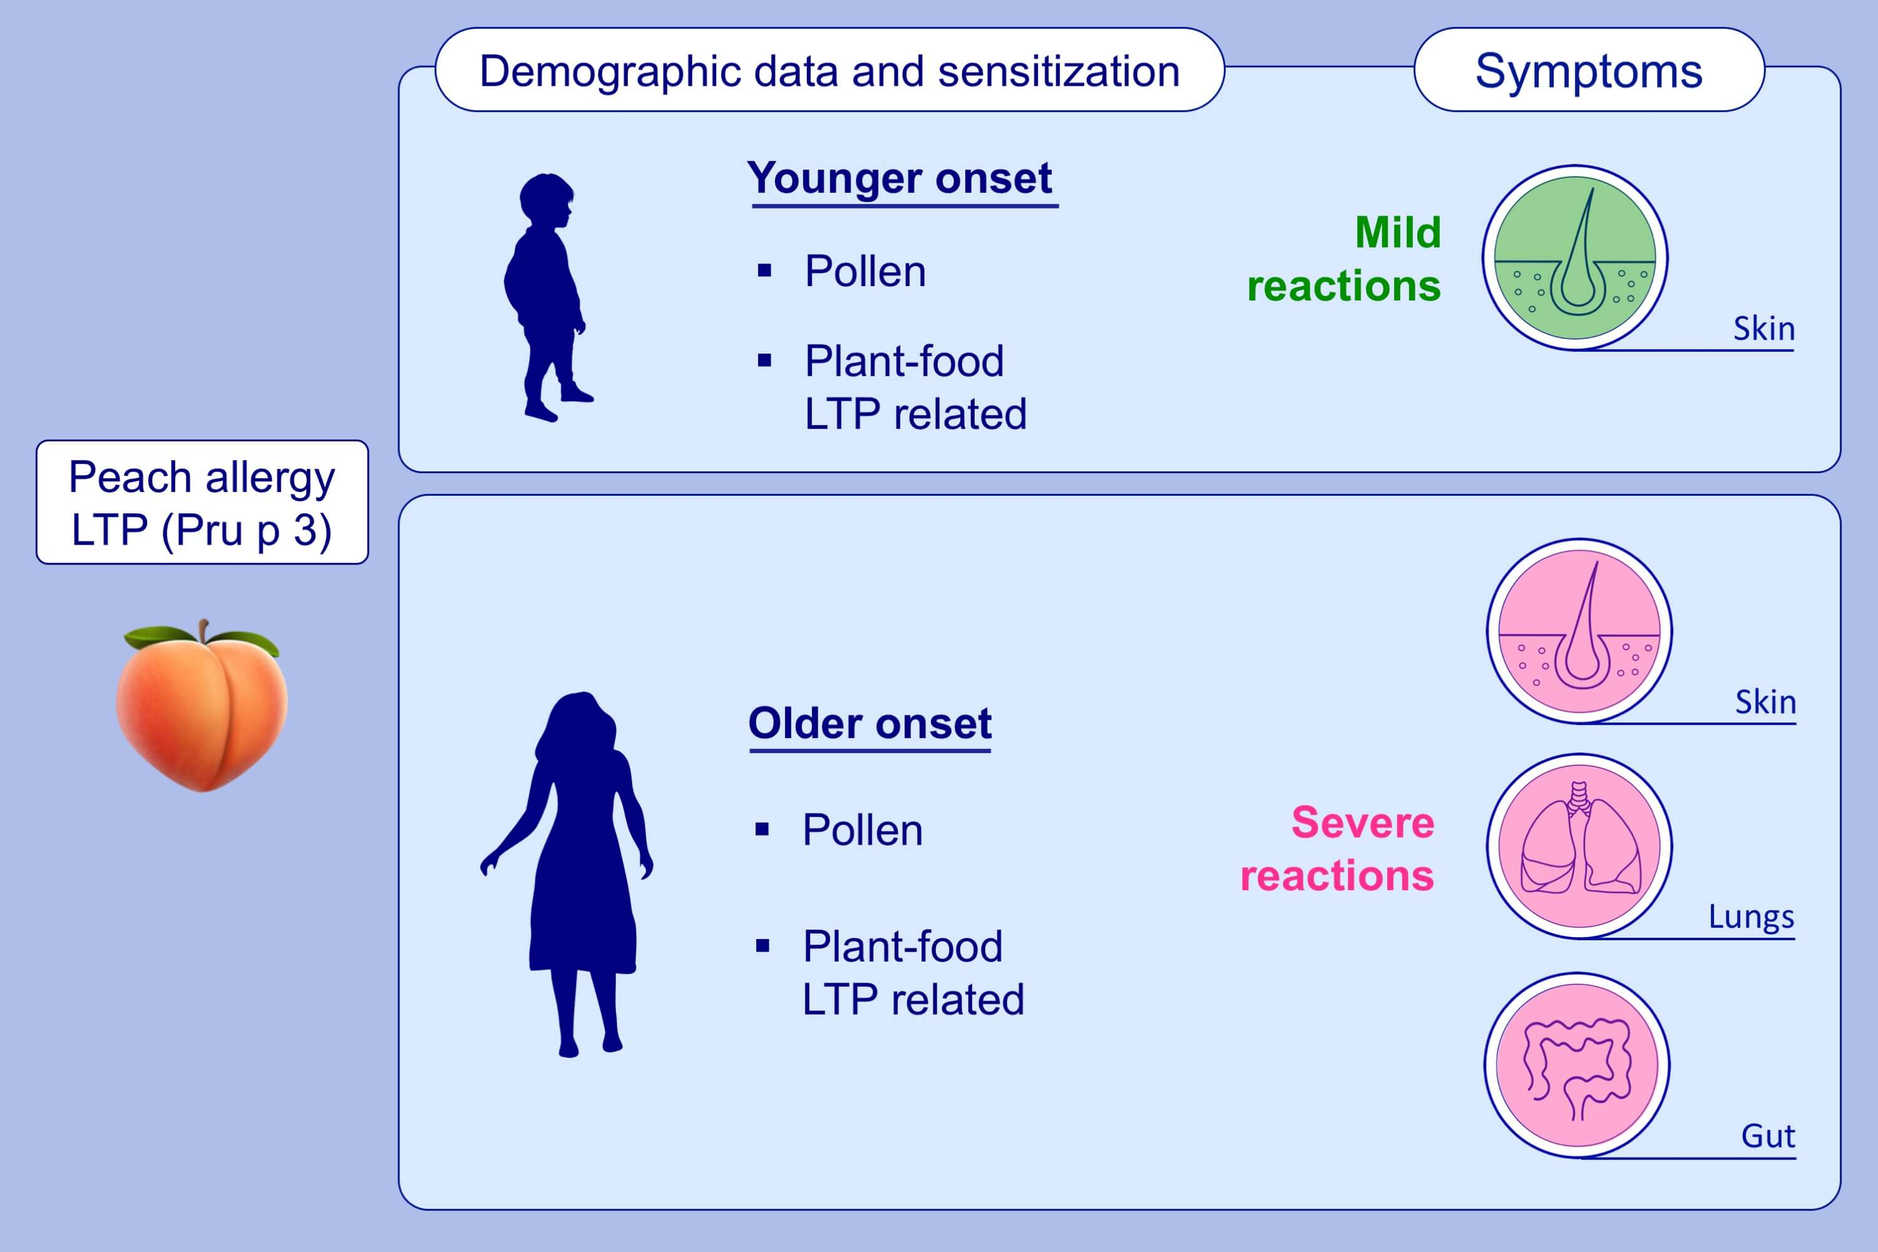
Phenotyping peach‐allergic patients sensitized to lipid transfer protein and analysing severity biomarkers
Gador Bogas, Rosa Muñoz‐Cano, Cristobalina Mayorga, Rocio Casas, Joan Bartra, et al.
Allergy. 2020; 3228-3236 https://doi.org/10.1111/all.14447
© 2019 EAACI and John Wiley and Sons A/S. Published by John Wiley and Sons Ltd.
Notes:
HIGHLIGHTS
Most LTP-dependent peach-allergic patients with an early onset end up suffering from an LTP-syndrome.
An early intervention could potentially reduce the risk of developing an LTP-syndrome.
Pollen sensitisation profiles could be used as a severity biomarker.
Abbreviation: LTP, lipid transfer protein

