Slide 1
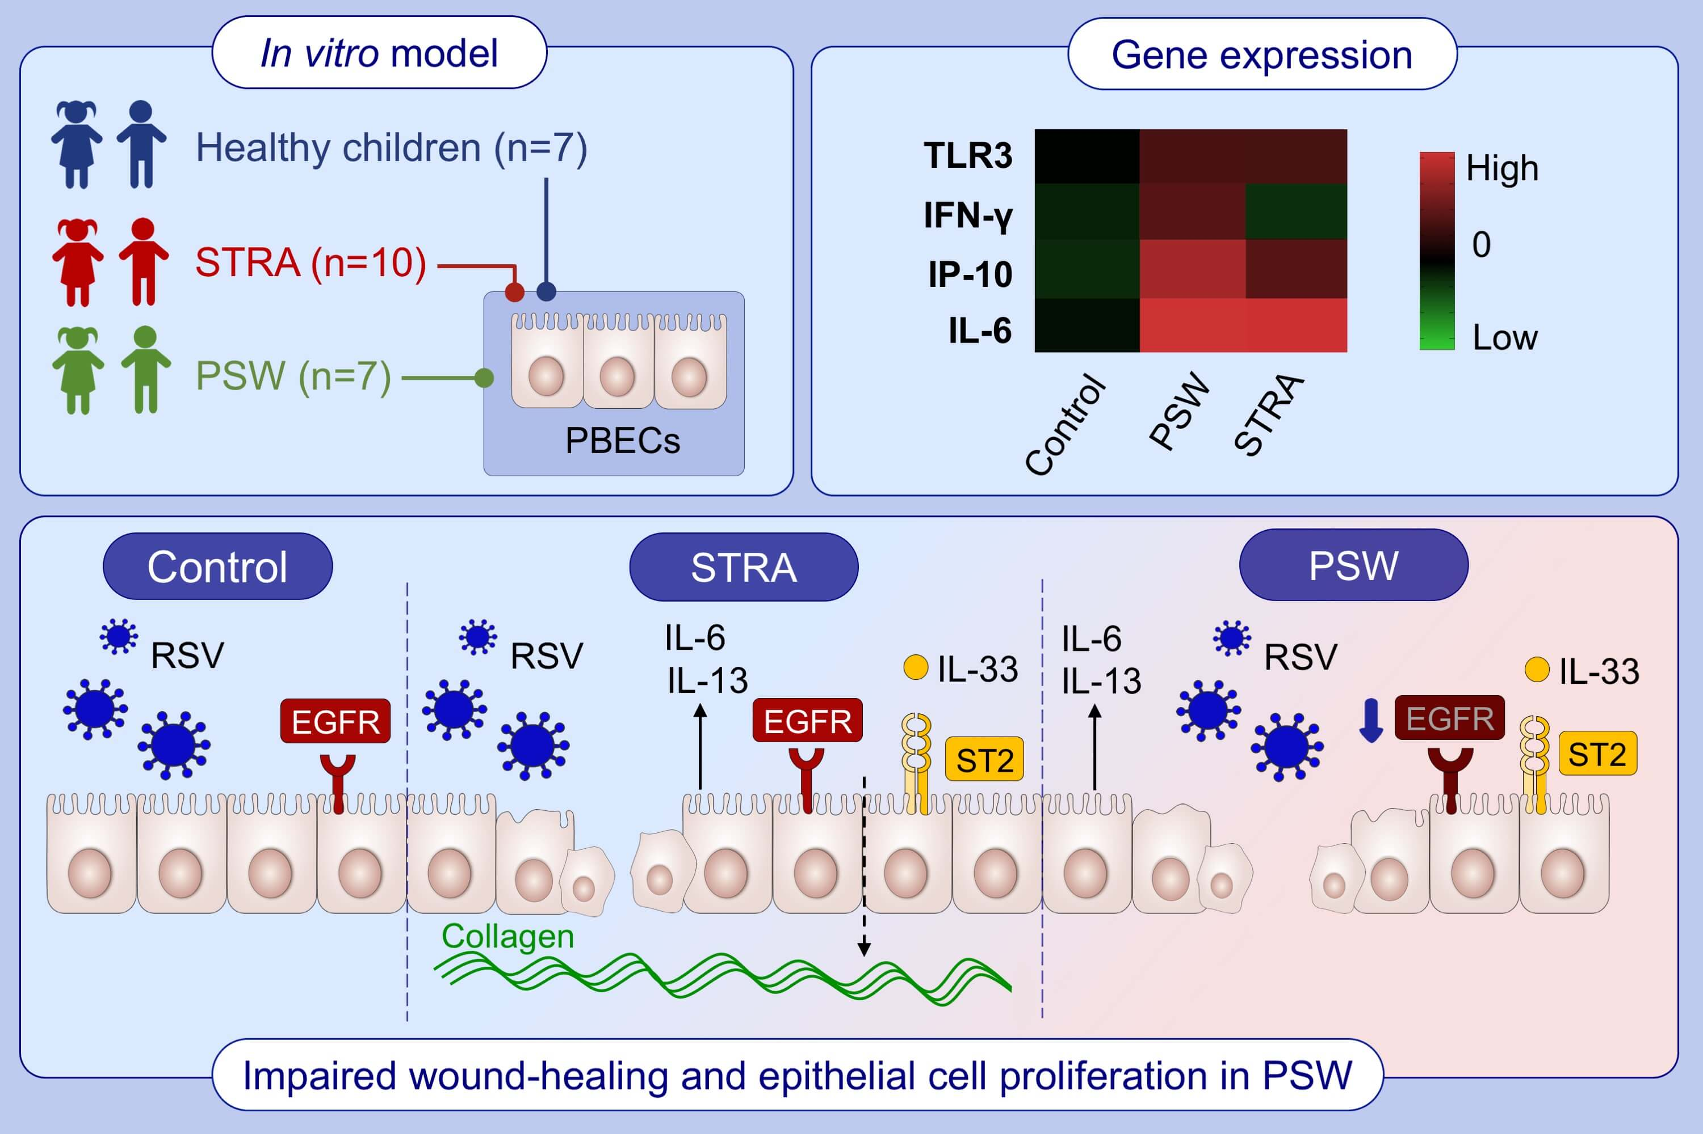
Impaired airway epithelial cell wound‐healing capacity is associated with airway remodelling following RSV infection in severe preschool wheeze
Cecilia K. Andersson, Jua Iwasaki, James Cook, Polly Robinson, Prasad Nagakumar, et al.
Allergy. 2020; 3195-3207 https://doi.org/10.1111/all.14466
© 2019 EAACI and John Wiley and Sons A/S. Published by John Wiley and Sons Ltd.
Notes:
HIGHLIGHTS
In response to RSV, PBECs from children with STRA and PSW demonstrate increased TLR3 gene expression and enhanced secretion of pro-inflammatory cytokines compared to controls.
IL-33 expression correlates with collagen deposition in children with STRA and PSW.
Despite the increased antiviral responses, airway epithelial proliferative responses following barrier damage are impaired in children with PSW.
Abbreviations: EGFR, epithelial growth factor receptor; IFN-γ, interferon-γ;
IP-10, IFN-γ-inducible protein 10; PBECs, primary bronchial epithelial cells; PSW, pre-school wheeze; RSV, respiratory syncytial virus; STRA, severe therapy resistant asthma; TLR3, toll-like receptor

