Slide 1
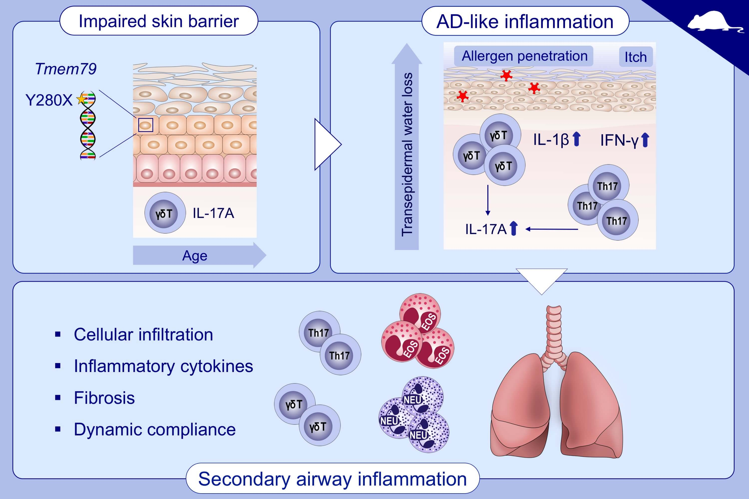
Dysregulated skin barrier function in Tmem79 mutant mice promotes IL‐17A‐dependent spontaneous skin and lung inflammation
Sean P. Saunders, Achilleas Floudas, Tara Moran, Ciara M. Byrne, Michael D. Rooney, et al.
Allergy. 2020; 3216-3227 https://doi.org/10.1111/all.14488
© 2019 EAACI and John Wiley and Sons A/S. Published by John Wiley and Sons Ltd.
Notes:
HIGHLIGHTS
A single mutation in Tmem79 causes a dysregulation of skin barrier integrity, which – with increasing age - lead to the development of spontaneous dermatitis and subsequent lung inflammation.
In Tmem79^{ma/ma} mice, IL-17A-producing γδ T cells and Th17 cells infiltrate the skin prior to the occurrence of pulmonary disease.
Progression from skin to lung inflammation is dependent on the presence of γδ T cells and IL-17A.
Abbreviation: Tmem79, transmembrane protein 79

