Slide 1
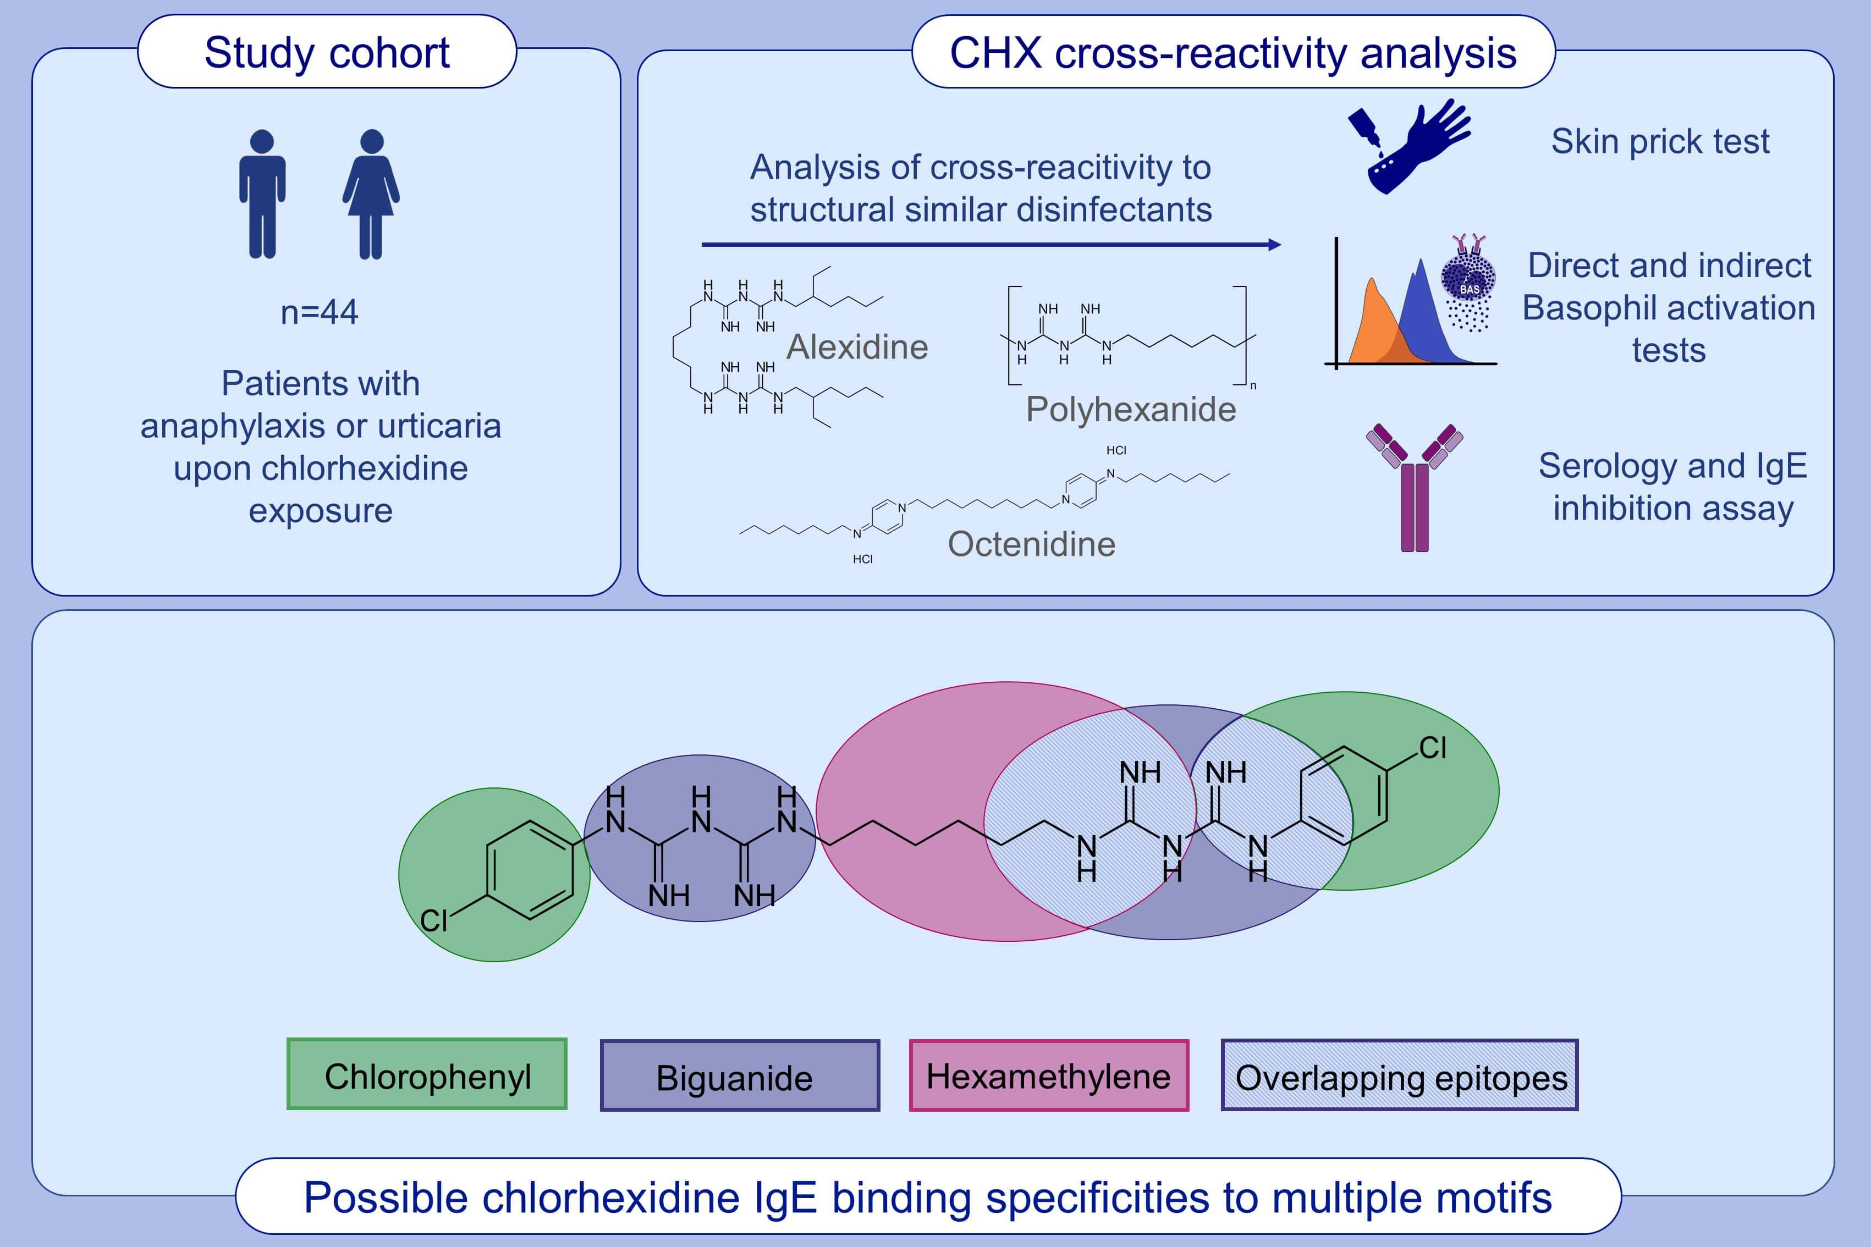
IgE‐mediated chlorhexidine allergy—Cross‐reactivity with other biguanide disinfectants
Nicole Mueller‐Wirth, Antonia Buenter, Lukas Jörg, Didier G. Ebo, Martin Glatz, et al.
Allergy. 2020; 3237-3247 https://doi.org/10.1111/all.14497
© 2019 EAACI and John Wiley and Sons A/S. Published by John Wiley and Sons Ltd.
Notes:
HIGHLIGHTS
CHX is composed of chlorophenyl, biguanide and hexamethylene structures. These offer binding sites for IgE seen in chlorhexidine allergic individuals.
Chlorophenyl is unique for CHX and the dominant epitope.
25-30% of CHX allergic individuals contain specific IgE to biguanide and hexamethylene structures, which are also present in alexidine or polyhexanide and might be responsible for cross-reactivity with other biguanide disinfectants.
Abbreviation: CHX, chlorhexidine

