Slide 1
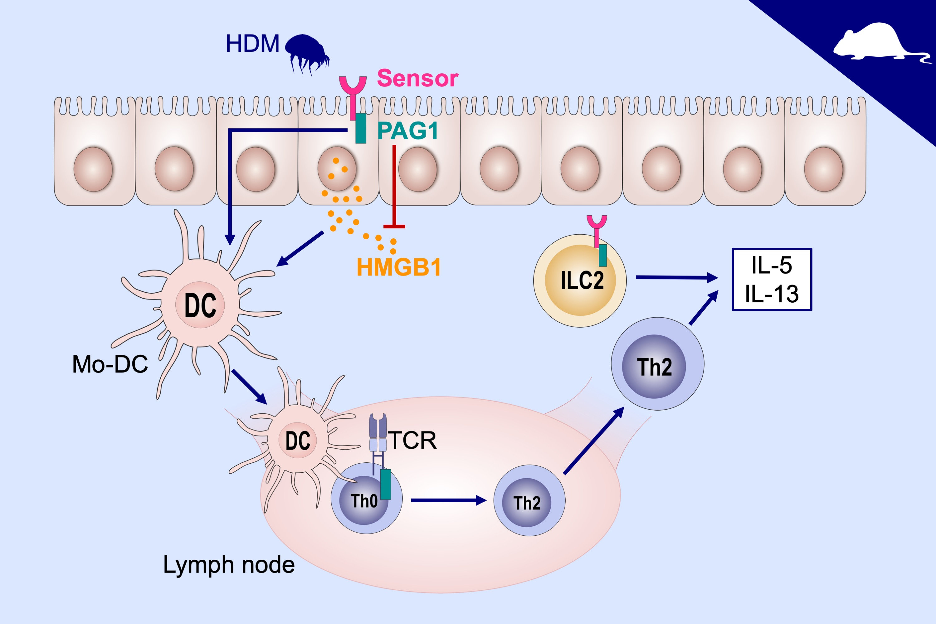
PAG1 limits allergen‐induced type 2 inflammation in the murine lung
Md Ashik Ullah, Cristina T. Vicente, Natasha Collinson, Bodie Curren, Md Al Amin Sikder, et al.
Allergy. 2020; 336-345 https://doi.org/10.1111/all.13991
© 2019 EAACI and John Wiley and Sons A/S. Published by John Wiley and Sons Ltd.
Notes:
HIGHLIGHTS
• PAG1 deficiency negatively regulates the release of epithelial HMGB1 following allergic sensitization.
• PAG1 deficiency promotes allergic sensitization by increasing the recruitment of monocyte-derived DCs and type-2 innate lymphoid cells and enhanced differentiation of CD4+ T cells into TH2
cells.
• Consequently, allergen-induced type 2 inflammation is aggravated in the lungs of PAG1-deficient mice.
ABBREVIATIONS
HDM, house dust mite; HMGB1: high-mobility group box 1; Mo-DC, monocyte-derived DCs; PAG1, phosphoprotein associated with glycosphingolipid-enriched microdomains 1

