Slide 1
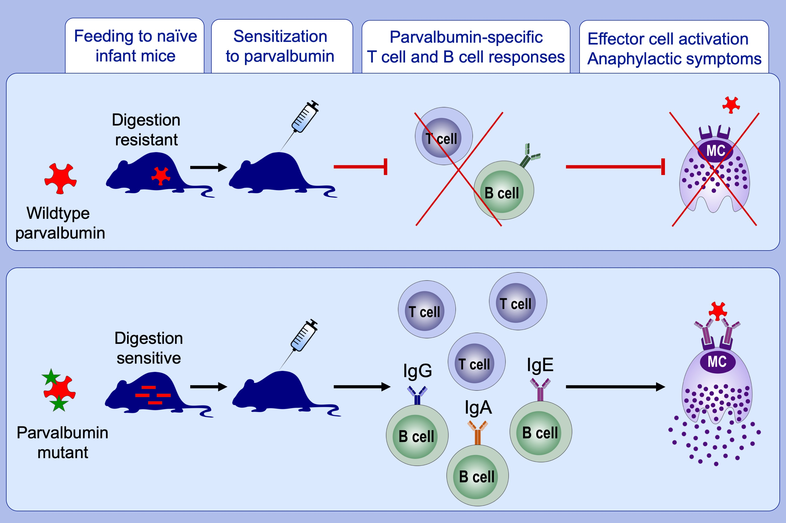
Resistance of parvalbumin to gastrointestinal digestion is required for profound and long‐lasting prophylactic oral tolerance
Raphaela Freidl, Antonia Gstöttner, Ulrike Baranyi, Ines Swoboda, Frank Stolz, et al.
Allergy. 2020; 326-335 https://doi.org/10.1111/all.13994
© 2019 EAACI and John Wiley and Sons A/S. Published by John Wiley and Sons Ltd.
Notes:
HIGHLIGHTS
• The calcium-binding protein parvalbumin, a major and cross-reactive allergen for fish allergic patients, induces robust and long-lasting immunological and clinical oral tolerance in a murine
model of fish allergy.
• A recombinant parvalbumin mutant, that resembled the wild-type parvalbumin regarding biochemical and immunological properties, but was more sensitive to in vitro digestion, failed to induce
oral tolerance.
• Sensitivity to digestion in the gastrointestinal tract influences the capacity of an allergen to induce prophylactic oral tolerance.

