Slide 1
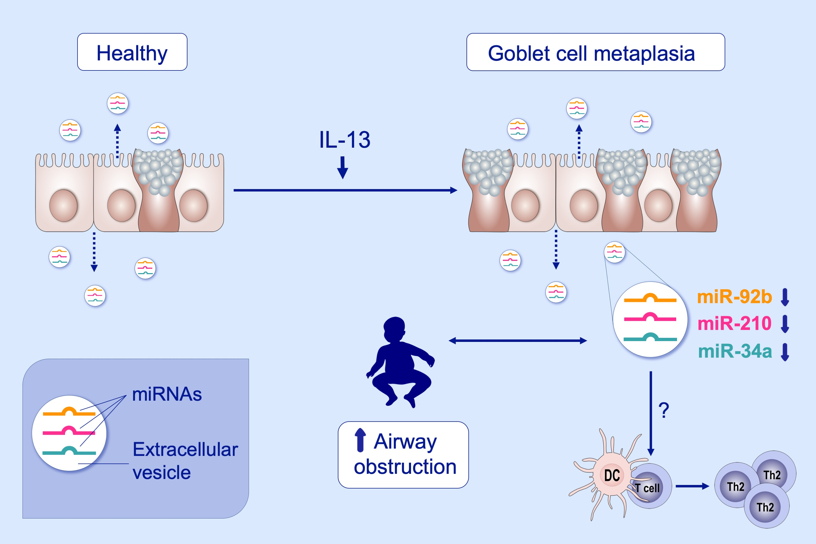
Human airway epithelial extracellular vesicle miRNA signature is altered upon asthma development
Sabine Bartel, Stefania La Grutta, Giovanna Cilluffo, Giovanni Perconti, Antonella Bongiovanni, et al.
Allergy. 2020; 346-356 https://doi.org/10.1111/all.14008
© 2019 EAACI and John Wiley and Sons A/S. Published by John Wiley and Sons Ltd.
Notes:
HIGHLIGHTS
• Primary human bronchial epithelial cells secrete microRNA-containing extracellular vesicles (EV) apically and basally.
• Upon Interleukin-13- induced goblet cell metaplasia, miR-34a, miR-92b, and miR-210 levels in EVs are lower, which is predicted to influence dendritic cell maturation and Th2 polarization.
• Lower levels of these microRNAs in EVs in nasal lavages correlate with increased airway obstruction in children.

