Slide 1
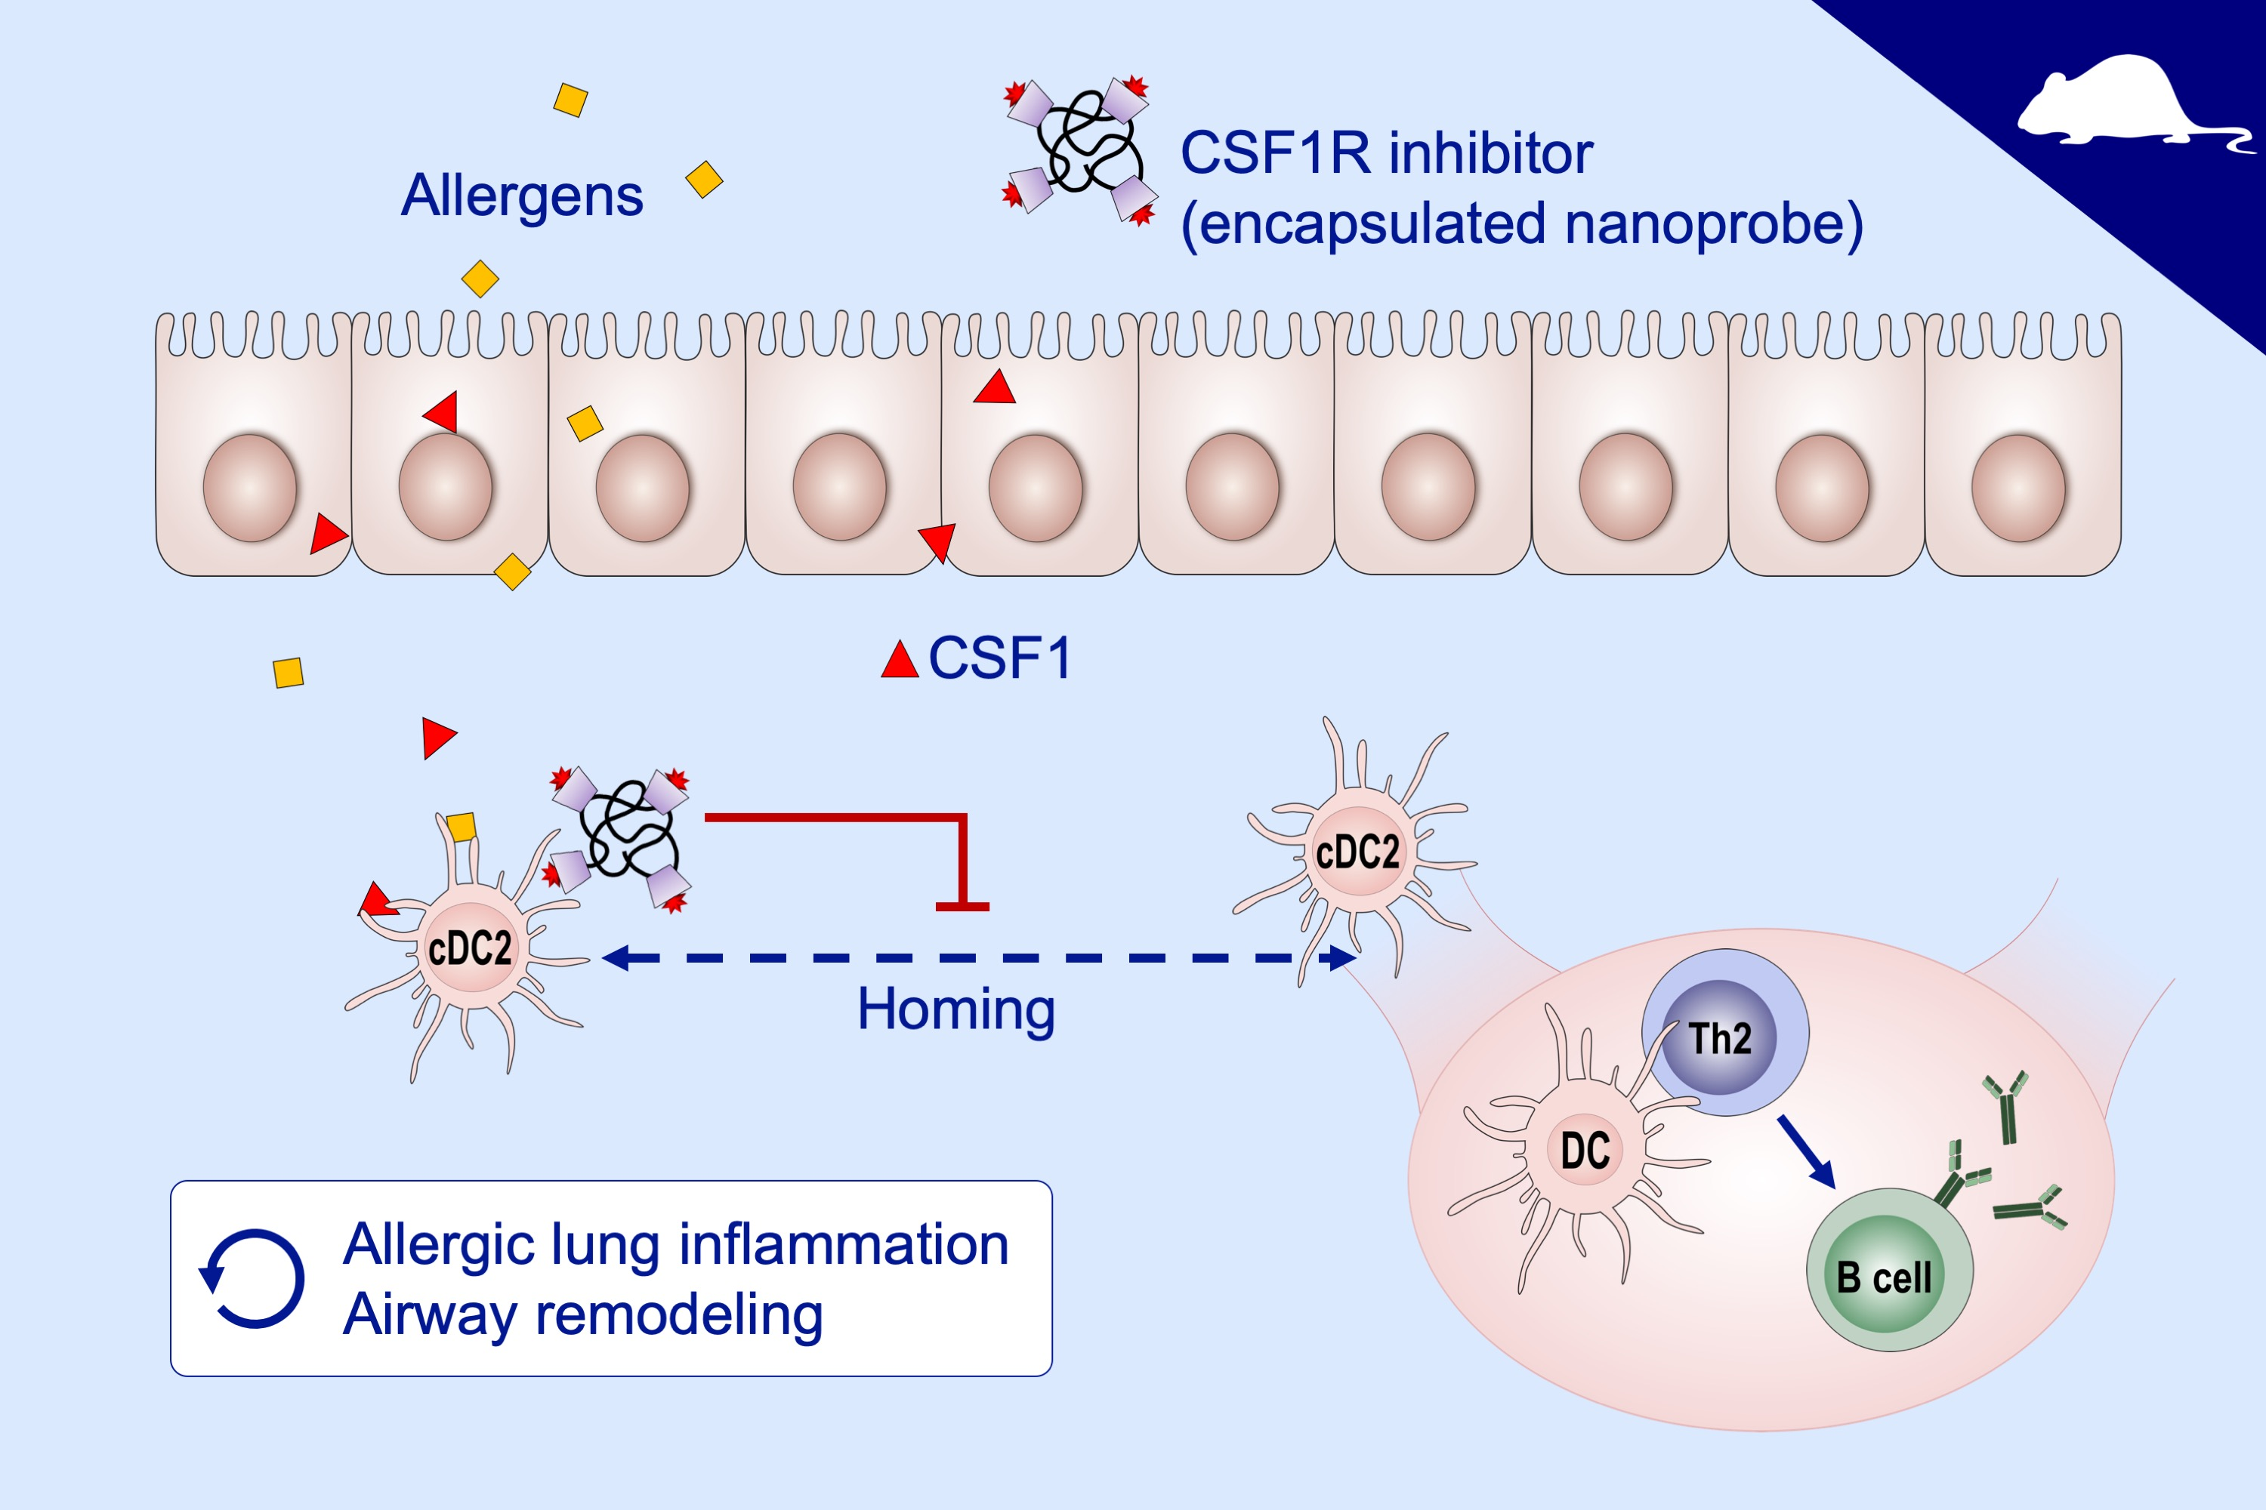
Colony‐stimulating factor 1 and its receptor are new potential therapeutic targets for allergic asthma
Hyung‐Geun Moon, Seung‐jae Kim, Myoung Kyu Lee, Homan Kang, Hak Soo Choi, et al.
Allergy. 2020; 357-369 https://doi.org/10.1111/all.14011
© 2019 EAACI and John Wiley and Sons A/S. Published by John Wiley and Sons Ltd.
Notes:
HIGHLIGHTS
• Genetic manipulation or pharmacological inhibition of the CSF1-CSF1R signaling pathway suppresses allergen sensitization and lowers the production of allergen-specific serum IgE.
• Inhibition of the CSF1-CSF1R pathway reverses established chronic allergic inflammation and airway remodeling.
• Intranasal delivery of CSF1R inhibitor carrying nanoprobes has efficacy and shows favorable pharmacokinetics without significant adverse effects.
ABBREVIATIONS
CSF1, colony stimulating factor 1

