Slide 1
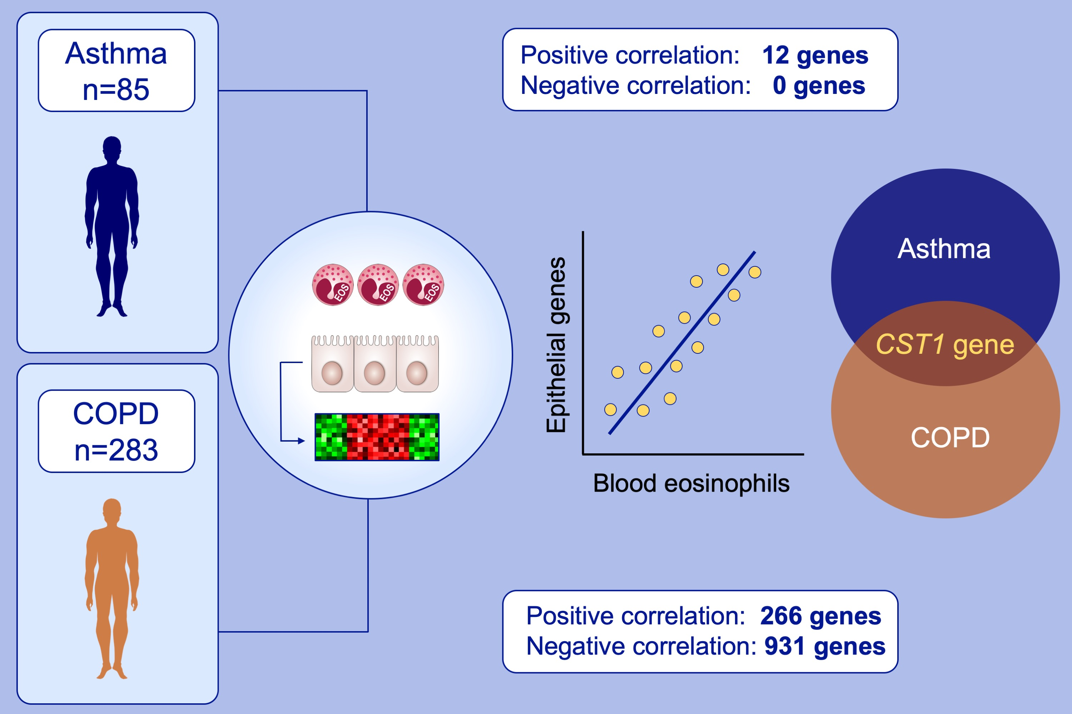
Blood eosinophil count and airway epithelial transcriptome relationships in COPD versus asthma
Leena George, Adam R. Taylor, Anna Esteve‐Codina, María Soler Artigas, Gian Andri Thun, et al.
Allergy. 2020; 370-380 https://doi.org/10.1111/all.14016
© 2019 EAACI and John Wiley and Sons A/S. Published by John Wiley and Sons Ltd.
Notes:
HIGHLIGHTS
• In a chronic obstructive pulmonary disease (COPD) cohort (EvA, n= 283), 12 genes, whereas in asthma cohort (UBIOPRED, n = 85), 1197 genes in bronchial epithelial brushes were correlated with a blood eosinophil count.
• The gene CST1 was common to eosinophilic asthma and COPD and was replicated in independent cohorts.
• Despite shared “treatable traits” between asthma and COPD, the molecular mechanisms underlying these clinical entities are predominately different.

