Slide 1
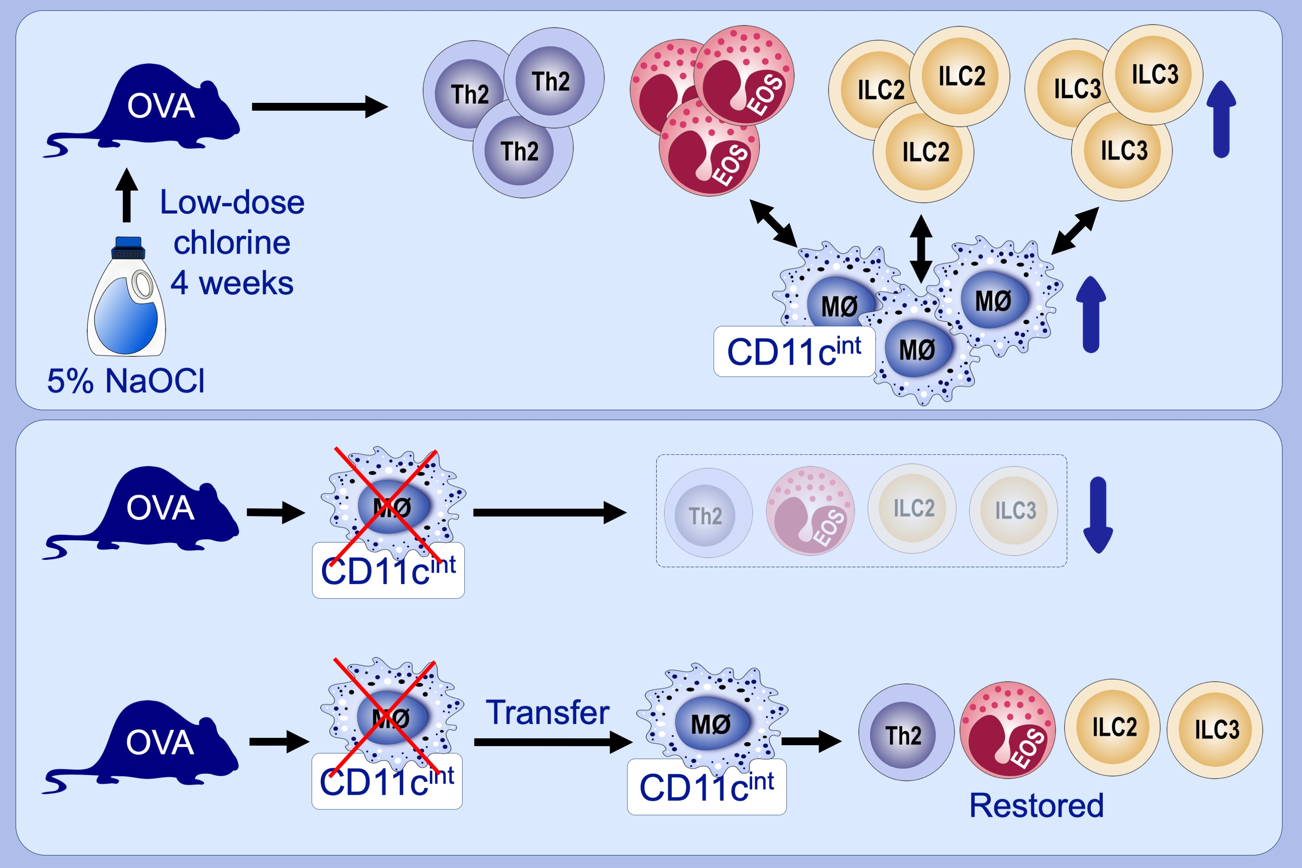
Aggravation of asthmatic inflammation by chlorine exposure via innate lymphoid cells and CD11cintermediate macrophages
Ji‐Su Shim, Hyun‐Seung Lee, Da‐Eun Park, Ji Won Lee, Boram Bae, et al.
Allergy. 2020; 381-391 https://doi.org/10.1111/all.14017
© 2019 EAACI and John Wiley and Sons A/S. Published by John Wiley and Sons Ltd.
Notes:
HIGHLIGHTS
• When ovalbumin-induced asthmatic mice were exposed to low-dose chlorine gas, significant increases in eosinophils, type 2 T helper cells, group 2 and 3 innate lymphoid cells, and
CD11cintermediate macrophages occurred.
• The deletion and adoptive transfer of CD11cintermediate macrophages revealed that these particular types of macrophages were crucial for the maintenance of group 2 and 3 innate lymphoid
cells, and subsequently eosinophils and type 2 T helper cells.
ABBREVIATIONS
NaOCl, sodium hypochlorite; OVA, ovalbumin

