Slide 1
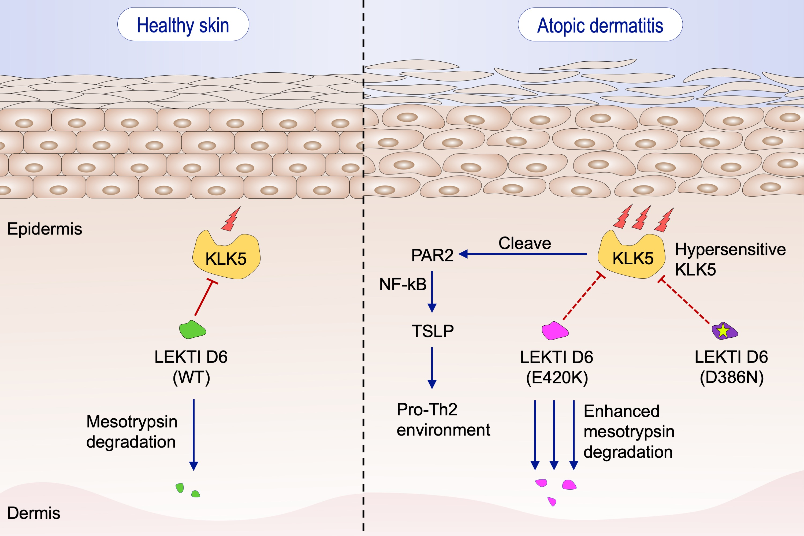
Exonic mutations associated with atopic dermatitis disrupt lympho‐epithelial Kazal‐type related inhibitor action and enhance its degradation
Karthik Ramesh, Sri Anusha Matta, Fook Tim Chew, Yu Keung Mok
Allergy. 2020; 403-411 https://doi.org/10.1111/all.14018
© 2019 EAACI and John Wiley and Sons A/S. Published by John Wiley and Sons Ltd.
Notes:
HIGHLIGHTS
• KLK5 protease is responsible for skin homeostasis and is under the tight inhibitory control of the multidomain proteinase inhibitor, LEKTI, encoded by SPINK5.
• D386N SNP at the active site of LEKTI disrupts its inhibitory activity, whereas E420K SNP enhances its degradation by mesotrypsin.
• Hyperactive KLK5 cleave PAR2 and activate TSLP leading to Pro-Th2 innate immune response independent of skin barrier function and environmental factors.
ABBREVIATIONS
KLK5, Kallikrein 5; LEKTI, Lympho-epithelial Kazaltype- related inhibitor; NF-κB, Nuclear factor κB; PAR2, Protease activated receptor 2; SNP, Single nucleotide polymorphism; TSLP,
Thymic stromal lymphopoietin; WT, Wild-type

