Slide 1
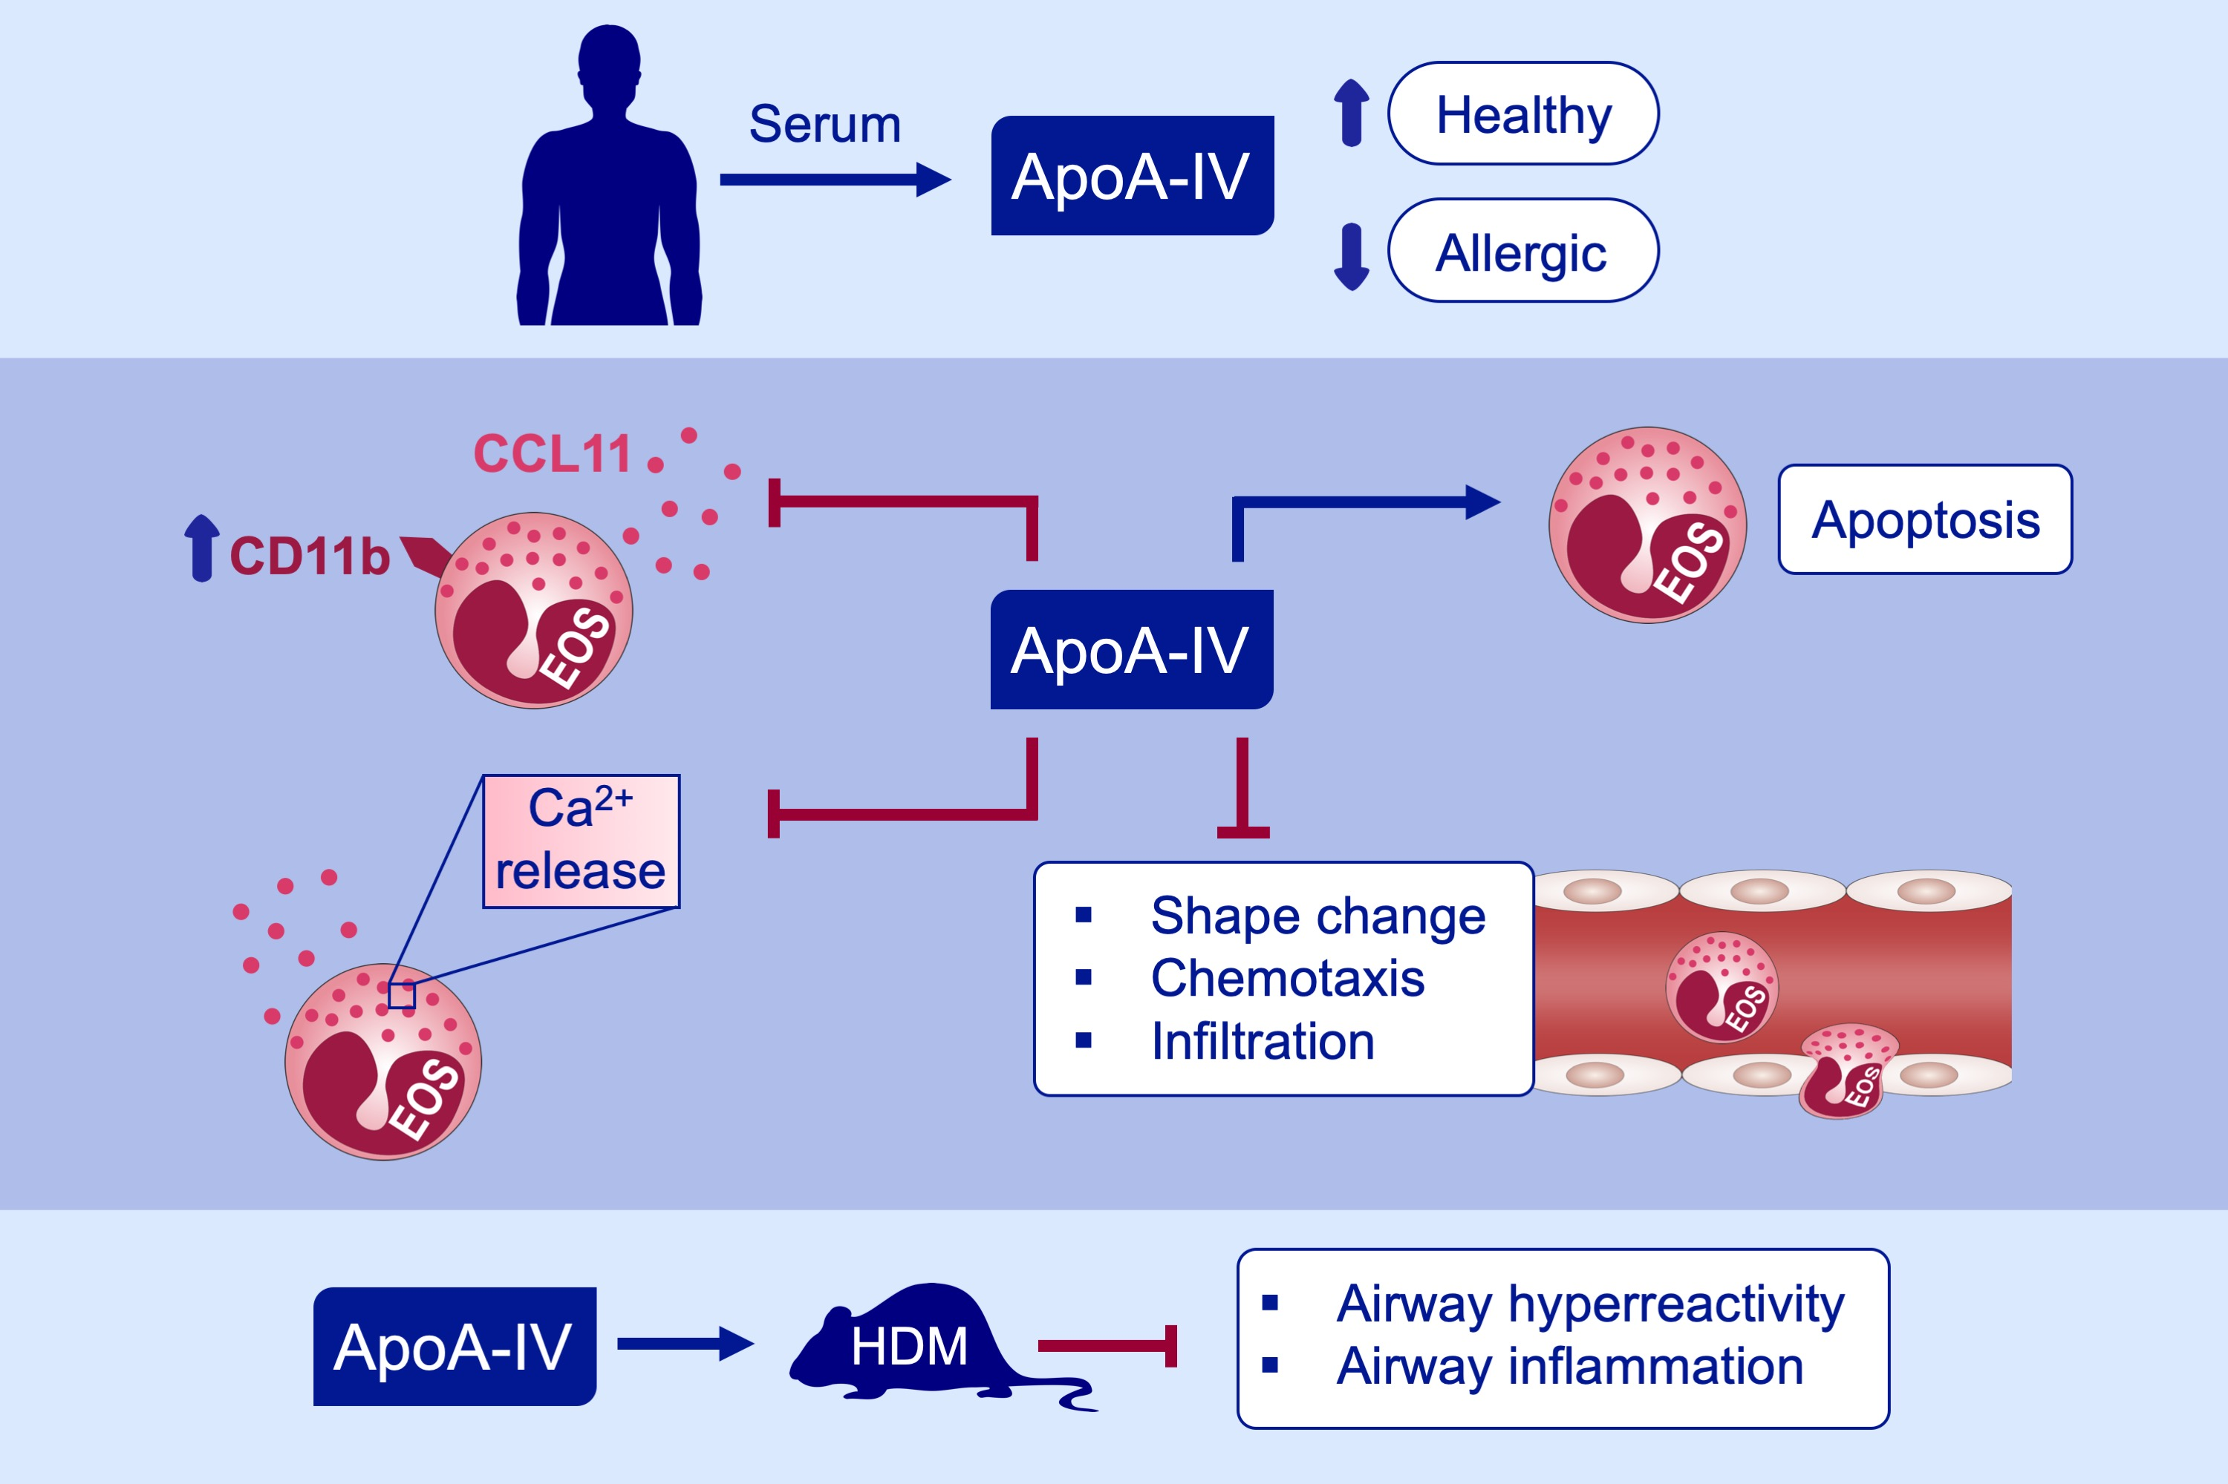
Apolipoprotein A‐IV acts as an endogenous anti‐inflammatory protein and is reduced in treatment‐naïve allergic patients and allergen‐challenged mice
David Roula, Anna Theiler, Petra Luschnig, Gunter J. Sturm, Peter V. Tomazic, et al.
Allergy. 2020; 392-402 https://doi.org/10.1111/all.14022
© 2019 EAACI and John Wiley and Sons A/S. Published by John Wiley and Sons Ltd.
Notes:
HIGHLIGHTS
• ApoA-IV is decreased in serum from untreated allergic patients compared to healthy controls.
• ApoA-IV potently inhibits eosinophil function in vitro.
• Systemic application of ApoA-IV reduces airway hyperreactivity and airway eosinophilia in a murine model of allergic asthma.
ABBREVIATIONS
ApoA-IV, apolipoprotein A-IV; HDM, house dust mite

