Slide 1
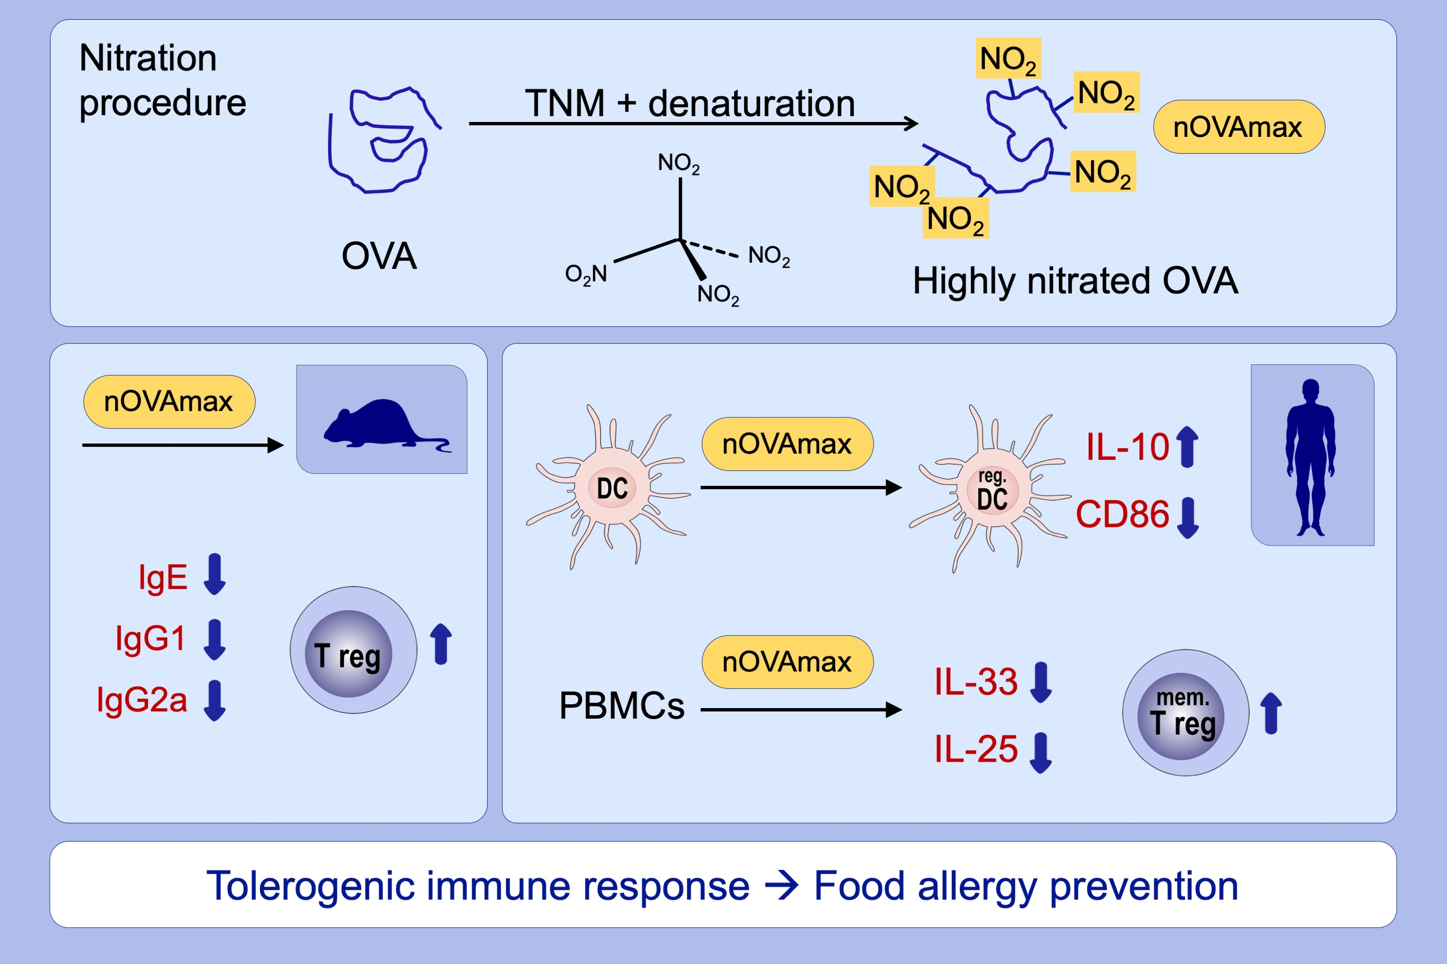
Nitrated food proteins induce a regulatory immune response associated with allergy prevention after oral exposure in a Balb/c mouse food allergy model
Nazanin Samadi, Martina Klems, Denise Heiden, Renate Bauer, Claudia Kitzmüller, et al.
Allergy. 2020; 412-422 https://doi.org/10.1111/all.14030
© 2019 EAACI and John Wiley and Sons A/S. Published by John Wiley and Sons Ltd.
Notes:
HIGHLIGHTS
• Oral pre-exposure to highly nitrated food proteins is associated with prevention of food allergy development and immune tolerance as evidenced by suppressed allergen-specific IgE levels and
enhanced Tregs.
• A regulatory moDC phenotype indicated by low expression of costimulatory molecules and higher secretion of IL-10 was observed after pre-incubation with highly nitrated proteins.
• Secondary protein structure of highly nitrated allergens is substantially altered potentially being associated with the capacity to induce a tolerogenic immune response.
ABBREVIATIONS
OVA: ovalbumin; PBMCs, peripheral blood mononuclear cells; TNM, tetranitromethane

