Slide 1
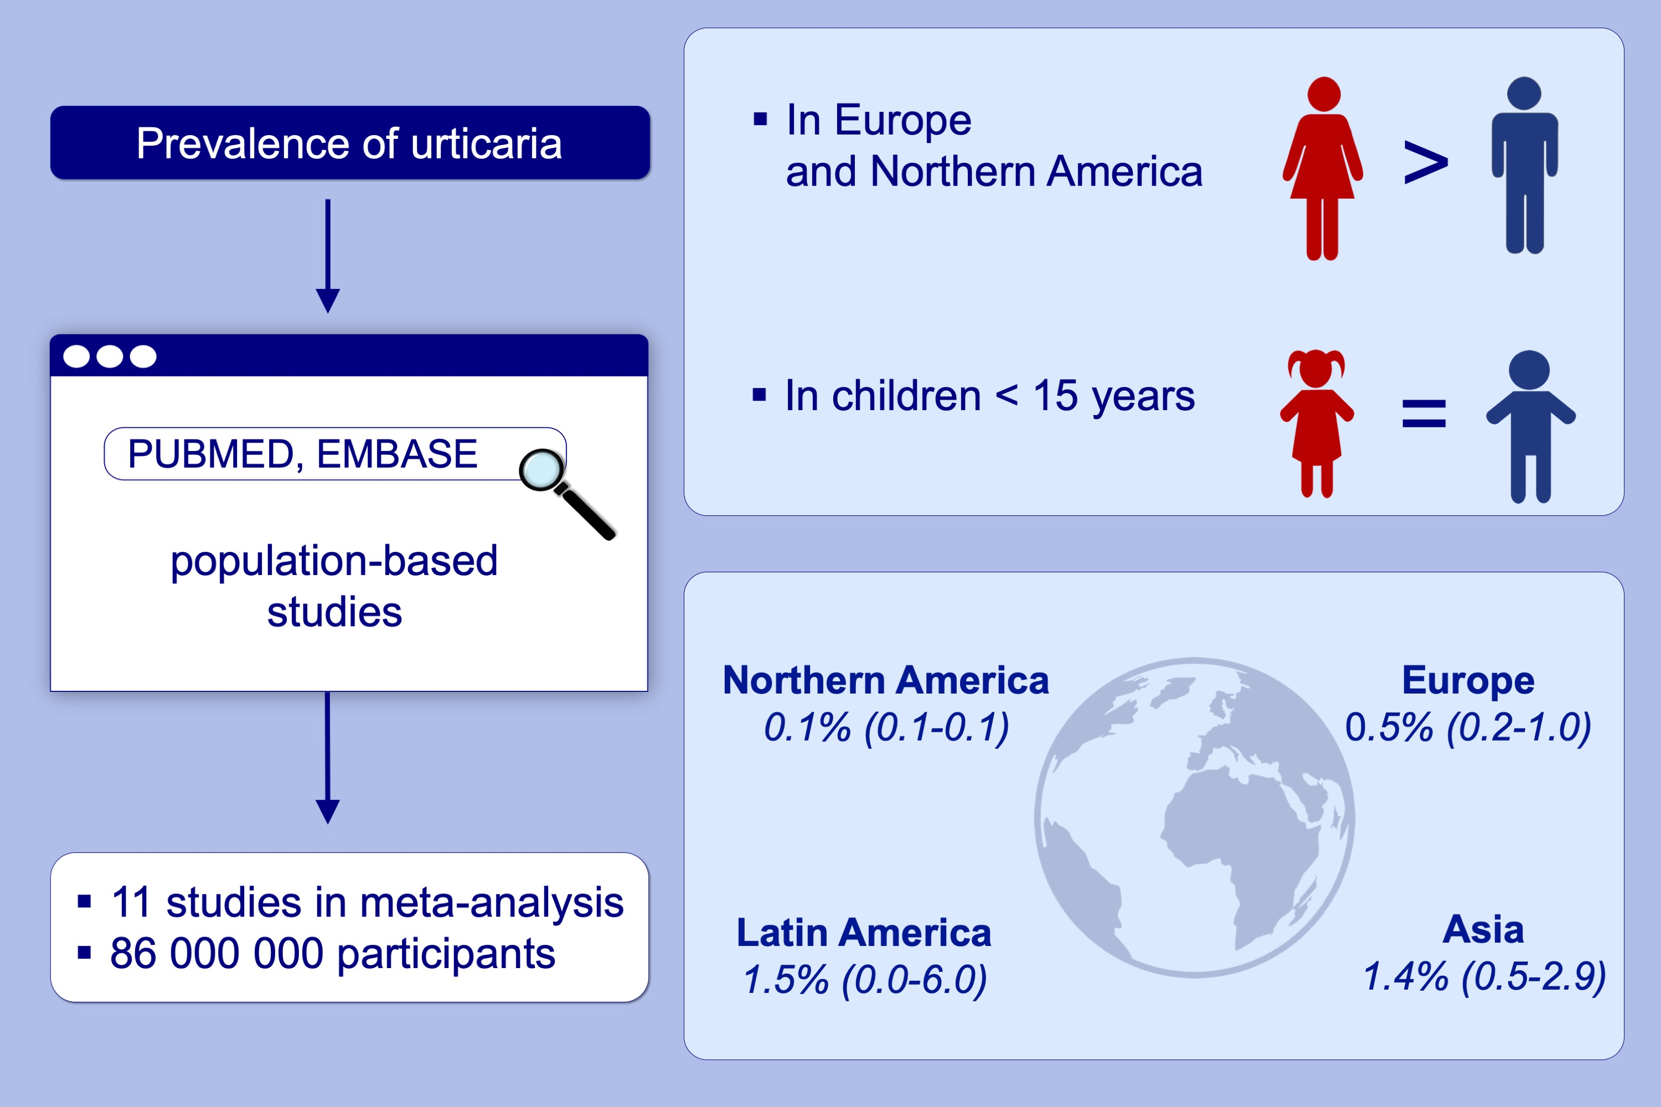
Prevalence of chronic urticaria in children and adults across the globe: Systematic review with meta‐analysis
Julia Fricke, Gabriela Ávila, Theresa Keller, Karsten Weller, Susanne Lau, et al.
Allergy. 2020; 423-432 https://doi.org/10.1111/all.14037
© 2019 EAACI and John Wiley and Sons A/S. Published by John Wiley and Sons Ltd.
Notes:
HIGHLIGHTS
• We evaluated the prevalence of chronic urticaria worldwide by performing a systematic search in PUBMED and EMBASE.
• Chronic urticaria seems to be more prevalent in Asia than in Europe and Northern America.
• Women in Europe and Northern America were more affected by chronic urticaria than men, whereas in children < 15 years we did not find a sex-specific difference.

