Slide 1
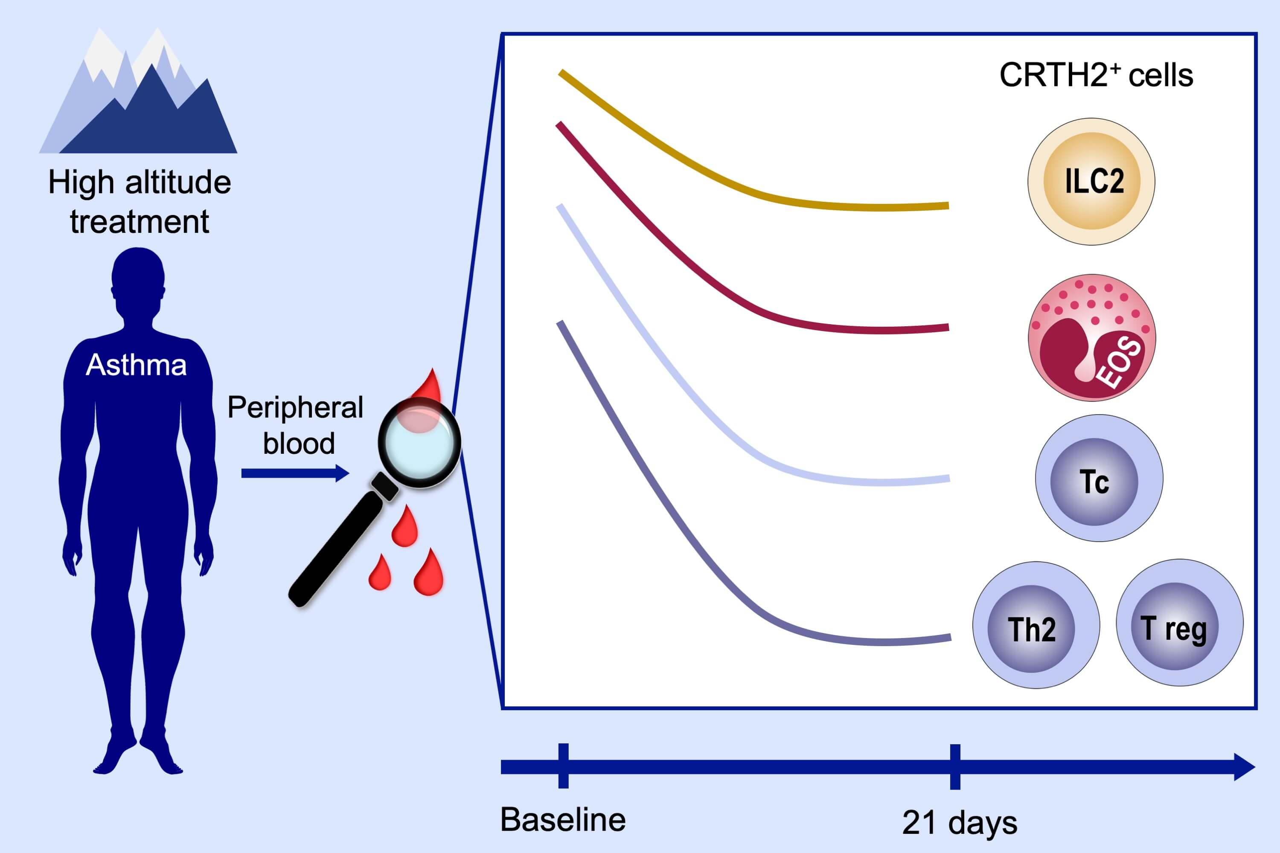
Impact of high‐altitude therapy on type‐2 immune responses in asthma patients
Tadech Boonpiyathad, Gertruda Capova, Hans‐Werner Duchna, Andrew L. Croxford, Herve Farine, et al.
Allergy. 2020; 84-94 https://doi.org/10.1111/all.13967
© 2019 EAACI and John Wiley and Sons A/S. Published by John Wiley and Sons Ltd.
Notes:
HIGHLIGHTS
• High-altitude therapy of asthma reduces the frequencies of chemoattractant receptor homolog expressed on Th2 cells (CRTH2) innate lymphoid cells, activated eosinophils, helper and cytotoxic T cells.
• CRTH2+ T regulatory cells are defective in their suppressive function and show less suppressive function in PGD2-stimulated cultures.
• High-altitude therapy improves asthma symptoms associated with the correction of dysregulated type-2 and T regulatory responses.
ABBREVIATIONS
CRTH2, Chemoattractant receptor-homologous molecule expressed on TH2 cells; PGD2, Prostaglandin D2

