Slide 1
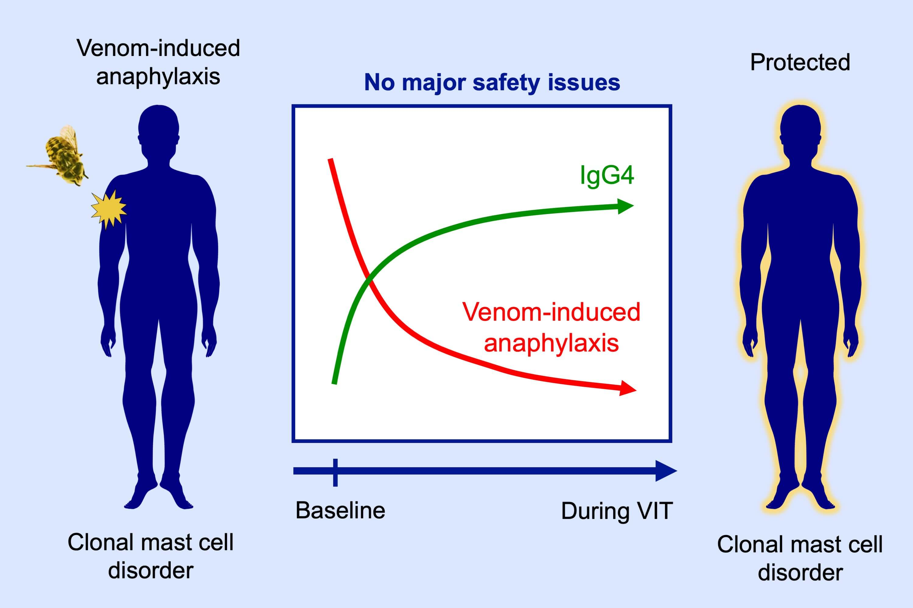
Venom immunotherapy in patients with clonal mast cell disorders: IgG4 correlates with protection
Jesper Jarkvist, Clara Salehi, Cem Akin, Theo Gülen
Allergy. 2020; 169-177 https://doi.org/10.1111/all.13980
© 2019 EAACI and John Wiley and Sons A/S. Published by John Wiley and Sons Ltd.
Notes:
HIGHLIGHTS
• Patients with clonal mast cell disorders (cMCD) convey increased risk for venom-induced anaphylaxis and lifelong venom-immunotherapy (VIT) is recommended, when appropriate.
• VIT appears to be rather safe and effective in cMCD patients, as the risk of severe adverse reactions are rare.
• Elevated levels of venom-specific IgG4 correlates with protection from re-sting anaphylaxis in cMCD patients during VIT.

