Slide 1
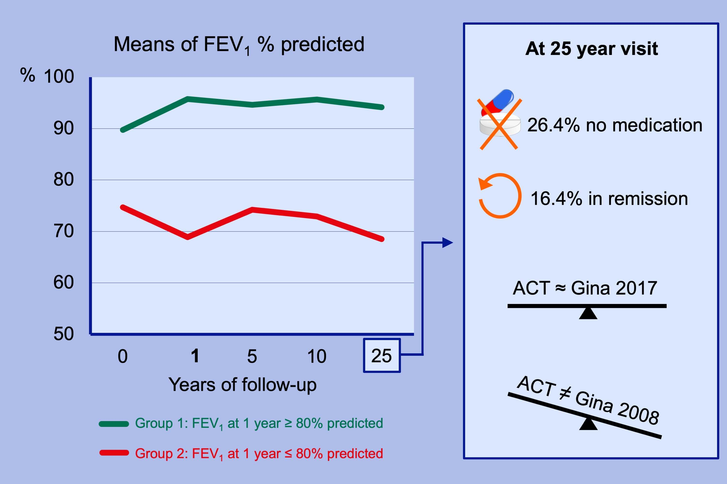
The first year of treatment predicts the prognosis of asthma over 25 y—A prospective study
Ritva Kauppinen, Vesa Vilkka, Harri Sintonen, Jouni Hedman
Allergy. 2020; 75-83 https://doi.org/10.1111/all.13983
© 2019 EAACI and John Wiley and Sons A/S. Published by John Wiley and Sons Ltd.
Notes:
HIGHLIGHTS
• In adult-onset asthma, the level of FEV1% reached during the first treatment year predicts the later lung function level.
• 26.4% of the patients had discontinued their medication, and 16.4 % were in clinical remission with good HRQoL.
• The patients' perceptions of their asthma control level were closely aligned as assessed by the Asthma Control Test and GINA 2017, but GINA 2008 yielded discrepancies.
ABBREVIATIONS
FEV1, Forced expiratory volume in one second; HRQoL, Health-related quality of life

