Slide 1
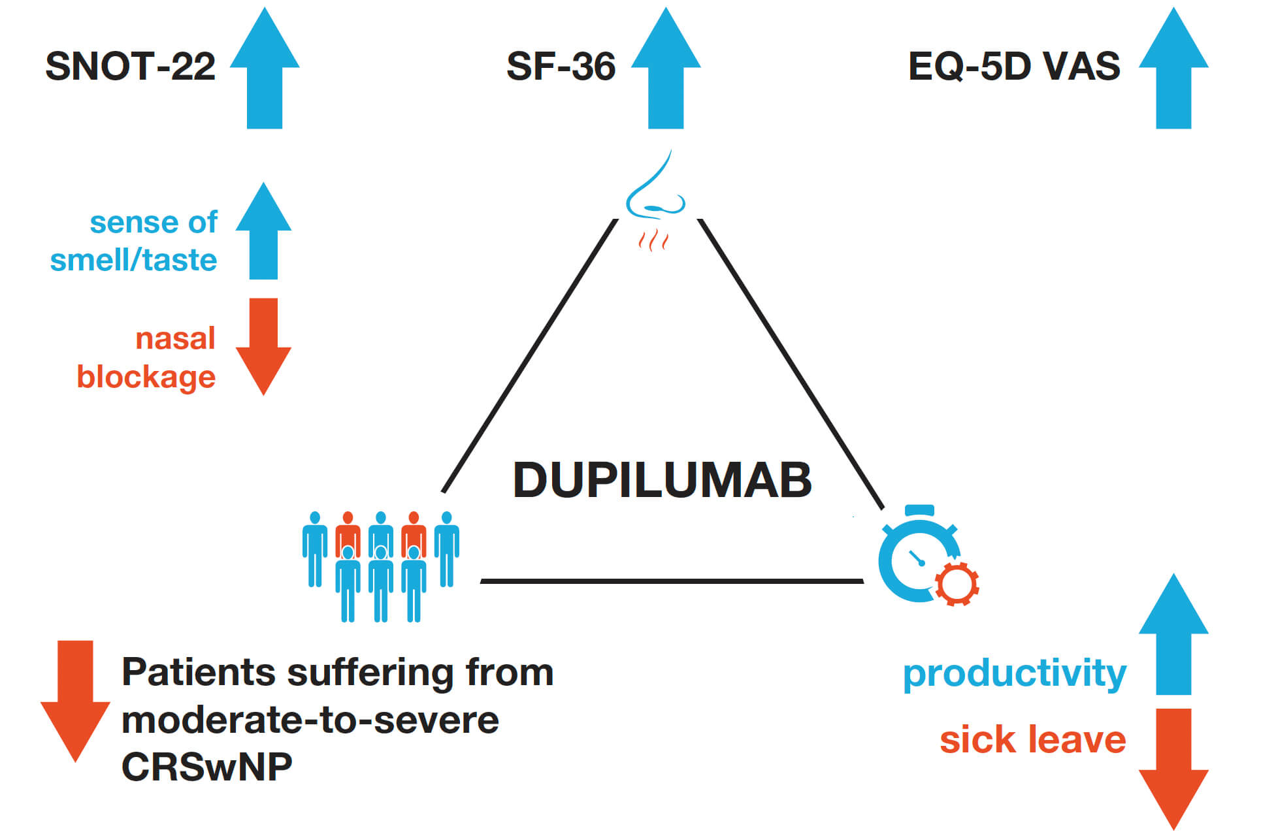
Dupilumab improves health‐related quality of life in patients with chronic rhinosinusitis with nasal polyposis
Claus Bachert, Peter W. Hellings, Joaquim Mullol, Daniel L. Hamilos, Philippe Gevaert, et al.
Allergy. 2020; 148-157 https://doi.org/10.1111/all.13984
© 2019 EAACI and John Wiley and Sons A/S. Published by John Wiley and Sons Ltd.
Notes:
HIGHLIGHTS
• Dupilumab improves HRQoL, with significantly greater improvement in SNOT-22, SF-36, and EQ-5D VAS, and with the greatest improvement vs placebo in the SNOT-22 items ‘sense of smell/
taste’ and ‘nasal blockage’.
• Dupilumab reduces CRSwNP disease severity VAS, decreasing the proportion of patients with moderate-to-severe CRSwNP.
• Dupilumab improves productivity, with significantly lower annualized mean sick leave days vs placebo.
ABBREVIATIONS
CRSwNP, Chronic rhinosinusitis with nasal polyposis; EQ-5D, 5-dimension EuroQoL questionnaire; HRQoL, Health-related quality of life; SF-36, 36-item short-form health survey; SNOT-22,
22-item sino-nasal outcome test; VAS, Visual analog scale

