Slide 1
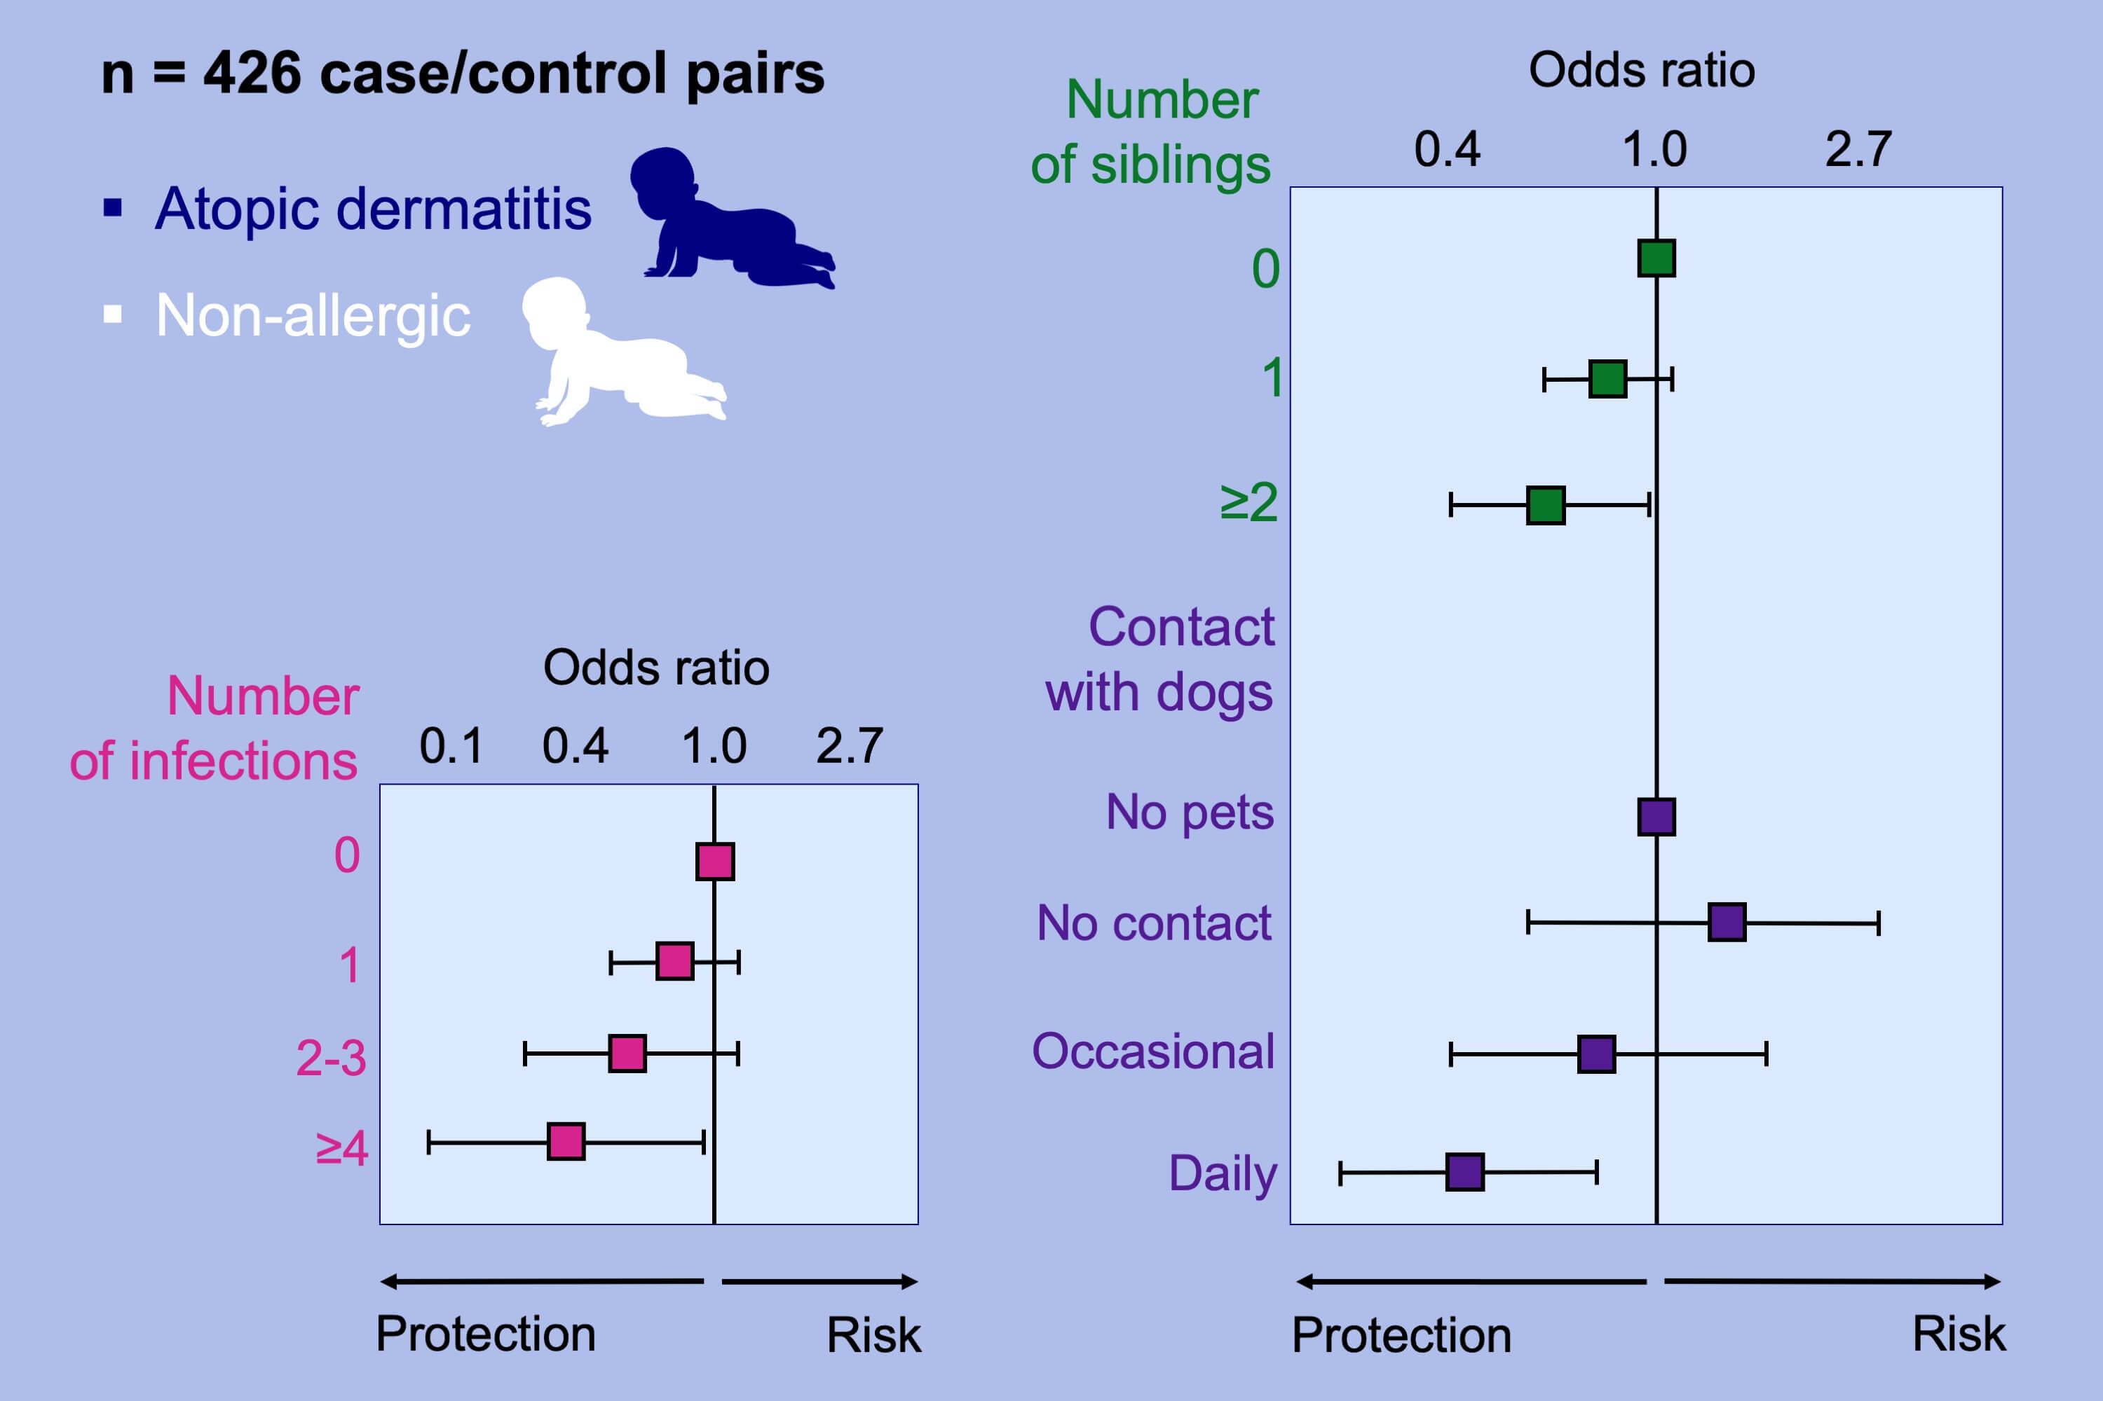
Markers of microbial exposure lower the incidence of atopic dermatitis
Liliane Chatenoud, Paola Bertuccio, Federica Turati, Carlotta Galeone, Luigi Naldi, et al.
Allergy. 2020; 104-115 https://doi.org/10.1111/all.13990
© 2019 EAACI and John Wiley and Sons A/S. Published by John Wiley and Sons Ltd.
Notes:
HIGHLIGHTS
• The results of this large case-control study supported the hygiene hypothesis in atopic dermatitis (AD).
• The high number of infectious events had a protective effect against AD occurrence.
• Increasing number of siblings and daily contact with dogs were inversely associated with AD risk.

