Slide 1
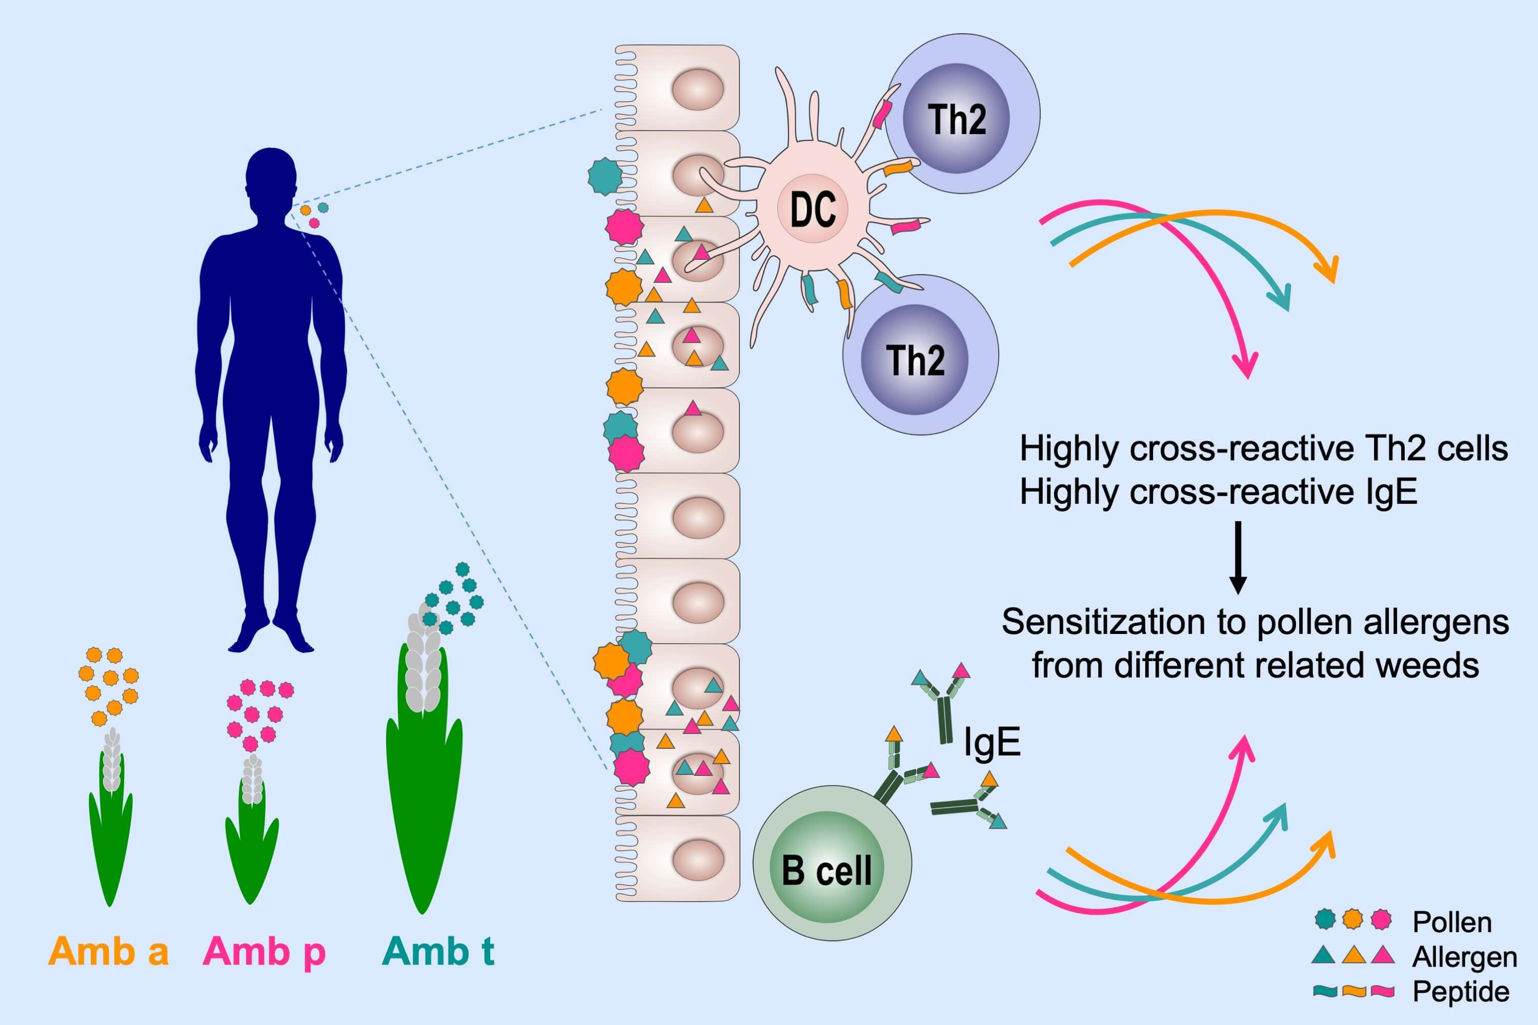
Diverse and highly cross‐reactive T‐cell responses in ragweed allergic patients independent of geographical region
Peter A. Würtzen, Ilka Hoof, Lars H. Christensen, Zuzana Váczy, Helene Henmar, et al.
Allergy. 2020; 137-147 https://doi.org/10.1111/all.13992
© 2019 EAACI and John Wiley and Sons A/S. Published by John Wiley and Sons Ltd.
Notes:
HIGHLIGHTS
• T-cell epitopes of multiple major and minor ragweed allergens/ isoallergens are involved in the diverse T-cell responses in ragweed allergic individuals.
• The T-cells cross-react to epitopes of related ragweed species and the same epitopes are important for American and European individuals.
• Extensive T-cell and IgE cross-reactivity support that related ragweed species can be considered an Amb a allergen homology group regarding diagnosis and immunotherapy treatment.

