Slide 1
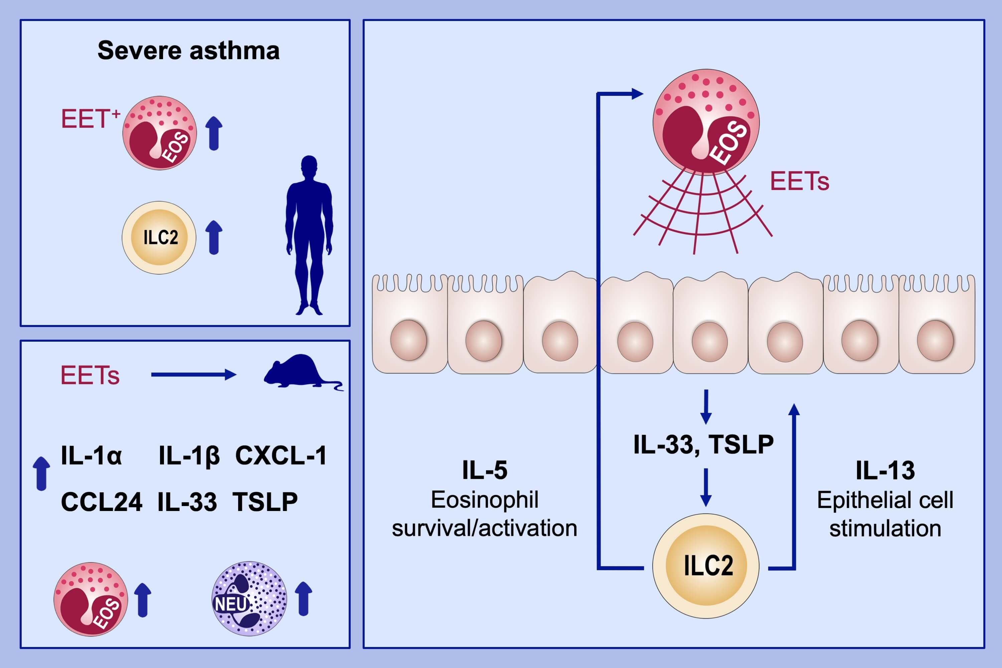
Eosinophil extracellular traps activate type 2 innate lymphoid cells through stimulating airway epithelium in severe asthma
Youngwoo Choi, Young‐Min Kim, Hee‐Ra Lee, Jiyeong Mun, Soyoon Sim, et al.
Allergy. 2020; 95-103 https://doi.org/10.1111/all.13997
© 2019 EAACI and John Wiley and Sons A/S. Published by John Wiley and Sons Ltd.
Notes:
HIGHLIGHTS
• The numbers of EET+ eosinophils and type 2 innate lymphoid cells (ILC2s) are significantly elevated in severe asthma.
• EETs treatment in mice induces significant increase of epithelium-derived cytokines (IL-1α, IL-1β, CXCL-1, CCL24, IL-33, and TSLP) and eosinophil/neutrophil count in bronchoalveolar lavage fluid.
• EETs activate IL-5 or IL-13-producing ILC2s through stimulating airway epithelium.
ABBREVIATIONS
EETs, Eosinophil extracellular traps; TSLP, Thymic stromal lymphopoietin

