Slide 1
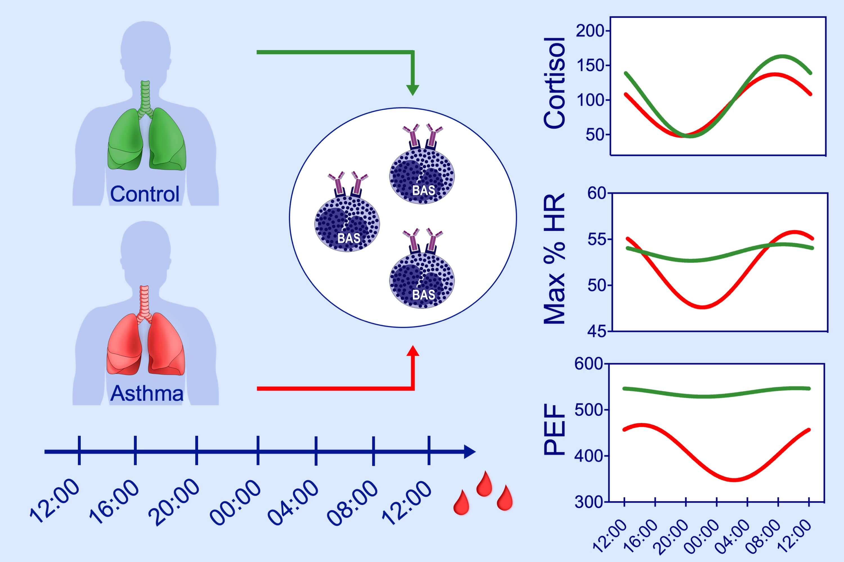
Basophil degranulation in response to IgE ligation is controlled by a distinctive circadian clock in asthma
Giuseppe Spadaro, Giorgio Giurato, Cristiana Stellato, Gianni Marone, Vincenzo Casolaro, et al.
Allergy. 2020; 158-168 https://doi.org/10.1111/all.14002
© 2019 EAACI and John Wiley and Sons A/S. Published by John Wiley and Sons Ltd.
Notes:
HIGHLIGHTS
• Basophils were collected serially for 24 hours from asthmatics or controls and activated with IgE- or non-IgE-mediated secretagogues.
• Histamine release induced by anti-IgE exhibited significant circadian rhythmicity in asthma but not controls, in parallel with asynchronous changes in cortisol and PEF levels.
• Circadian variability of IgE-dependent basophil responsiveness may contribute to diurnal variability in respiratory function and symptoms in asthma.
ABBREVIATIONS
Max % HR, Maximal percent histamine release; PEF, Peak expiratory flow

